Slide 1
Project: STARS (Successfully Teaching AstRonomy in Schools)
This project has been funded with the support of the Erasmus+ Programme, K2 Action, Strategic Partnerships in School Education.
Project Agreement Number: 2017-1-SK01-KA201-035344
Training programme for teachers (O2)
Module #2
Motion of Celestial Bodies. Conic Sections.
The current publication reflects only the author´s view and neither the Slovak National Agency, nor the European Commission are responsible for any use that may be made of the information it contains.

Slide 2
STARS project intro
1. STARS Methodological Handbook for Teachers
ready-to-use resource for teachers
2. STARS Training Program for Teachers
innovative and comprehensive approach
3. STARS Online Platform with examples of good practice and opportunities for discussions and exchange
4. STARS Concept for Astronomy Education Program
International Online Conference 2020
project-stars.com
The current publication reflects only the author´s view and neither the Slovak National Agency, nor the European Commission are responsible for any use that may be made of the information it contains.

Slide 3
STARS modules
#1 Constellations. #6 Galactic Neighbourhood.
#2 Motion of Celestial Bodies. #7 Sun and the Stars.
#3 Newton‘s Law of Gravitation. #8 Milky Way Galaxy and other galaxies.
#4 Space Exploration. #9 The Universe.
#5 Solar System. #10 Observatories.
The current publication reflects only the author´s view and neither the Slovak National Agency, nor the European Commission are responsible for any use that may be made of the information it contains.

Slide 4
Structure of the modules
There are several topics in each module.
Each topic contains:
A brief introduction and key words;
Theoretical part for the teacher - provides the basic information, necessary for the planning a lesson on that topic (and links to additional information in some cases).
! THESE ARE NOT READY-TO-USE LESSONS!
Practical exercises and activities for the students -ready for use in the classroom (in most cases) and with answers provided where applicable.
The current publication reflects only the author´s view and neither the Slovak National Agency, nor the European Commission are responsible for any use that may be made of the information it contains.

Slide 5
How to work with the materials 1
Carefully read the theoretical part for the teacher.
Should questions arise, look for answers in the supplementary materials , on the project’s website (http://project-stars.com), or other internet sites.
Attention! Make sure the information is reliable!
Prepare the theoretical part of your lesson.
The current publication reflects only the author´s view and neither the Slovak National Agency, nor the European Commission are responsible for any use that may be made of the information it contains.

Slide 6
How to work with the materials 2
Read carefully the practical exercises and their answers.
Should questions arise, look for answers in the supplementary materials , on the project’s website (http://project-stars.com), or other internet sites.
Attention! Make sure the information is reliable!
Depending on the theoretical content of your lesson, choose appropriate pracical activities to use. You can look for additional exercises in the supplementary materials or at the webpage of the project (http://project-stars.com/?lang=bg), or other internet sites.
Attention! Make sure the information is reliable!
The current publication reflects only the author´s view and neither the Slovak National Agency, nor the European Commission are responsible for any use that may be made of the information it contains.

Slide 7
How to work with the materials 3
7. Keep in mind that some of the activities require materials that should be available during the lesson.
8. We reccomend you try out the activities yourself before presenting them in the classroom. Based on yours students ages and abilities, you might need to modify the activities (either to make them easier or more difficult). However make sure to keep them correct in terms of physics.
You can give parts of, or whole exercises as homework.
The current publication reflects only the author´s view and neither the Slovak National Agency, nor the European Commission are responsible for any use that may be made of the information it contains.

Slide 8
Module 2 - content
1. Motion of celestial bodies.
Apparent and true, daily and annual rotation of the starry sky, the Sun, the Moon and the planets.
2. Conic sections. Orbits of celestial bodies. Orbital elements.
Conic sections: types, parameters.
Orbiits of the cellestial bodies: application of conic sections in astronomy; orbits of the Solar system bodies; basic elements of the orbits.
The current publication reflects only the author´s view and neither the Slovak National Agency, nor the European Commission are responsible for any use that may be made of the information it contains.

Slide 9
Theoretical content
2.1 Apparent and true motion of celestial bodies
- Circumpolar constellations, seasonal constellations;
- Apparent daily and annual movement of the starry sky;
- Apparent daily and annual movement of the Sun;
- Apparent annual movement of the planets;
- Movement of the Moon in the sky.
The topic is not easy for middle school students and understanding these movements requires abstract thinking and observational experience. Planetarium computer programs are very useful and should be used to the maximum.
The current publication reflects only the author´s view and neither the Slovak National Agency, nor the European Commission are responsible for any use that may be made of the information it contains.

Slide 10
Theoretical content
2.3 Conic sections:
The students have to be able to name all types of conic sections and differentiate between them.
The students must comprehend the terms (semi-)major axis, (semi-)minor axis, eccentricity and how these change for the different conic sections.
* For a more clear illustration, activities 1 and 2 (Make a cone and cut your own conic sections; Draw the conic sections using pins and thread. ) can be used. Alternatively, you can show a video with similar content during the lesson’s theoretical part.
Orbits and orbital elements:
The students must be able to comprehend what is an orbits, what its basic elements are; what is the ecliptic.
The current publication reflects only the author´s view and neither the Slovak National Agency, nor the European Commission are responsible for any use that may be made of the information it contains.

Slide 11
List of Practical activities
2.1.1. WORK WITH A MOVING STAR MAP OR PLANETARIUM TYPE COMPUTER PROGRAM
2.1.2. SEASONS
2.1.3. APPARENT MOTION OF THE SKY
The current publication reflects only the author´s view and neither the Slovak National Agency, nor the European Commission are responsible for any use that may be made of the information it contains.

Slide 12
List of Practical activities
2.3.1. Make a cone and cut your own conic sections.
2.3.2. Draw the conic sections using pins and thread.
2.3.3. Orbits. Orbital elements.
The current publication reflects only the author´s view and neither the Slovak National Agency, nor the European Commission are responsible for any use that may be made of the information it contains.

Slide 13
Practical activity: 2.1.1. WORK WITH A MOVING STAR MAP OR PLANETARIUM TYPE COMPUTER PROGRAM
Methodical part: Motion of celestial bodies, practical exercise1.
Materials and tools: A mving star map or computer with installed computer program type Planetarium.
Procedure: Students must follow the sunrise and sunset of the various constellations and determine the so-called "Non-setting" constellations - constellations that never set below the horizon for a given latitude.
The current publication reflects only the author´s view and neither the Slovak National Agency, nor the European Commission are responsible for any use that may be made of the information it contains.

Slide 14
Answer:
For the latitude of Bulgaria the “non-setting” constellations are:
Ursa Major
Ursa Minor
Draco
Cepheus
Cassiopeia
Camelopardalis
Lynx
The current publication reflects only the author´s view and neither the Slovak National Agency, nor the European Commission are responsible for any use that may be made of the information it contains.

Slide 15
Practical activity: 2.1.2. SEASONS
Methodical part: file APPENDIX 1 of topic 1, module 2
Materials and tools: A blank table printed on a sheet of paper about the characteristics of the seasons
Procedure: Students should look for information or fill in the table based on their own experience.
The current publication reflects only the author´s view and neither the Slovak National Agency, nor the European Commission are responsible for any use that may be made of the information it contains.

Slide 16
 | SEASONS
№ | In the North Hemisphere |  |  |  |  |  |  | Constellation the Sun is in
 | Data | Position | Season start | Day / Night | Sunrise | Sunset | Altitude of the Sun
1 | 20 March
2 | 21 June
3 | 23 September
4 | 22 December
The current publication reflects only the author´s view and neither the Slovak National Agency, nor the European Commission are responsible for any use that may be made of the information it contains.

Slide 17
Answer:
The current publication reflects only the author´s view and neither the Slovak National Agency, nor the European Commission are responsible for any use that may be made of the information it contains.

Slide 18
Practical activity: 2.1.3. APPARENT MOTION OF THE SKY
Methodical part: file APPENDIX 2а,2b и 2c, topic 1, module 2
Materials and tools: Printed on a sheet or shown in electronic version 3 images of the starry sky at 3 different moments for the same evening for an observer in the northern hemisphere.
Procedure: Students must arrange the three images in the correct order.
The current publication reflects only the author´s view and neither the Slovak National Agency, nor the European Commission are responsible for any use that may be made of the information it contains.

Slide 19
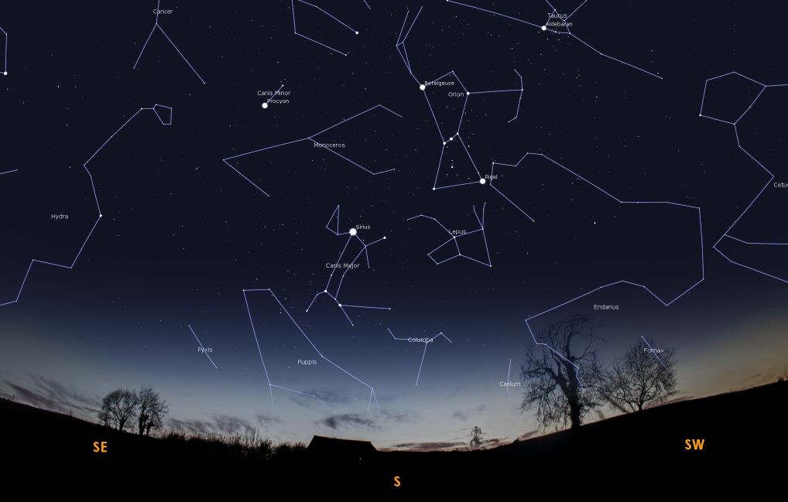
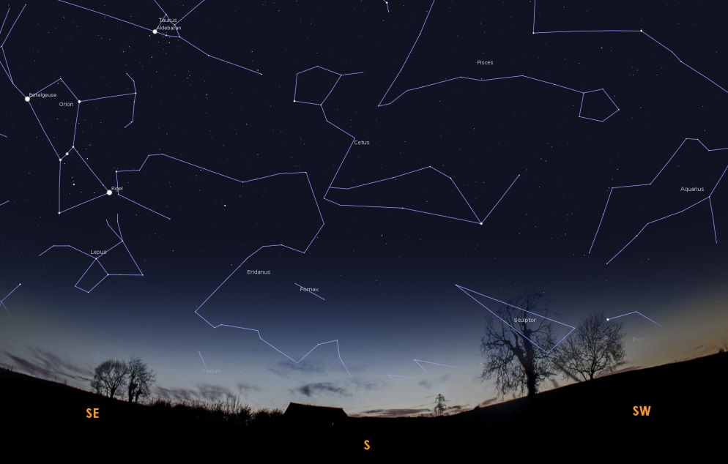
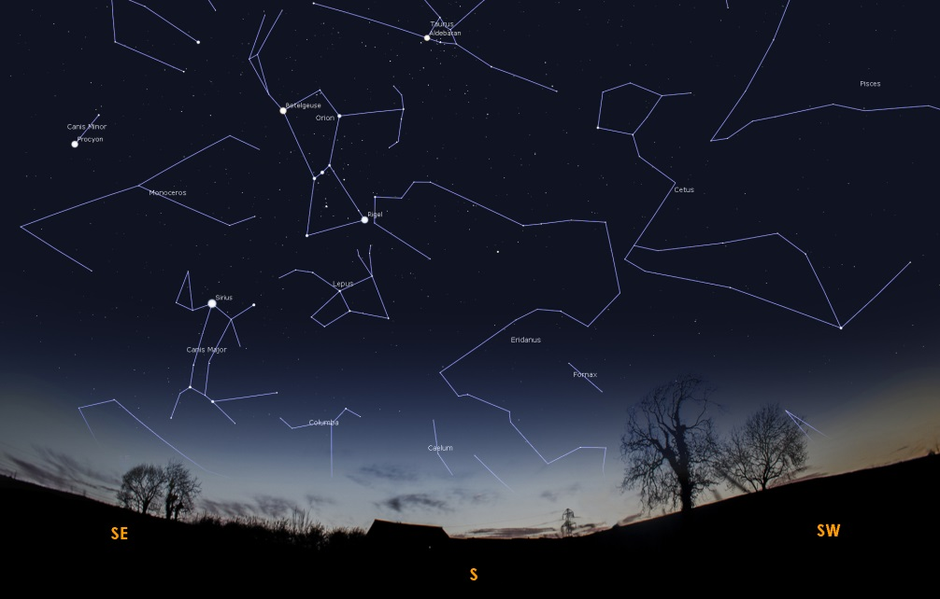
2a
2b
2c
The current publication reflects only the author´s view and neither the Slovak National Agency, nor the European Commission are responsible for any use that may be made of the information it contains.

Slide 20
Answer:
2b
2c
2a
The current publication reflects only the author´s view and neither the Slovak National Agency, nor the European Commission are responsible for any use that may be made of the information it contains.

Slide 21
Ecercise 2.3.1: Make a cone and cut your own conic sections. Suitable for younger students.
Methodical part: module 2, topic “Conic sections”.
AIM: To illustrate how the conic sections are produced. This activity can be done individually or in pairs.
Materials and Procedure: described in detail in module 2, topic “Conic sections”, practical section.
The current publication reflects only the author´s view and neither the Slovak National Agency, nor the European Commission are responsible for any use that may be made of the information it contains.

Slide 22
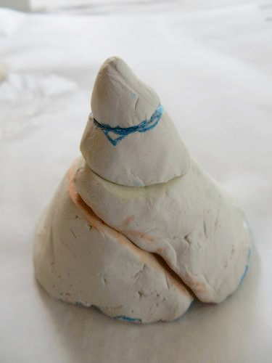
Ecercise 2.3.1: Make a cone and cut your own conic sections.
Example result:
The current publication reflects only the author´s view and neither the Slovak National Agency, nor the European Commission are responsible for any use that may be made of the information it contains.

Slide 23
Ecercise 2.3.2:Draw the conic sections using pins and thread.
Methodical part: module 2, topic “Conic sections”.
AIM: To illustrate how the conic sections are produced. This activity can be done individually for the drawing of the circle and ellipse, but for the parabola work in pairs is recommended.
Materials and Procedure: described in detail in module 2, topic “Conic sections”, practical section.
The current publication reflects only the author´s view and neither the Slovak National Agency, nor the European Commission are responsible for any use that may be made of the information it contains.

Slide 24
Ecercise 2.3.2:Draw the conic sections using pins and thread.
Example results:
circle (left) and
an ellipse (right).
The current publication reflects only the author´s view and neither the Slovak National Agency, nor the European Commission are responsible for any use that may be made of the information it contains.

Slide 25
Ecercise 2.3.3 : Orbits. Orbital elements.
Methodical part: module 2, topic “Conic sections”.
AIM: To clarify and illustrate the meaning of orbits and their basic parameters and demonstrate how the orbits change depending on their parameters.
Materials and Procedure: described in detail in module 2,
topic “Conic sections”, practical section.
The current publication reflects only the author´s view and neither the Slovak National Agency, nor the European Commission are responsible for any use that may be made of the information it contains.

Slide 26
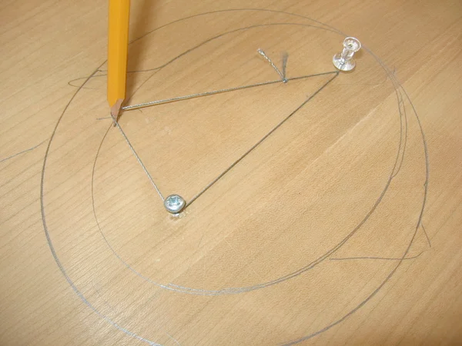
Exercise 2.3.3: Orbits. Orbital elements.
Example result for the first part of the activity.
The current publication reflects only the author´s view and neither the Slovak National Agency, nor the European Commission are responsible for any use that may be made of the information it contains.

Slide 27
Exercise 2.3.3: Orbits. Orbital elements.
The Inclination of Pluto’s orbit is marked on the figure. Explanation:
Assuming all other orbits lie in the eclitic, then the inclination will be the angle between any planet’s orbit and that of Pluto.
i
http://WWW.RFCAFE.COM/REFERENCES/GENERAL/SOLAR-SYSTEM.HTM
The current publication reflects only the author´s view and neither the Slovak National Agency, nor the European Commission are responsible for any use that may be made of the information it contains.

Slide 28
Exercise 2.3.3: Orbits. Orbital elements.
Summary questions:
Q: Which orbital element determines how far away a planet is from the Sun? How?
A: The semi-major axis (a). The larger a is, the more distant the planet is.
Q: Which orbital parameter determins how elongated they are? How?
A: Eccentricity. The larger it is, the more elongated the orbit is.
Q: What is the inclination of Earth’s orbit?
A: Zero.
The current publication reflects only the author´s view and neither the Slovak National Agency, nor the European Commission are responsible for any use that may be made of the information it contains.

Slide 29
Conclusions, results check 1
Feed Forward: Base your olans for the next lessons on the results of the students:
Difficulty of the lessons: depending on student comprehension of the material and level of completion of the activities.
Preparation: Clear and well appointed goals of the lesson and activities. When the goal is well understood, the attention towards a task/material is easier and more effective.
Approach toward the material: What would be the correct approach that would help the student comprehension and activity completion.
The current publication reflects only the author´s view and neither the Slovak National Agency, nor the European Commission are responsible for any use that may be made of the information it contains.
Notes:
DOI: 10.3102/003465430298487, The Power of Feedback, John Hattie and Helen Timperley, University of Auckland

Slide 30
Conclusions, results check 2
Selfevaluation: selfdiscipline, steering and control of the activities.
Individual approach: Individual approach and guidance.
Check: How did I do? Individual evaluation of the student’s work, pertaining to the specific activity and goal. Must contain information about the advance (or lack of) the student has made and to guide them to achieve the goals and standards.
The current publication reflects only the author´s view and neither the Slovak National Agency, nor the European Commission are responsible for any use that may be made of the information it contains.
Notes:
DOI: 10.3102/003465430298487, The Power of Feedback, John Hattie and Helen Timperley, University of Auckland

