Slide 1


Project: STARS (Successfully Teaching AstRonomy in Schools)
This project has been funded with the support of the Erasmus+ Programme, K2 Action, Strategic Partnerships in School Education.
Project Agreement Number: 2017-1-SK01-KA201-035344
Training programme for teachers (O2)
Module #3
Newton's law of Gravitation
Newton's law of Gravitation, weightlessness
The current publication reflects only the author´s view and neither the Slovak National Agency, nor the European Commission are responsible for any use that may be made of the information it contains.

Slide 2
Project STARS introduction
1. STARS Methodological Handbook for Teachers
ready-to-use resource for teachers
2. STARS Training Program
for Teachers
innovative and comprehensive approach
3. STARS Online Platform
with examples of good practice and opportunities for discussions and exchange
4. STARS Concept for Astronomy Education Program
International Online Conference 2020
project-stars.com
The current publication reflects only the author´s view and neither the Slovak National Agency, nor the European Commission are responsible for any use that may be made of the information it contains.

Slide 3
Project STARS modules
#1 Constellations. #6 Galactic Neighbourhood.
#2 Motion of Celestial Bodies. #7 Sun and Stars.
#3 Newton's law of Gravitation. #8 Our Galaxy and other galaxies.
#4 Discovery of the Universe. #9 The Universe.
#5 Solar System. #10 Observatories.
The current publication reflects only the author´s view and neither the Slovak National Agency, nor the European Commission are responsible for any use that may be made of the information it contains.

Slide 4
Structure of the modules
There are several topics in each module.
Each topic contains:
A brief introduction and key words;
Theoretical part for the teacher - provides the basic information, necessary for the planning
a lesson on that topic (and links to additional information in some cases).
Practical exercises and activities for the students - ready for use in the classroom (in most cases) and with answers provided where applicable.
The current publication reflects only the author´s view and neither the Slovak National Agency, nor the European Commission are responsible for any use that may be made of the information it contains.

Slide 5
How to work with the materials 1
Carefully read the theoretical part for the teacher.
Should questions arise, look for answers in the supplementary materials , on the project’s website (project-stars.com), or other internet sites.
Attention! Make sure the information is reliable!
Prepare the theoretical part of your lesson.
The current publication reflects only the author´s view and neither the Slovak National Agency, nor the European Commission are responsible for any use that may be made of the information it contains.

Slide 6
How to work with the materials 2
Read carefully the practical exercises and their answers.
Should questions arise, look for answers in the supplementary materials , on the project’s website (project-stars.com), or other internet sites.
Attention! Make sure the information is reliable!
Depending on the theoretical content of your lesson, choose appropriate practical activities to use. You can look for additional exercises in the supplementary materials or at the webpage of the project (project-stars.com), or other internet sites.
Attention! Make sure the information is reliable!
The current publication reflects only the author´s view and neither the Slovak National Agency, nor the European Commission are responsible for any use that may be made of the information it contains.

Slide 7
How to work with the materials 3
Keep in mind that some of the activities require materials that should be available during the lesson.
We recommend you try out the activities yourself before presenting them in the classroom. Based on yours students ages and abilities, you might need to modify the activities (either to make them easier or more difficult). However make sure to keep them correct in terms of physics.
You can give parts of, or whole exercises as homework.
The current publication reflects only the author´s view and neither the Slovak National Agency, nor the European Commission are responsible for any use that may be made of the information it contains.

Slide 8
Моdule 3 – contents
3.1 Newton's law of Gravitation
  Law of Gravitation.
3.2 Weightlessness
  Free fall, weightlessness simulation.
The current publication reflects only the author´s view and neither the Slovak National Agency, nor the European Commission are responsible for any use that may be made of the information it contains.

Slide 9
Theoretical contents
3.1 Newton law of Gravitation
  Newton law of Gravitation.
The current publication reflects only the author´s view and neither the Slovak National Agency, nor the European Commission are responsible for any use that may be made of the information it contains.

Slide 10
Theoretical contents
3.2 Weightlessness
  Gravitational force, gravity;
  free fall and throw of bodies;
  motion in orbit and space;
  weightlessness simulation;
  state of weightlessness and impact on life;
  physical processes in the state of weightlessness;
  use of weightlessness.
The current publication reflects only the author´s view and neither the Slovak National Agency, nor the European Commission are responsible for any use that may be made of the information it contains.

Slide 11
List of Practical activities
3.1.1 The Moon in the distance…how far?!
3.2.1 Gravitational field around the Earth
3.2.2 Demonstration of a state of weightlessness in free fall
3.2.3 Behaviour of a fluid in a weightlessness
The current publication reflects only the author´s view and neither the Slovak National Agency, nor the European Commission are responsible for any use that may be made of the information it contains.

Slide 12
Practical activity: 3.1.1 Task II: The Moon in a distance…how far?!
Methodical part: Estimate distance between Moon and Earth. Terms not usually used in primary school (gravitational acceleration). Application of Newton‘s law of Gravitation and 3rd Kepler‘s law. Transfer of unit.
Material and tools: Calculator
Procedure: Pupil calculate distance between Moon and Earth based on knowledge of gravitational acceleration and orbital period of Moon.
The current publication reflects only the author´s view and neither the Slovak National Agency, nor the European Commission are responsible for any use that may be made of the information it contains.

Slide 13
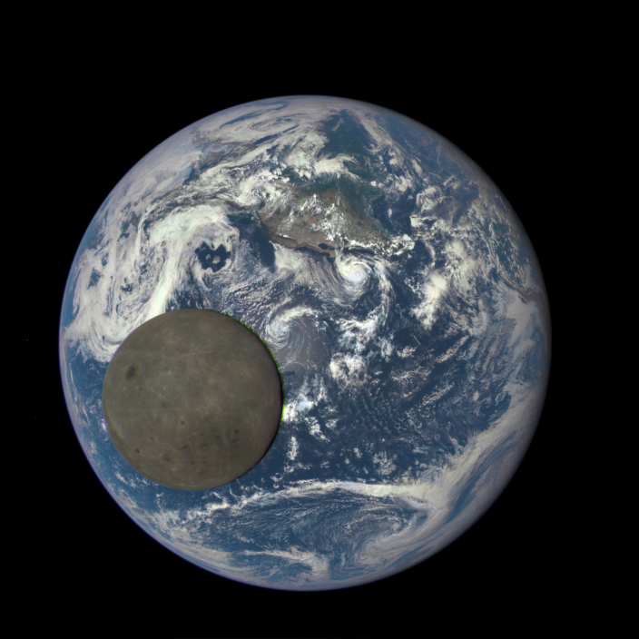
Practical activity: 3.1.1 Task II: The Moon in a distance…how far?!
g = 9.81 m ∙ s^{–2}
Newton‘s law of Gravitation
R = 6 378 km
T = 27.3 days
2nd law of motion
3rd Kepler‘s law
The current publication reflects only the author´s view and neither the Slovak National Agency, nor the European Commission are responsible for any use that may be made of the information it contains.

Slide 14
Practical activity: 3.2.1 Gravitational field around the Earth
Methodical part: Gravitational force of Earth acts to infinite distance. It is not necessary for the gravitational force to be zero for the existence of a state of weightlessness, e.g. gravitational force is only 12% less than on Earth surface.
Material and tool: Calculator, spreadsheet
Procedure: Pupils will understand that the force of gravity acts to infinite distance. They realize that it is not necessary for the gravitational force to be zero for the existence of a state of weightlessness. They can imagine the geometry of a low orbit.
The current publication reflects only the author´s view and neither the Slovak National Agency, nor the European Commission are responsible for any use that may be made of the information it contains.

Slide 15
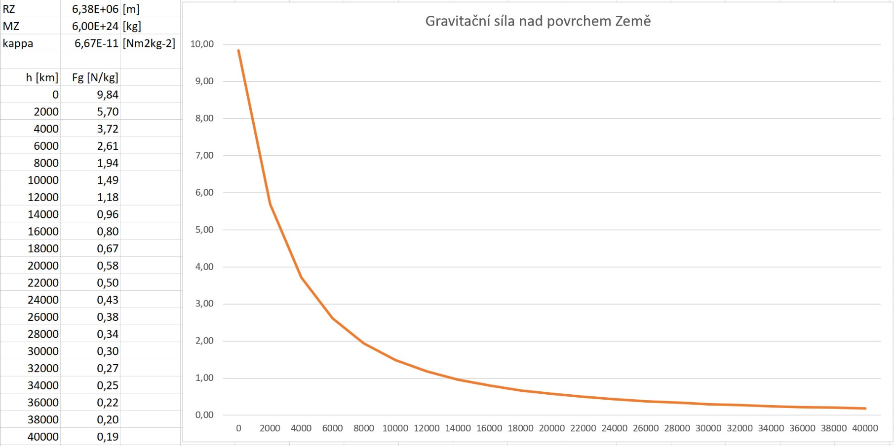
Practical activity: 3.2.1 Gravitational field around the Earth
Gravitational force of 9.84 N acts on the Earth's surface with a mass of 1 kg.
At a height of 400 km (ISS), a gravitational force of 8.71 N acts on the object weighing 1 kg.
At a height of 35,800 km (GEO), a gravitational force of 0.199 N acts on the object weighing 1 kg.
At a distance of 380,000 km (Moon), a gravitational force of 0.0027 N acts on the object weighing 1 kg.
the gravitational force is compensated by another force in the state of weightlessness - when orbiting the Earth it is a centrifugal force
gravitational force acting on a body weighing 1 kg on the Earth's surface
constant g = 10 N/kg
The current publication reflects only the author´s view and neither the Slovak National Agency, nor the European Commission are responsible for any use that may be made of the information it contains.

Slide 16
Practical activity: 3.2.2 Demonstration of weightlessness in free fall
Methodical part: The state of weightlessness can exist on the surface of the Earth, it is not limited to outer space. It is limited to a few seconds on Earth.
Material and tool: PET water bottle, a box of juice with water utility - a dynamometer in a transparent box
Procedure: Pupils realize that a state of weightlessness can also arise on the Earth's surface. They will understand that a state of weightlessness can be achieved on the surface of the Earth in a free fall. However, it is limited to short periods of time.
The current publication reflects only the author´s view and neither the Slovak National Agency, nor the European Commission are responsible for any use that may be made of the information it contains.

Slide 17
Practical activity: 3.2.2 Demonstration of weightlessness in free fall
Plastic PET bottle filled with water
A special tool - a dynamometer with a weight suspended in a transparent box or frame
A general problem is that free fall on the Earth's surface can only be achieved for a very short time, during which the experiment can also be observed. It is appropriate to capture the implementation of the experiment with a camera with a short exposure time.
Another problem is that the falling object must be stopped at the end of the experiment, if possible in such a way that it does not break. From this point of view, a falling PET bottle or juice box is more accessible. However, performing an experiment with a dynamometer showing zero deflection is again more convincing.
a state of weightlessness would arise in a falling torn elevator
The current publication reflects only the author´s view and neither the Slovak National Agency, nor the European Commission are responsible for any use that may be made of the information it contains.

Slide 18
Practical activity: 3.2.3 Behaviour of liquid in weightlessness
Methodical part: The state of weightlessness can also exist on the surface of the Earth, it is not limited to outer space. It is limited to a few seconds on Earth.
Material and tool: Camera with manual focus modes and shutter speed pre-sets.
Procedure: Pupils will see that the liquid body assumes a spherical shape in a state of weightlessness. They will understand that a state of weightlessness can be achieved on the surface of the Earth in a free fall.
The current publication reflects only the author´s view and neither the Slovak National Agency, nor the European Commission are responsible for any use that may be made of the information it contains.

Slide 19
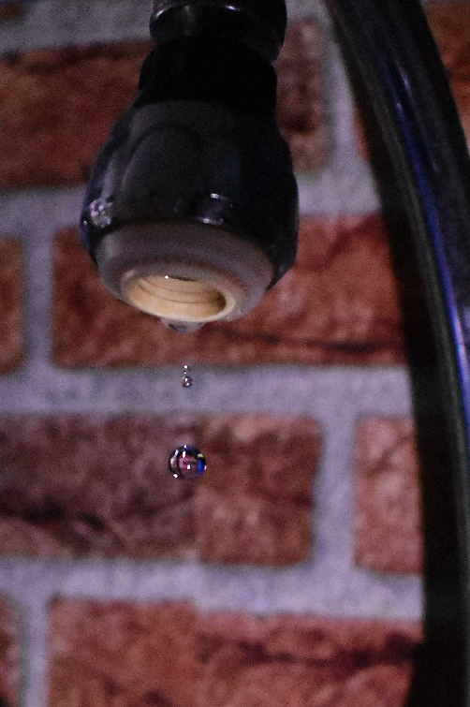
Practical activity: 3.2.3 Behaviour of liquid in weightlessness
In the state of weightlessness, the total force acting on the liquid object is zero, so that the liquid object floats in space. In such a situation, such surface tension forces will also be more significant, which are small in a normal situation and can often be neglected. The floating liquid object assumes a shape with the smallest possible surface area by the action of surface tension forces, which is, without contact with other objects, a spherical shape.
On the surface of the Earth, it is possible to observe a state of weightlessness in free fall. The behaviour of the liquid in the state of weightlessness can be observed on dripping and falling drops of water. The shape of the water drops is spherical, corresponding to the description above. Drops should be captured with a camera with a short exposure time (1/1000 s) in good light against a contrasting background.
The current publication reflects only the author´s view and neither the Slovak National Agency, nor the European Commission are responsible for any use that may be made of the information it contains.

Slide 20
Conclusions, results check 1
Feed Forward: Base your plans for the next lessons on the results of the pupils:
Difficulty of the lessons: depending on pupils comprehension of the material and level of completion of the activities.
Preparation: Clear and well appointed goals of the lesson and activities. When the goal is well understood, the attention towards a task/material is easier and more effective.
Approach toward the material: What would be the correct approach that would help the student comprehension and activity completion.
The current publication reflects only the author´s view and neither the Slovak National Agency, nor the European Commission are responsible for any use that may be made of the information it contains.
Notes:
DOI: 10.3102/003465430298487, The Power of Feedback, John Hattie and Helen Timperley, University of Auckland

Slide 21
Conclusions, results check 2
Self-evaluation: self-discipline, steering and control of the activities.
Individual approach: Individual approach and guidance.
Check: How did I do? Individual evaluation of the pupil’s work, pertaining to the specific activity and goal. Must contain information about the advance (or lack of) the pupil has made and to guide them to achieve the goals and standards.
The current publication reflects only the author´s view and neither the Slovak National Agency, nor the European Commission are responsible for any use that may be made of the information it contains.
Notes:
DOI: 10.3102/003465430298487, The Power of Feedback, John Hattie and Helen Timperley, University of Auckland

