Slide 1
Project: STARS (Successfully Teaching AstRonomy in Schools)
This project has been funded with the support of the Erasmus+ Programme, K2 Action, Strategic Partnerships in School Education.
Project Agreement Number: 2017-1-SK01-KA201-035344
Training programme for teachers (O2)
Module #3 Newton's Law of Gravitation. Newton's Law of Gravitation, Escape Velocity, Mass and Weight.
The current publication reflects only the author´s view and neither the Slovak National Agency, nor the European Commission are responsible for any use that may be made of the information it contains.

Slide 2
STARS project intro
1. STARS Methodological Handbook for Teachers
ready-to-use resource for teachers
2. STARS Training Program for Teachers
innovative and comprehensive approach
3. STARS Online Platform with examples of good practice and opportunities for discussions and exchange
4. STARS Concept for Astronomy Education Program
International Online Conference 2020
project-stars.com
The current publication reflects only the author´s view and neither the Slovak National Agency, nor the European Commission are responsible for any use that may be made of the information it contains.

Slide 3
STARS modules
#1 Constellations. #6 Galactic Neighbourhood.
#2 Motion of Celestial Bodies. #7 Sun and the Stars.
#3 Newton‘s Law of Gravitation. #8 Milky Way Galaxy and other galaxies.
#4 Space Exploration. #9 The Universe.
#5 Solar System. #10 Observatories.
The current publication reflects only the author´s view and neither the Slovak National Agency, nor the European Commission are responsible for any use that may be made of the information it contains.

Slide 4
Structure of the modules
There are several topics in each module.
Each topic contains:
A brief introduction and key words;
Theoretical part for the teacher - provides the basic information, necessary for the planning a lesson on that topic (and links to additional information in some cases).
! THESE ARE NOT READY-TO-USE LESSONS!
Practical exercises and activities for the students -ready for use in the classroom (in most cases) and with answers provided where applicable.
The current publication reflects only the author´s view and neither the Slovak National Agency, nor the European Commission are responsible for any use that may be made of the information it contains.

Slide 5
How to work with the materials 1
Carefully read the theoretical part for the teacher.
Should questions arise, look for answers in the supplementary materials , on the project’s website (http://project-stars.com), or other internet sites.
Attention! Make sure the information is reliable!
Prepare the theoretical part of your lesson.
The current publication reflects only the author´s view and neither the Slovak National Agency, nor the European Commission are responsible for any use that may be made of the information it contains.

Slide 6
How to work with the materials 2
Read carefully the practical exercises and their answers.
Should questions arise, look for answers in the supplementary materials , on the project’s website (http://project-stars.com), or other internet sites.
Attention! Make sure the information is reliable!
Depending on the theoretical content of your lesson, choose appropriate pracical activities to use. You can look for additional exercises in the supplementary materials or at the webpage of the project (http://project-stars.com/?lang=bg), or other internet sites.
Attention! Make sure the information is reliable!
The current publication reflects only the author´s view and neither the Slovak National Agency, nor the European Commission are responsible for any use that may be made of the information it contains.

Slide 7
How to work with the materials 3
7. Keep in mind that some of the activities require materials that should be available during the lesson.
8. We reccommend you try out the activities yourself before presenting them in the classroom. Based on your students ages and abilities, you might need to modify the activities (either to make them easier or more difficult). However make sure to keep them correct in terms of physics.
You can give parts of, or whole exercises as homework.
The current publication reflects only the author´s view and neither the Slovak National Agency, nor the European Commission are responsible for any use that may be made of the information it contains.

Slide 8
Module # 3 Contents:
Newton's law of Gravitation.
Escape velocity.
Mass and weight.
The current publication reflects only the author´s view and neither the Slovak National Agency, nor the European Commission are responsible for any use that may be made of the information it contains.

Slide 9
Theoretical part:
Newton’s law of gravitation: deffinition, generalization of Kepler’s laws by Newton’s laws.
Deffinition and explanation of escape velocity.
Mass and weight: deffinition, differences, state of weightlessness.
The current publication reflects only the author´s view and neither the Slovak National Agency, nor the European Commission are responsible for any use that may be made of the information it contains.

Slide 10
List of Practical activities:
3.1.1. Proportionality in Newton’s law of gravitation.
3.1.2 and 3.1.3 Forces of attraction.
3.1.4. Weight at different gravitational accelerations.
3.1.5 Escape velocity
3.1.6. Calculating the escape velocity for celestial bodies with different masses.
The current publication reflects only the author´s view and neither the Slovak National Agency, nor the European Commission are responsible for any use that may be made of the information it contains.

Slide 11
What to pay attention to:
Newton’s law of gravitation:
The students must understand and remember the proportionalities in the formula for universal gravitation. They must comprehend what is gravitational acceleration.
Escape velocity:
Students must comprehend what is escape velocity and how it depends on mass (gravity).
Mass and weight:
The students must be able to differentiate between mass and weight.
You should carefully explain the term “free fall”.
The students must be able to differentiate between weightlessness and “sense of weightlessness”.
The current publication reflects only the author´s view and neither the Slovak National Agency, nor the European Commission are responsible for any use that may be made of the information it contains.

Slide 12
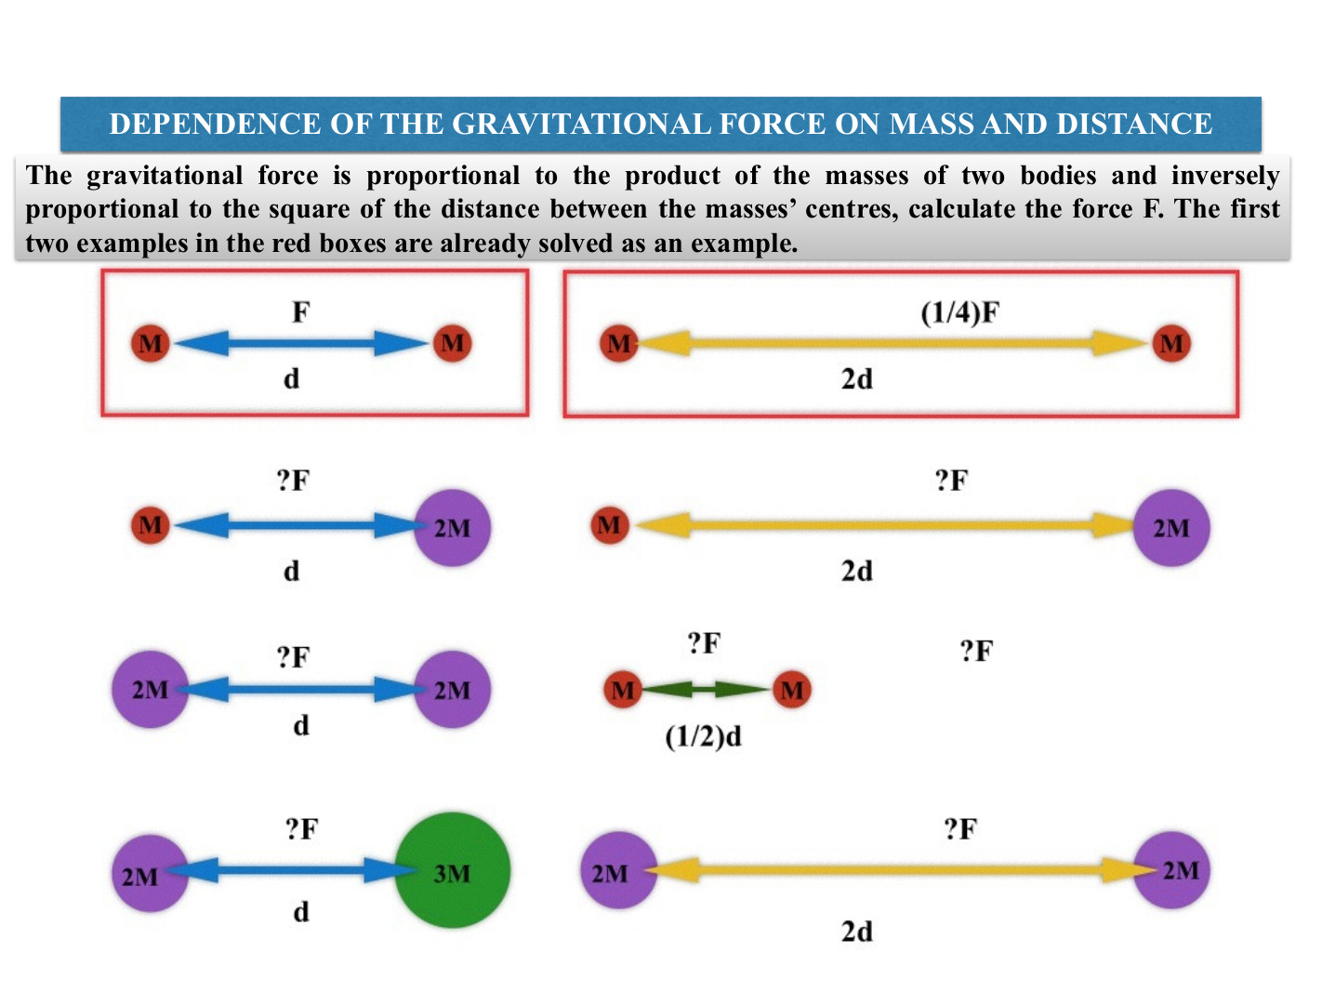
Exercise 3.1.1: Proportionality in Newton’s law of gravitation.
Procedure: The cartoon shows the dependence of the gravitational force on the masses of the bodies and the distance between them. The first two cases are already solved as an example. Solve the rest in a similar manner.
The current publication reflects only the author´s view and neither the Slovak National Agency, nor the European Commission are responsible for any use that may be made of the information it contains.

Slide 13
Exercise 3.1.2, 3.1.3: Gravitational forces.
Methodical part: module 3, topic “Newton’s law of gravitation”.
AIM: To demonstrate the change in the gravitational force with the change of the distance or masses of the bodies. To demonstrate that the gravitational acceleration (g) =(G MEarth)/(REarth)2. The activities are individual. The discussion of the results is for the whole class.
Materials and Procedure: described in detail in module 3,
topic “Newton’s law of gravitation”, practical section,
exercises 3.2 and 3.3.
The current publication reflects only the author´s view and neither the Slovak National Agency, nor the European Commission are responsible for any use that may be made of the information it contains.

Slide 14
Exercise 3.1.4: Weight at different gravitational accelerations
Methodical part: module 3, topic “Newton’s law of gravitation”
AIM: To demonstrate the difference between mass and weight. To show how a person’s weight changes (and the mass does not) depending on the gravitational acceleration of the other body (which in turn depends on its mass and radius).
Name | Mass,kg | Radius,km | Gravitational acceleration, m/s² | Weight of the person,kg
Moon | 7.342×1022 | 1 737 | 1.62
Mercury | 3.301×1023 | 2 440 | 3.7
Venus | 4.8675×1024 | 6 052 | 8.87
Mars | 6.4171×1023 | 3 390 | 3.72
Jupiter | 1.8982×1027 | 69 911 | 24.79
Saturn | 5.6834×1026 | 58 232 | 10.44
Uranus | 8.6810×1025 | 25 362 | 8.87
Neptune | 1.024 × 10²⁶ | 24 622 | 11.15
Materials and Procedure: described in detail in module 3,
topic “Newton’s law of gravitation”, practical section,
exercise 3.4
The current publication reflects only the author´s view and neither the Slovak National Agency, nor the European Commission are responsible for any use that may be made of the information it contains.

Slide 15
Exercise 3.1.5.: Escape velocity
Methodical part: module 3, topic “Newton’s law of gravitation”.
AIM: To better understand the concept of escape velocity.
Procedure: described in detail in module 3,
topic “Newton’s law of gravitation”, practical section,
exercise 3.5
The current publication reflects only the author´s view and neither the Slovak National Agency, nor the European Commission are responsible for any use that may be made of the information it contains.

Slide 16
Exercise 3.1.6: Calculating the escape velocity for celestial bodies with different masses.
Methodical part: module 3, topic “Newton’s law of gravitation”.
AIM: To better understand the scale of escape velocities for celestial bodies of different mass .
!The objects can be either chosen in advance by the teacher or this can be a first part of the task for the students!
The current publication reflects only the author´s view and neither the Slovak National Agency, nor the European Commission are responsible for any use that may be made of the information it contains.

Slide 17
Conclusions, results check 1
Feed Forward: Base your olans for the next lessons on the results of the students:
Difficulty of the lessons: depending on student comprehension of the material and level of completion of the activities.
Preparation: Clear and well appointed goals of the lesson and activities. When the goal is well understood, the attention towards a task/material is easier and more effective.
Approach toward the material: What would be the correct approach that would help the student comprehension and activity completion.
The current publication reflects only the author´s view and neither the Slovak National Agency, nor the European Commission are responsible for any use that may be made of the information it contains.
Notes:
DOI: 10.3102/003465430298487, The Power of Feedback, John Hattie and Helen Timperley, University of Auckland

Slide 18
Conclusions, results check 2
Selfevaluation: selfdiscipline, steering and control of the activities.
Individual approach: Individual approach and guidance.
Check: How did I do? Individual evaluation of the student’s work, pertaining to the specific activity and goal. Must contain information about the advance (or lack of) the student has made and to guide them to achieve the goals and standards.
The current publication reflects only the author´s view and neither the Slovak National Agency, nor the European Commission are responsible for any use that may be made of the information it contains.
Notes:
DOI: 10.3102/003465430298487, The Power of Feedback, John Hattie and Helen Timperley, University of Auckland

