Slide 1
Project: STARS (Successfully Teaching AstRonomy in Schools)
This project has been funded with the support of the Erasmus+ Programme, K2 Action, Strategic Partnerships in School Education.
Project Agreement Number: 2017-1-SK01-KA201-035344
Training programme for teachers (O2)
Module #4
Discovery of the Universe. Basic Orientation on the Sky.
The current publication reflects only the author´s view and neither the Slovak National Agency, nor the European Commission are responsible for any use that may be made of the information it contains.

Slide 2
STARS project intro
1. STARS Methodological Handbook for Teachers
ready-to-use resource for teachers
2. STARS Training Program for Teachers
innovative and comprehensive approach
3. STARS Online Platform with examples of good practice and opportunities for discussions and exchange
4. STARS Concept for Astronomy Education Program
International Online Conference 2020
project-stars.com
The current publication reflects only the author´s view and neither the Slovak National Agency, nor the European Commission are responsible for any use that may be made of the information it contains.

Slide 3
STARS modules
#1 Constellations. #6 Galactic Neighbourhood.
#2 Motion of Celestial Bodies. #7 Sun and the Stars.
#3 Newton‘s Law of Gravitation. #8 Milky Way Galaxy and other galaxies.
#4 Space Exploration. #9 The Universe.
#5 Solar System. #10 Observatories.
The current publication reflects only the author´s view and neither the Slovak National Agency, nor the European Commission are responsible for any use that may be made of the information it contains.

Slide 4
Structure of the modules
There are several topics in each module.
Each topic contains:
A brief introduction and key words;
Theoretical part for the teacher - provides the basic information, necessary for the planning a lesson on that topic (and links to additional information in some cases).
! THESE ARE NOT READY-TO-USE LESSONS!
Practical exercises and activities for the students -ready for use in the classroom (in most cases) and with answers provided where applicable.
The current publication reflects only the author´s view and neither the Slovak National Agency, nor the European Commission are responsible for any use that may be made of the information it contains.

Slide 5
How to work with the materials 1
Carefully read the theoretical part for the teacher.
Should questions arise, look for answers in the supplementary materials , on the project’s website (http://project-stars.com), or other internet sites.
Attention! Make sure the information is reliable!
Prepare the theoretical part of your lesson.
The current publication reflects only the author´s view and neither the Slovak National Agency, nor the European Commission are responsible for any use that may be made of the information it contains.

Slide 6
How to work with the materials 2
Read carefully the practical exercises and their answers.
Should questions arise, look for answers in the supplementary materials , on the project’s website (http://project-stars.com), or other internet sites.
Attention! Make sure the information is reliable!
Depending on the theoretical content of your lesson, choose appropriate pracical activities to use. You can look for additional exercises in the supplementary materials or at the webpage of the project (http://project-stars.com/?lang=bg), or other internet sites.
Attention! Make sure the information is reliable!
The current publication reflects only the author´s view and neither the Slovak National Agency, nor the European Commission are responsible for any use that may be made of the information it contains.

Slide 7
How to work with the materials 3
7. Keep in mind that some of the activities require materials that should be available during the lesson.
8. We reccomend you try out the activities yourself before presenting them in the classroom. Based on yours students ages and abilities, you might need to modify the activities (either to make them easier or more difficult). However make sure to keep them correct in terms of physics.
You can give parts of, or whole exercises as homework.
The current publication reflects only the author´s view and neither the Slovak National Agency, nor the European Commission are responsible for any use that may be made of the information it contains.

Slide 8
Module 4 - content
4.1 Basic orientation on the Sky:
Most recognizable constellations. The North star. Deep sky objects. Messier and NGC catalogs.
The current publication reflects only the author´s view and neither the Slovak National Agency, nor the European Commission are responsible for any use that may be made of the information it contains.

Slide 9
Theoretical content
4.1 Basic orientation on the Sky
- Orientation on the Sky. North star. Finding the North star;
- Discovering and recognizing constellations in the sky through landmarks;
- Star names;
- Deep sky objects. Messier and NGC catalogs.
The current publication reflects only the author´s view and neither the Slovak National Agency, nor the European Commission are responsible for any use that may be made of the information it contains.

Slide 10
List of Practical activities
WORK WITH A COMPUTER PROGRAM OR A SMARTPHONE PLANETARUM-TYPE APPLICATION
NAMES OF STARS
MESSIER OBJECTS
The current publication reflects only the author´s view and neither the Slovak National Agency, nor the European Commission are responsible for any use that may be made of the information it contains.

Slide 11
Practical activity: 1. WORK WITH A PLANETARUM-TYPE COMPUTER PROGRAM OR A SMARTPHONE APPLICATION
Methodical part: Basic orientation, activity 1
Materials and tools: Computer and program type Planetarium or smartphone and installed application
Procedure: Get acquainted with some basic functions of the program and the application. tasks 1: Get acquainted with the shape of the constellations, the names of the stars, the rotation of the celestial sphere, etc.
The current publication reflects only the author´s view and neither the Slovak National Agency, nor the European Commission are responsible for any use that may be made of the information it contains.

Slide 12
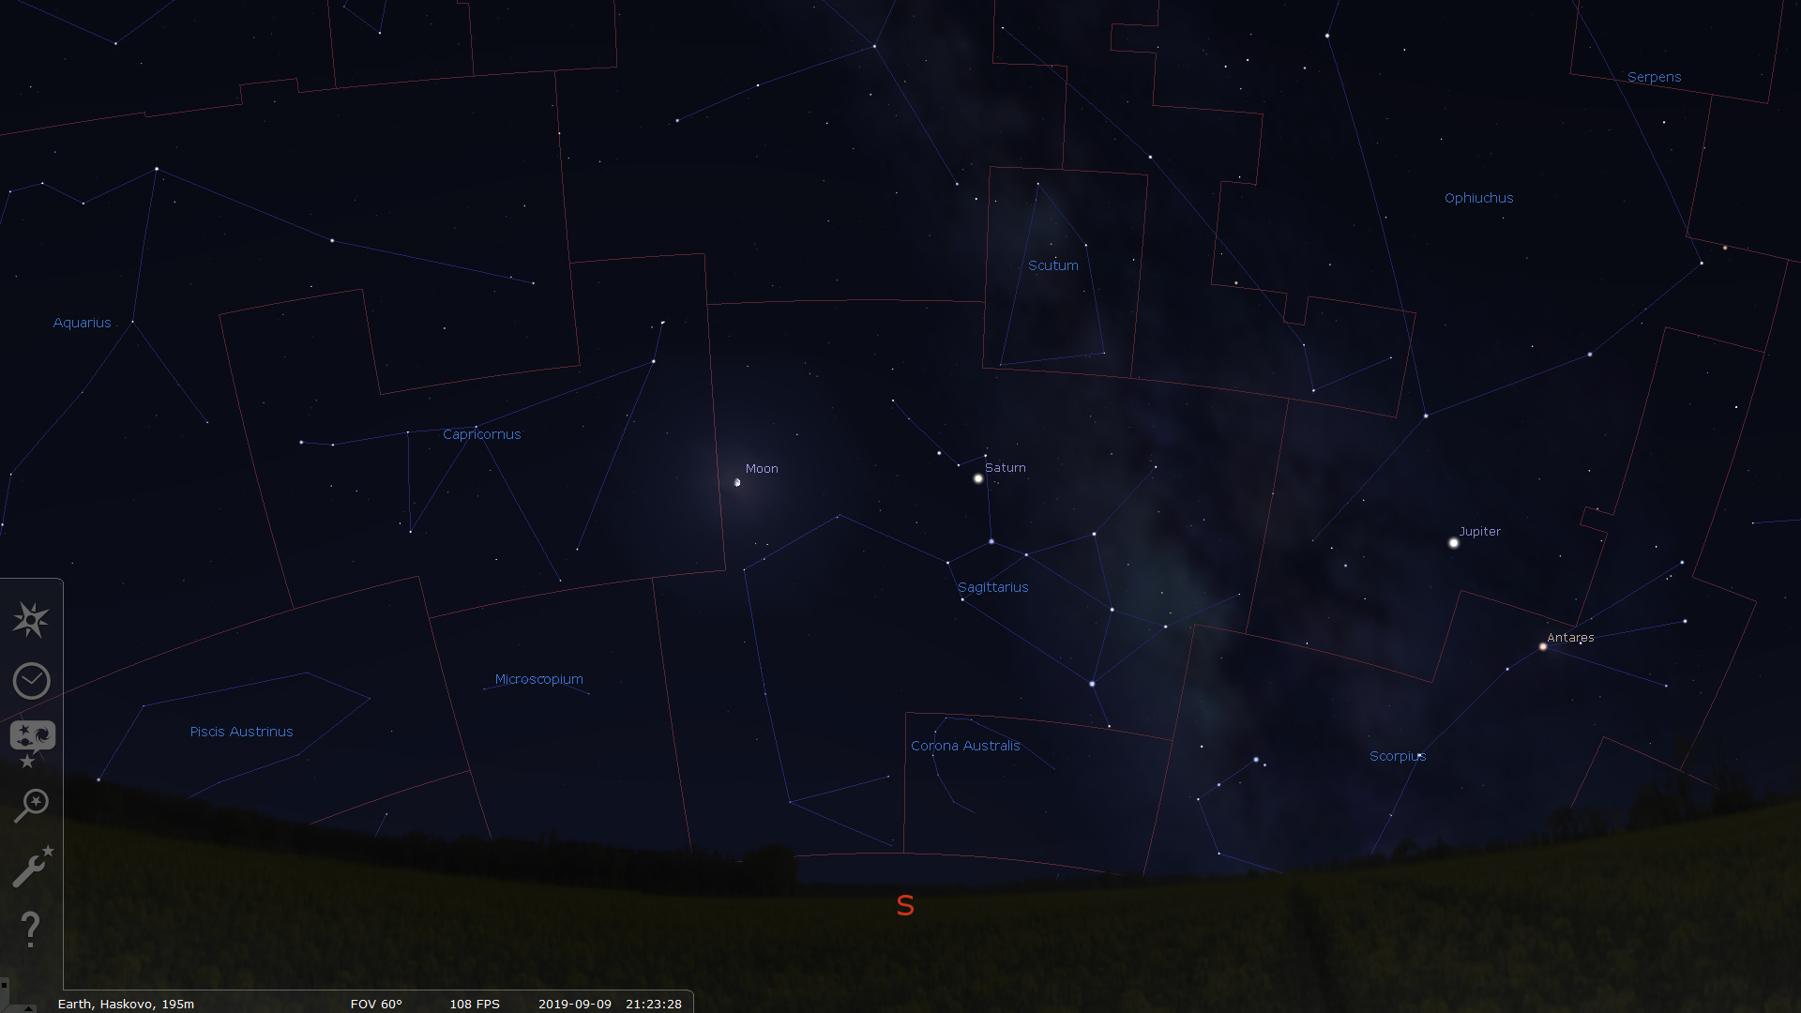
STELLARIUM
The current publication reflects only the author´s view and neither the Slovak National Agency, nor the European Commission are responsible for any use that may be made of the information it contains.

Slide 13
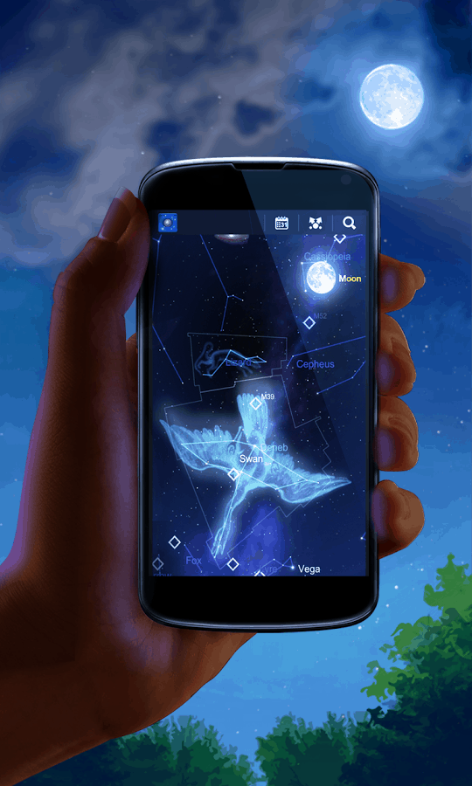
SMARTPHONE PLANETARUM-TYPE APPLICATION
The current publication reflects only the author´s view and neither the Slovak National Agency, nor the European Commission are responsible for any use that may be made of the information it contains.

Slide 14
Practical activity: 2. NAMES OF STARS
Methodical part: Basic orientation, file APPENDIX 1А;
Materials and tools: Printed table with partially filled names of constellations and stars. Computer and program type Planetarium, smartphone and installed application, or a printed star map.
Procedure: Students must fill in the missing names of constellations or the names of the brightest stars in them.
The current publication reflects only the author´s view and neither the Slovak National Agency, nor the European Commission are responsible for any use that may be made of the information it contains.

Slide 15
CONSTELLATION | BRIGHTEST STAR IN THE CONSTELLATION
Lyra
Canis Major
Cygnus
 | Capella
Taurus
Leo
Virgo
 | Betelgeuse
Scorpius
 | Procyon
The current publication reflects only the author´s view and neither the Slovak National Agency, nor the European Commission are responsible for any use that may be made of the information it contains.

Slide 16
CONSTELLATION | BRIGHTEST STAR IN THE CONSTELLATION
Lyra | Vega
Canis Major | Sirius
Cygnus | Deneb
Auriga | Capella
Taurus | Aldebaran
Leo | Regulus
Virgo | Spica
Орион | Betelgeuse
Scorpius | Antares
Canis Minor | Procyon
Answer:
The current publication reflects only the author´s view and neither the Slovak National Agency, nor the European Commission are responsible for any use that may be made of the information it contains.

Slide 17
Practical activity: 3. MESSIER OBJECTS
Methodical part: Basic orientation, file APPENDIX 2;
Materials and tools: Printed photos of "deep objects" or computer images of such.
Procedure: Students must recognize which image is of a nebula, star cluster, or galaxy. It is good to be able to name at least one representative of the three classes of objects.
The current publication reflects only the author´s view and neither the Slovak National Agency, nor the European Commission are responsible for any use that may be made of the information it contains.

Slide 18
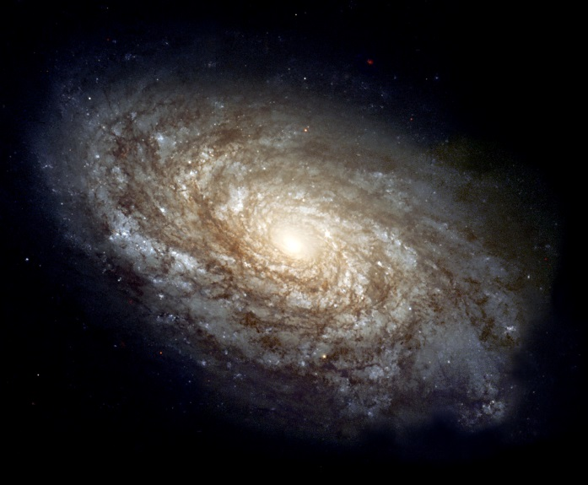
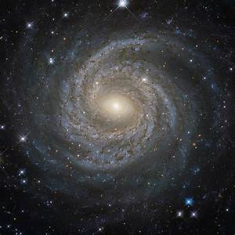
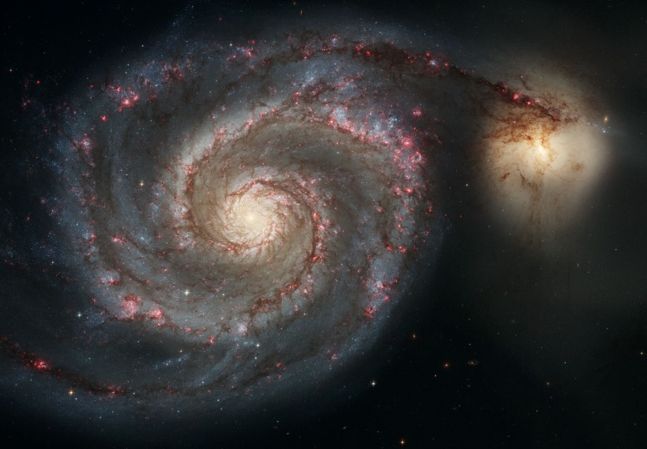
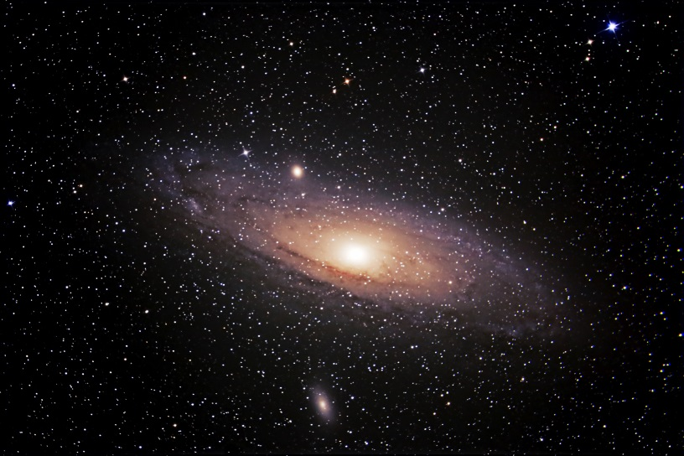
The current publication reflects only the author´s view and neither the Slovak National Agency, nor the European Commission are responsible for any use that may be made of the information it contains.

Slide 19
Answer:
GALAXIES
ANDROMEDA galaxy, М31
The current publication reflects only the author´s view and neither the Slovak National Agency, nor the European Commission are responsible for any use that may be made of the information it contains.

Slide 20
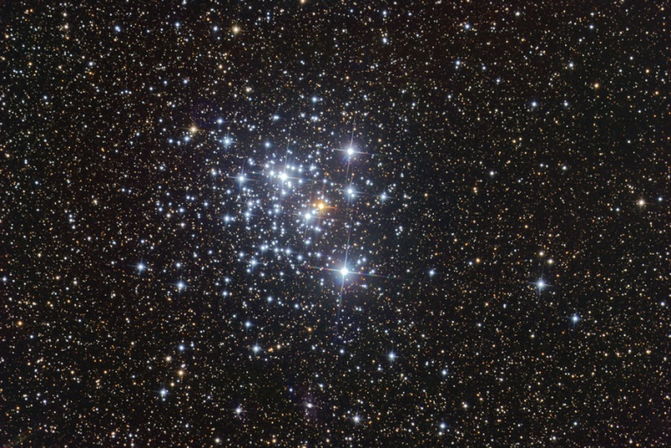
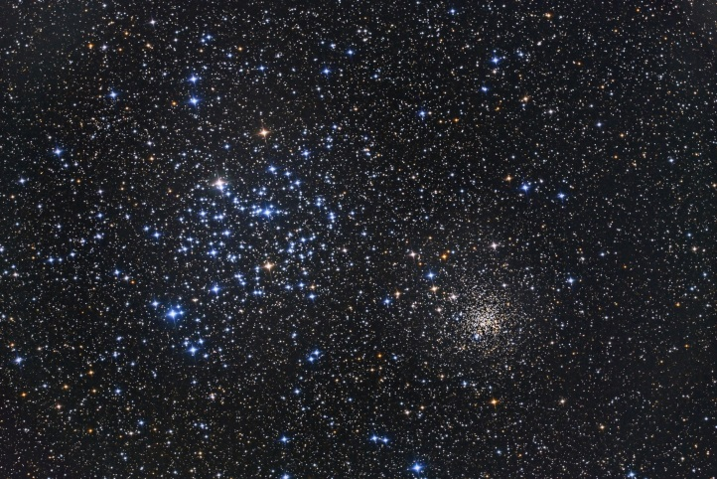
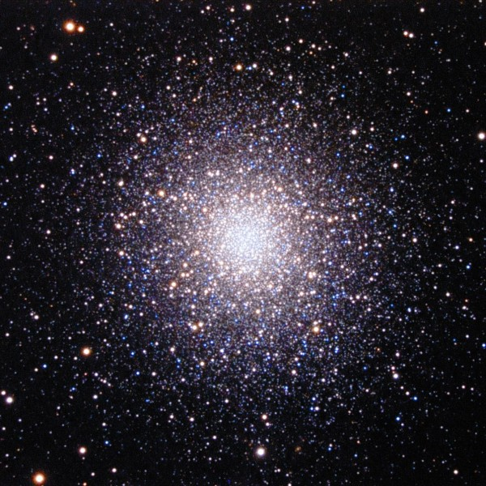
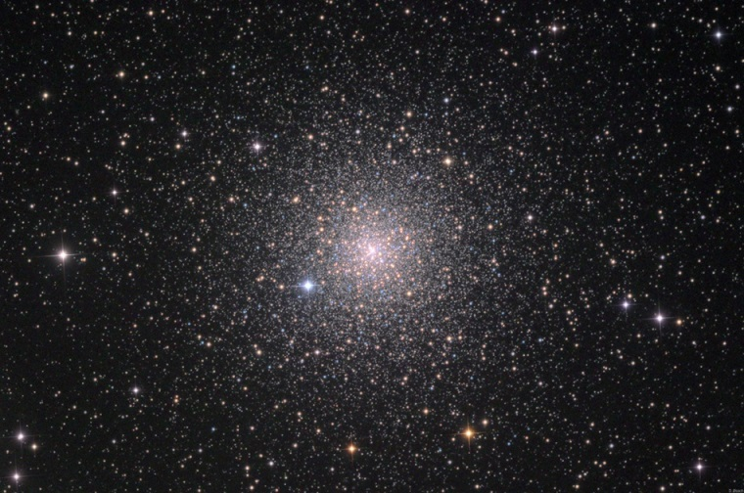
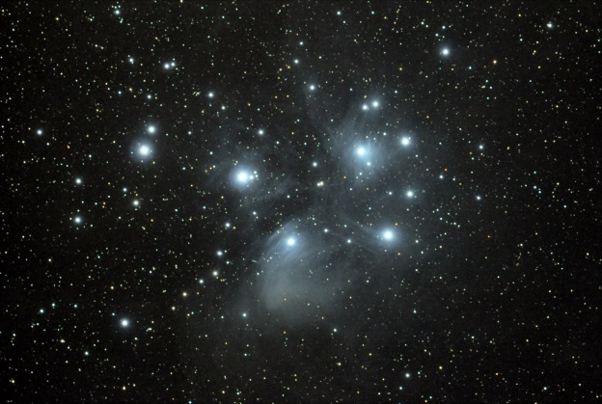
The current publication reflects only the author´s view and neither the Slovak National Agency, nor the European Commission are responsible for any use that may be made of the information it contains.

Slide 21
Answer:
STAR CLUSTERS
PLEIADES star cluster,
М45
The current publication reflects only the author´s view and neither the Slovak National Agency, nor the European Commission are responsible for any use that may be made of the information it contains.

Slide 22
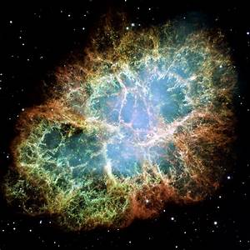
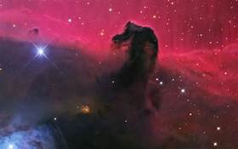
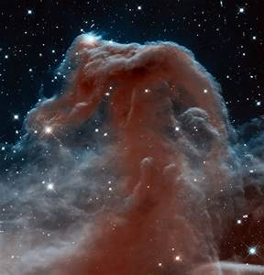
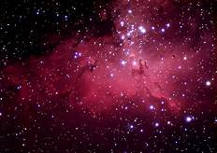
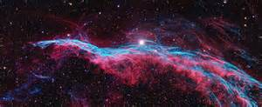
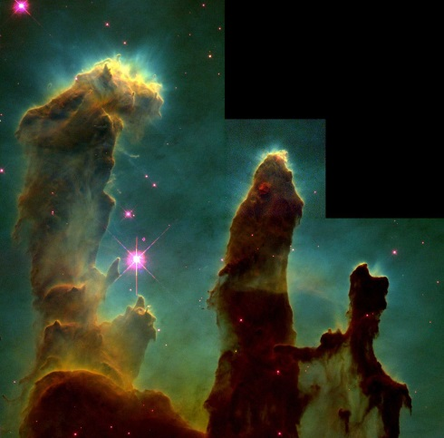
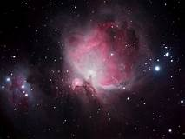
The current publication reflects only the author´s view and neither the Slovak National Agency, nor the European Commission are responsible for any use that may be made of the information it contains.

Slide 23
Answer:
NEBULAE
ORION nebula, М42
The current publication reflects only the author´s view and neither the Slovak National Agency, nor the European Commission are responsible for any use that may be made of the information it contains.

Slide 24
Conclusions, results check 1
Feed Forward: Base your olans for the next lessons on the results of the students:
Difficulty of the lessons: depending on student comprehension of the material and level of completion of the activities.
Preparation: Clear and well appointed goals of the lesson and activities. When the goal is well understood, the attention towards a task/material is easier and more effective.
Approach toward the material: What would be the correct approach that would help the student comprehension and activity completion.
The current publication reflects only the author´s view and neither the Slovak National Agency, nor the European Commission are responsible for any use that may be made of the information it contains.
Notes:
DOI: 10.3102/003465430298487, The Power of Feedback, John Hattie and Helen Timperley, University of Auckland

Slide 25
Conclusions, results check 2
Selfevaluation: selfdiscipline, steering and control of the activities.
Individual approach: Individual approach and guidance.
Check: How did I do? Individual evaluation of the student’s work, pertaining to the specific activity and goal. Must contain information about the advance (or lack of) the student has made and to guide them to achieve the goals and standards.
The current publication reflects only the author´s view and neither the Slovak National Agency, nor the European Commission are responsible for any use that may be made of the information it contains.
Notes:
DOI: 10.3102/003465430298487, The Power of Feedback, John Hattie and Helen Timperley, University of Auckland

