Slide 1


Project: STARS (Successfully Teaching AstRonomy in Schools)
This project has been funded with the support of the Erasmus+ Programme, K2 Action, Strategic Partnerships in School Education.
Project Agreement Number: 2017-1-SK01-KA201-035344
Training programme for teachers (O2)
Module #1
Constellations (Explanation, List of Constellations, Myths, Legends).
The current publication reflects only the author´s view and neither the Slovak National Agency, nor the European Commission are responsible for any use that may be made of the information it contains.

Slide 2

STARS project intro
1. STARS Methodological Handbook for Teachers
ready-to-use resource for teachers
2. STARS Training Program for Teachers
innovative and comprehensive approach
3. STARS Online Platform with examples of good practice and opportunities for discussions and exchange
4. STARS Concept for Astronomy Education Program
International Online Conference 2020
project-stars.com
The current publication reflects only the author´s view and neither the Slovak National Agency, nor the European Commission are responsible for any use that may be made of the information it contains.

Slide 3
STARS modules
#1 Constellations. #6 Galactic Neighbourhood.
#2 Motion of Celestial Bodies. #7 Sun and the Stars.
#3 Newton's laws of Gravitation. #8 Milky Way Galaxy and other galaxies.
#4 Space Exploration. #9 The Universe.
#5 Solar System. #10 Observatories.
The current publication reflects only the author´s view and neither the Slovak National Agency, nor the European Commission are responsible for any use that may be made of the information it contains.

Slide 4
Structure of the modules
There are several topics in each module.
Each topic contains:
A brief introduction and key words;
Theoretical part for the teacher - provides the basic information, necessary for the planning a lesson on that topic (and links to additional information in some cases).
! THESE ARE NOT READY-TO-USE LESSONS!
Practical exercises and activities for the students -ready for use in the classroom (in most cases) and with answers provided where applicable.
The current publication reflects only the author´s view and neither the Slovak National Agency, nor the European Commission are responsible for any use that may be made of the information it contains.

Slide 5
How to work with the materials 1
Carefully read the theoretical part for the teacher.
Should questions arise, look for answers in the supplementary materials , on the project’s website (http://project-stars.com), or other internet sites.
Attention! Make sure the information is reliable!
Prepare the theoretical part of your lesson.
The current publication reflects only the author´s view and neither the Slovak National Agency, nor the European Commission are responsible for any use that may be made of the information it contains.

Slide 6
How to work with the materials 2
Read carefully the practical exercises and their answers.
Should questions arise, look for answers in the supplementary materials , on the project’s website (http://project-stars.com), or other internet sites.
Attention! Make sure the information is reliable!
Depending on the theoretical content of your lesson, choose appropriate pracical activities to use. You can look for additional exercises in the supplementary materials or at the webpage of the project (http://project-stars.com/?lang=bg), or other internet sites.
Attention! Make sure the information is reliable!
The current publication reflects only the author´s view and neither the Slovak National Agency, nor the European Commission are responsible for any use that may be made of the information it contains.

Slide 7
How to work with the materials 3
7. Keep in mind that some of the activities require materials that should be available during the lesson.
8. We reccomend you try out the activities yourself before presenting them in the classroom. Based on yours students ages and abilities, you might need to modify the activities (either to make them easier or more difficult). However make sure to keep them correct in terms of physics.
You can give parts of, or whole exercises as homework.
The current publication reflects only the author´s view and neither the Slovak National Agency, nor the European Commission are responsible for any use that may be made of the information it contains.

Slide 8
Module 1 - content
Constellations:
Explanations. The list of the constellations. Myths and legends.
The current publication reflects only the author´s view and neither the Slovak National Agency, nor the European Commission are responsible for any use that may be made of the information it contains.

Slide 9
Theoretical content
Constellations
  - the need for constellations;
  - historical review;
  - modern constellations;
  - asterism;
  - Greek legends and myths for the constellations;
  - zodiacal constellations;
  - Bulgarian names and legends for the constellations.
The current publication reflects only the author´s view and neither the Slovak National Agency, nor the European Commission are responsible for any use that may be made of the information it contains.

Slide 10
List of Practical activities
CONSTELLATION NAMES
TYPES OF CONSTELLATIONS
WORD FINDER PUZZLES
RECOGNIZING CONSTELLATIONS
CONSTELLATION SHAPES
The current publication reflects only the author´s view and neither the Slovak National Agency, nor the European Commission are responsible for any use that may be made of the information it contains.

Slide 11
Practical activity: 1. CONSTELLATION NAMES
Methodical part: The students should name the constellations they know;
Materials and tools: N/A
Procedure: Students list the names of constellations they know, but do not have to recognize them in the sky.
The current publication reflects only the author´s view and neither the Slovak National Agency, nor the European Commission are responsible for any use that may be made of the information it contains.

Slide 12
Practical activity: 1. CONSTELLATION NAMES
Answer:
Big Dipper (Ursa Major)
Small Dipper (Ursa Minor)
Aries
Orion
Aquarius…
The current publication reflects only the author´s view and neither the Slovak National Agency, nor the European Commission are responsible for any use that may be made of the information it contains.

Slide 13
Practical activity: 2. TYPES OF CONSTELLATIONS
Methodical part: file APPENDIX 1, APPENDIX 2, tasks 1,2,3,4;
Materials and tools: 1. List of constellations, 2. Table with the constellations divided into groups, 3. Colour pencils
Procedure: task 1: Students fill the names of the constellations in the empty table by dividing them into groups; task 2: Summarize the number of constellations by different criteria; task 3: color all zodiacal constellations; task 4: other groups of constellations can be colored with other colors (equatorial, non-setting, against the background of the Milky Way, etc).
The current publication reflects only the author´s view and neither the Slovak National Agency, nor the European Commission are responsible for any use that may be made of the information it contains.

Slide 14
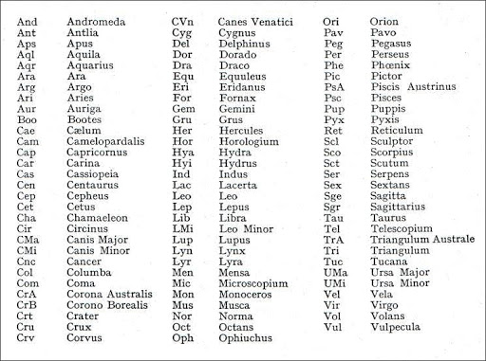
List of constellations:
The current publication reflects only the author´s view and neither the Slovak National Agency, nor the European Commission are responsible for any use that may be made of the information it contains.

Slide 15
The current publication reflects only the author´s view and neither the Slovak National Agency, nor the European Commission are responsible for any use that may be made of the information it contains.

Slide 16
Answer:
The current publication reflects only the author´s view and neither the Slovak National Agency, nor the European Commission are responsible for any use that may be made of the information it contains.

Slide 17
Practical activity: 3. WORD FINDER PUZZLES
Methodical part: file APPENDIX 3;
Materials and tools: Game words sheets (according to age and difficulty), colored pencils
Procedure: tasks 1: Students must find and shade and/or list the names of the constellations they have found in the puzzle.
The current publication reflects only the author´s view and neither the Slovak National Agency, nor the European Commission are responsible for any use that may be made of the information it contains.

Slide 18
C | E | N | T | A | U | R | U | S | P
C | R | A | T | E | R | O | L | M | E
A | S | N | D | G | H | J | K | H | R
N | Y | D | R | A | C | O | K | E | S
L | Y | R | A | W | F | J | T | R | E
S | C | O | R | P | I | U | S | C | U
Q | X | M | D | G | Y | R | Z | U | S
E | R | E | O | R | I | O | N | L | A
H | Y | D | R | A | F | G | E | E | L
C | F | A | B | C | N | L | A | S | Y
I VERSION
The current publication reflects only the author´s view and neither the Slovak National Agency, nor the European Commission are responsible for any use that may be made of the information it contains.

Slide 19
C | E | N | T | A | U | R | U | S | P
C | R | A | T | E | R | O | L | M | E
A | S | N | D | G | H | J | K | H | R
N | Y | D | R | A | C | O | K | E | S
L | Y | R | A | W | F | J | T | R | E
S | C | O | R | P | I | U | S | C | U
Q | X | M | D | G | Y | R | Z | U | S
E | R | E | O | R | I | O | N | L | A
H | Y | D | R | A | F | G | E | E | L
C | F | A | B | C | N | L | A | S | Y
I VERSION
Answer:
The current publication reflects only the author´s view and neither the Slovak National Agency, nor the European Commission are responsible for any use that may be made of the information it contains.

Slide 20
A | D | P | E | G | A | S | U | S | O | C | K | L | F | C
Z | Q | Y | K | C | H | A | M | A | L | E | O | N | H | O
C | E | N | T | A | U | R | U | S | P | P | D | R | J | R
W | T | A | Y | I | P | O | L | M | E | H | T | P | L | O
A | S | N | D | G | H | J | K | H | R | E | H | H | A | N
N | Y | D | R | A | C | O | K | E | S | U | Q | O | S | A
L | Y | R | A | W | F | J | T | R | E | S | D | E | S | A
S | C | O | R | P | I | U | S | C | U | C | E | N | C | U
Q | X | M | D | G | Y | R | Z | U | S | R | L | I | U | S
E | R | E | O | R | I | O | N | L | A | A | P | X | L | T
H | Y | D | R | A | F | G | E | E | L | T | H | G | P | R
C | F | A | B | C | N | L | A | S | Y | E | I | H | T | A
C | A | S | S | I | O | P | E | I | A | R | N | J | O | L
A | D | T | E | L | E | S | C | O | P | I | U | M | R | I
N | M | O | Y | E | R | I | D | A | N | U | S | I | L | S
II version
The current publication reflects only the author´s view and neither the Slovak National Agency, nor the European Commission are responsible for any use that may be made of the information it contains.

Slide 21
A | D | P | E | G | A | S | U | S | O | C | K | L | F | C
Z | Q | Y | K | C | H | A | M | A | L | E | O | N | H | O
C | E | N | T | A | U | R | U | S | P | P | D | R | J | R
W | T | A | Y | I | P | O | L | M | E | H | T | P | L | O
A | S | N | D | G | H | J | K | H | R | E | H | H | A | N
N | Y | D | R | A | C | O | K | E | S | U | Q | O | S | A
L | Y | R | A | W | F | J | T | R | E | S | D | E | S | A
S | C | O | R | P | I | U | S | C | U | C | E | N | C | U
Q | X | M | D | G | Y | R | Z | U | S | R | L | I | U | S
E | R | E | O | R | I | O | N | L | A | A | P | X | L | T
H | Y | D | R | A | F | G | E | E | L | T | H | G | P | R
C | F | A | B | C | N | L | A | S | Y | E | I | H | T | A
C | A | S | S | I | O | P | E | I | A | R | N | J | O | L
A | D | T | E | L | E | S | C | O | P | I | U | M | R | I
N | M | O | Y | E | R | I | D | A | N | U | S | I | L | S
II version
Answer:
The current publication reflects only the author´s view and neither the Slovak National Agency, nor the European Commission are responsible for any use that may be made of the information it contains.

Slide 22
Practical activity: 4. RECOGNIZING CONSTELLATIONS
Methodical part: file APPENDIX 4;
Materials and tools: Pictures of the constellations - different types. They can be printed on sheets or be computer images
Procedure: tasks 1: Students should recognize which constellation is in the image and name it.
The current publication reflects only the author´s view and neither the Slovak National Agency, nor the European Commission are responsible for any use that may be made of the information it contains.

Slide 23
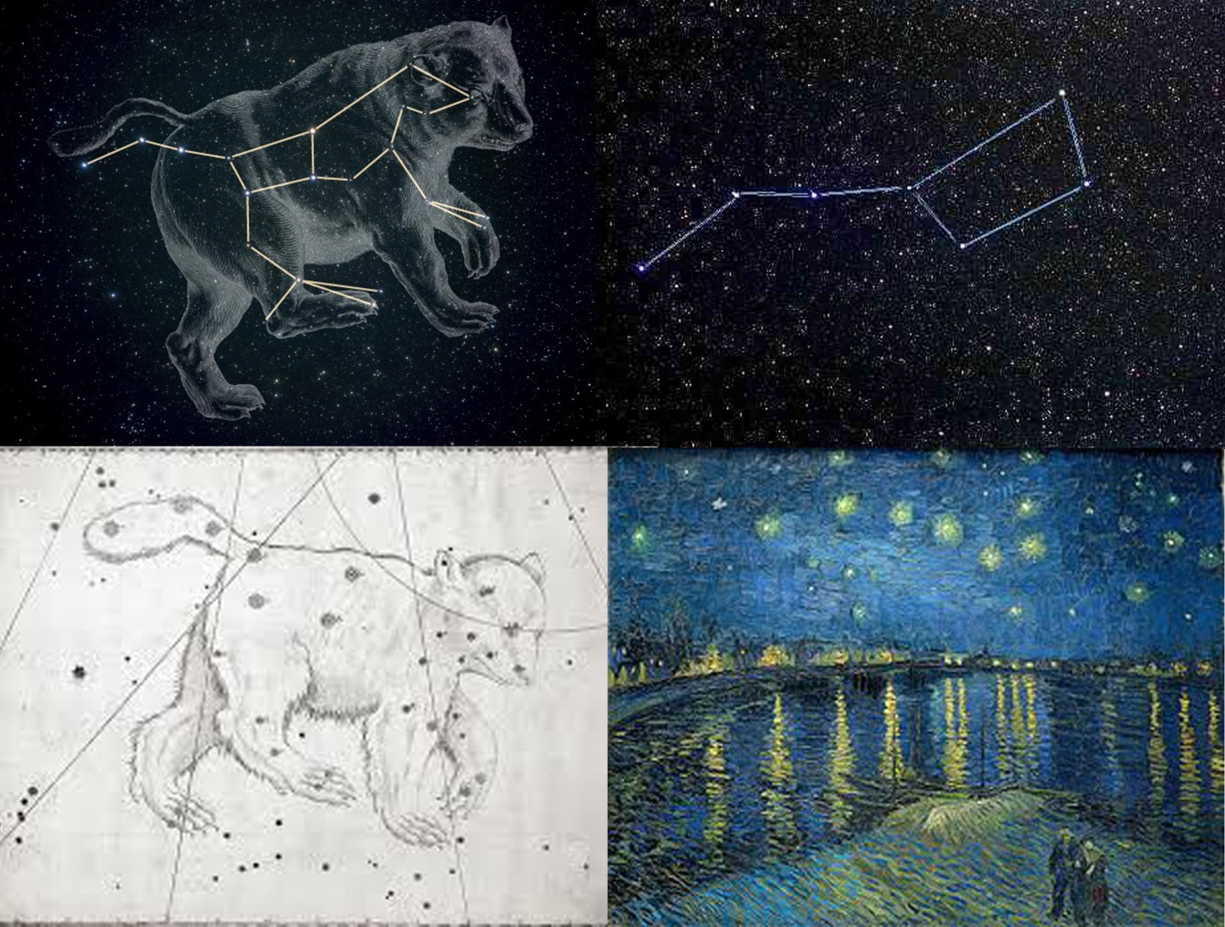
The current publication reflects only the author´s view and neither the Slovak National Agency, nor the European Commission are responsible for any use that may be made of the information it contains.

Slide 24
Answer:
Big Dipper (Ursa Major)
The current publication reflects only the author´s view and neither the Slovak National Agency, nor the European Commission are responsible for any use that may be made of the information it contains.

Slide 25
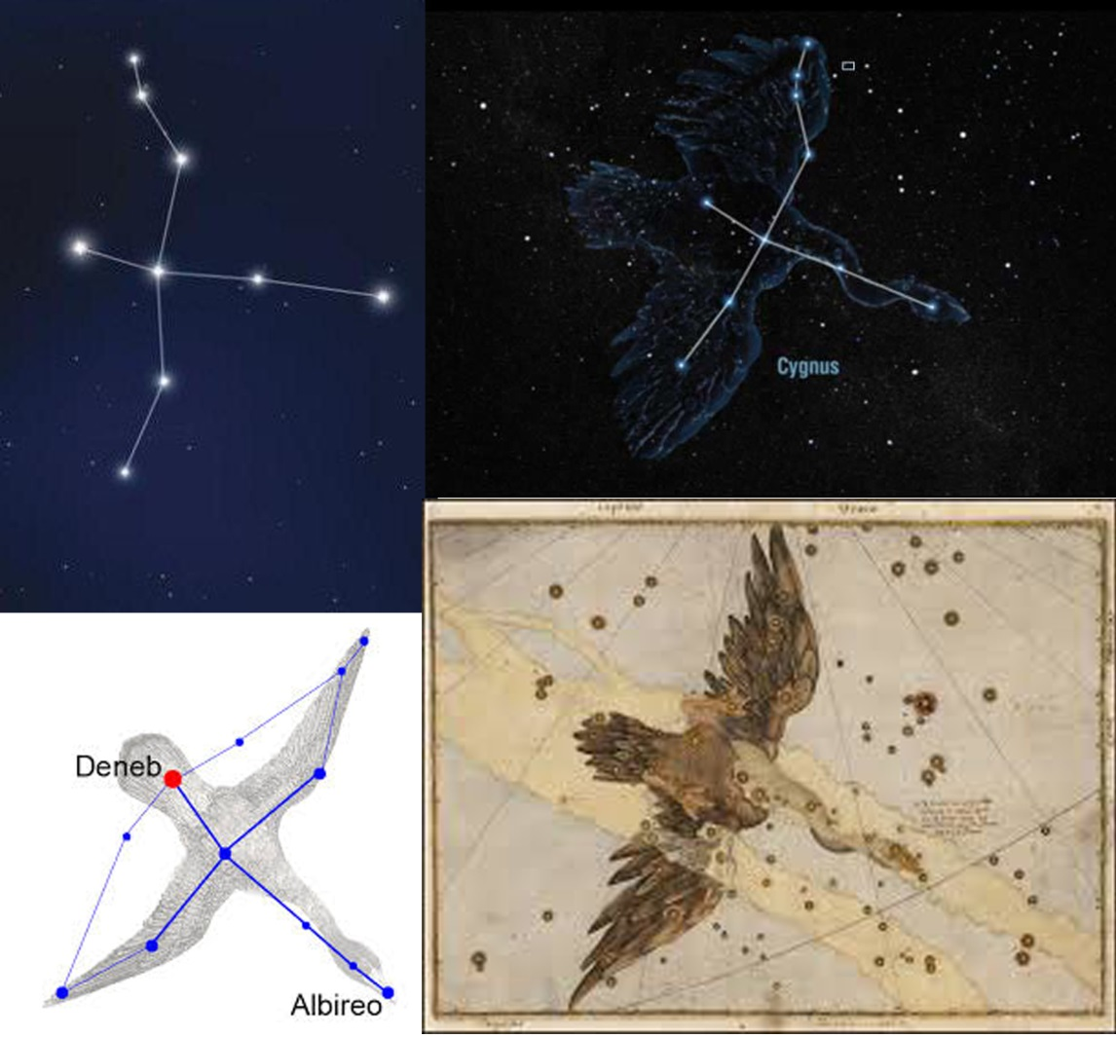
The current publication reflects only the author´s view and neither the Slovak National Agency, nor the European Commission are responsible for any use that may be made of the information it contains.

Slide 26
Answer:
Cygnus
The current publication reflects only the author´s view and neither the Slovak National Agency, nor the European Commission are responsible for any use that may be made of the information it contains.

Slide 27
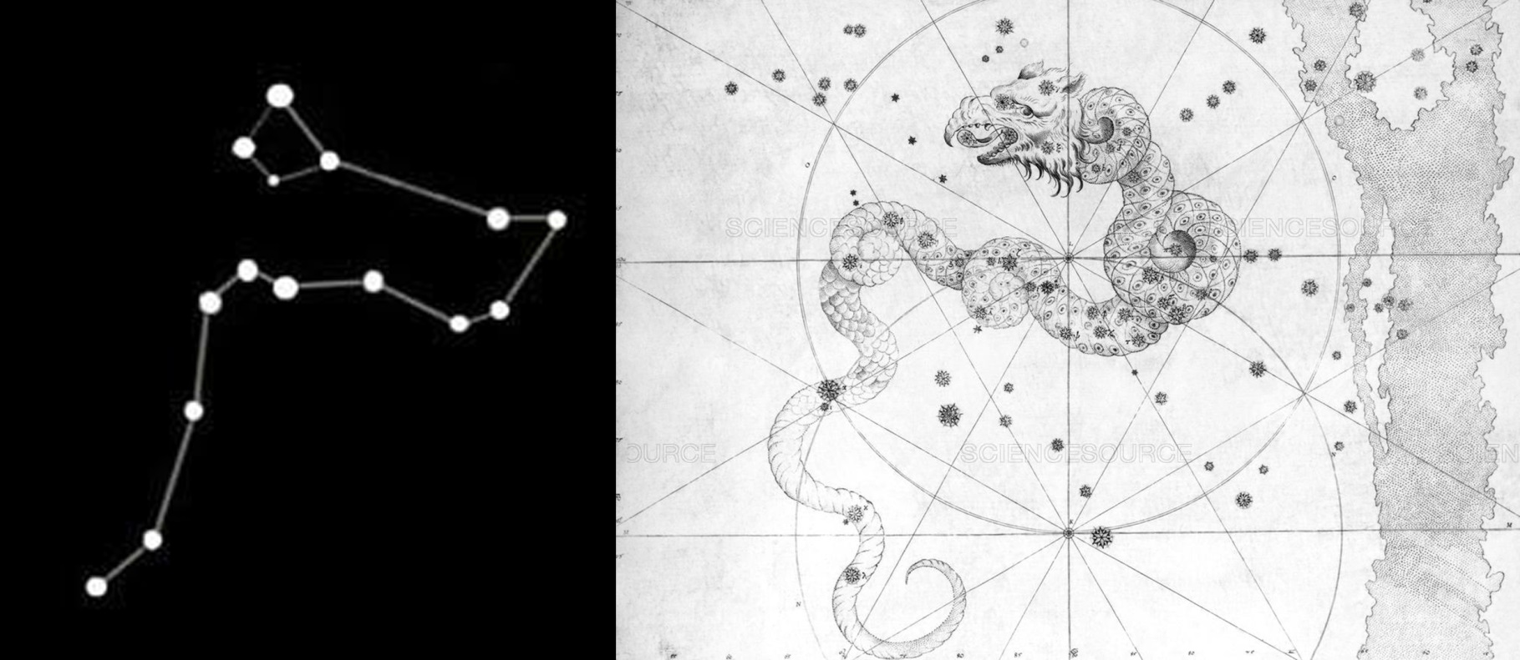
The current publication reflects only the author´s view and neither the Slovak National Agency, nor the European Commission are responsible for any use that may be made of the information it contains.

Slide 28
Answer:
Draco
The current publication reflects only the author´s view and neither the Slovak National Agency, nor the European Commission are responsible for any use that may be made of the information it contains.

Slide 29
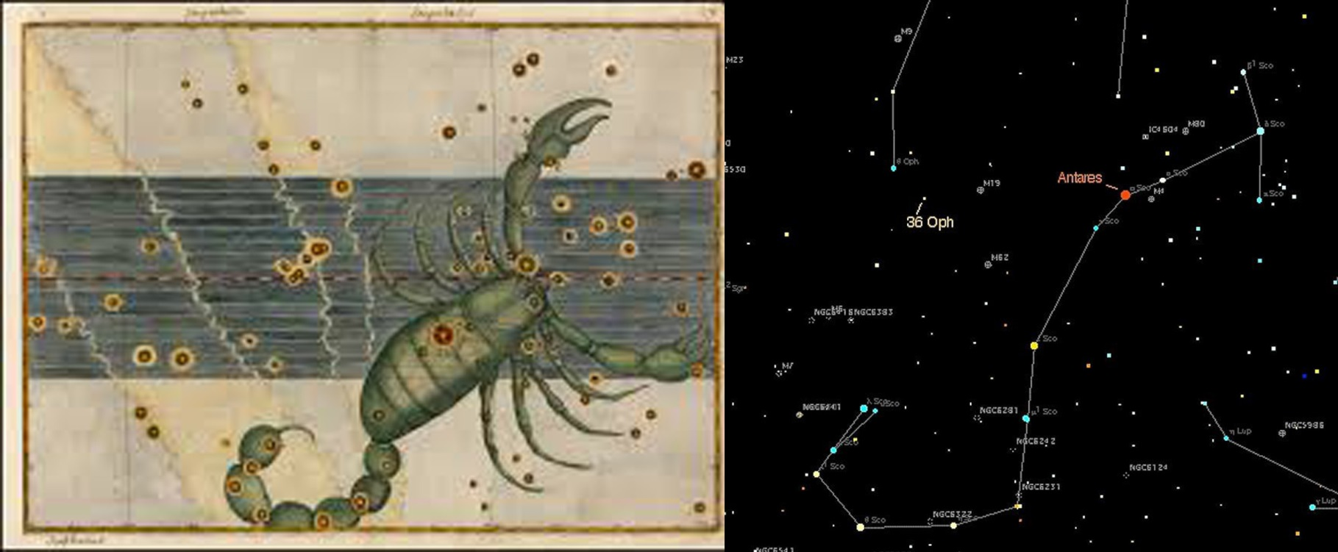
The current publication reflects only the author´s view and neither the Slovak National Agency, nor the European Commission are responsible for any use that may be made of the information it contains.

Slide 30
Answer:
Scorpius
The current publication reflects only the author´s view and neither the Slovak National Agency, nor the European Commission are responsible for any use that may be made of the information it contains.

Slide 31
Practical activity: 5. CONSTELLATION SHAPES
Methodical part: file APPENDIX 5;
Materials and tools: Printed diagram of the constellation Ursa Major, colored self-adhesive foil and a suitable star-shaped perforator. (In the absence of such a foil and a perforator, colored paper, scissors and glue are needed.)
Procedure: task 1: Students should stick colored stars on the Big Dipper asterism of the constellation Ursa Major. The size of the stars can correspond to the brightness of the real stars. The names of the stars can also be written.
The current publication reflects only the author´s view and neither the Slovak National Agency, nor the European Commission are responsible for any use that may be made of the information it contains.

Slide 32
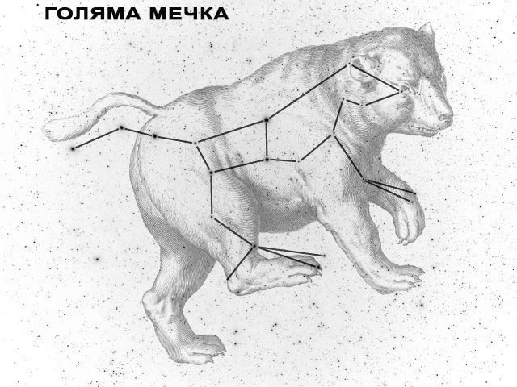
The current publication reflects only the author´s view and neither the Slovak National Agency, nor the European Commission are responsible for any use that may be made of the information it contains.

Slide 33
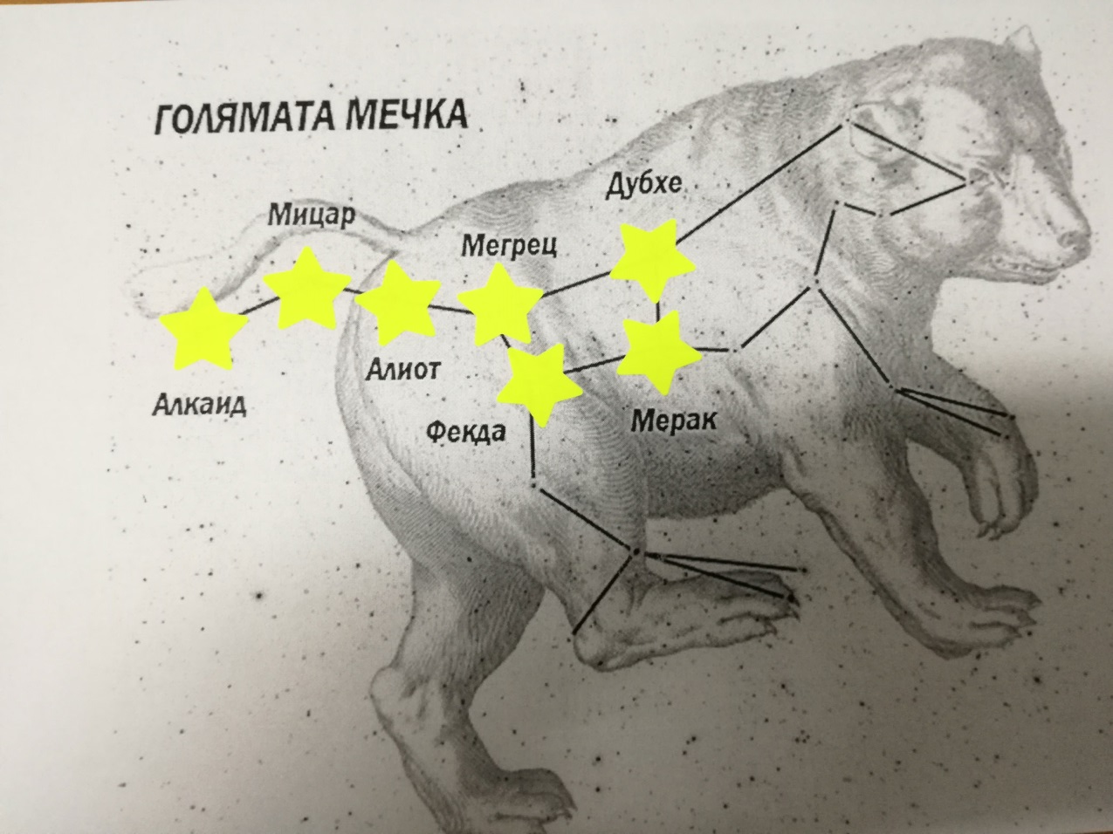
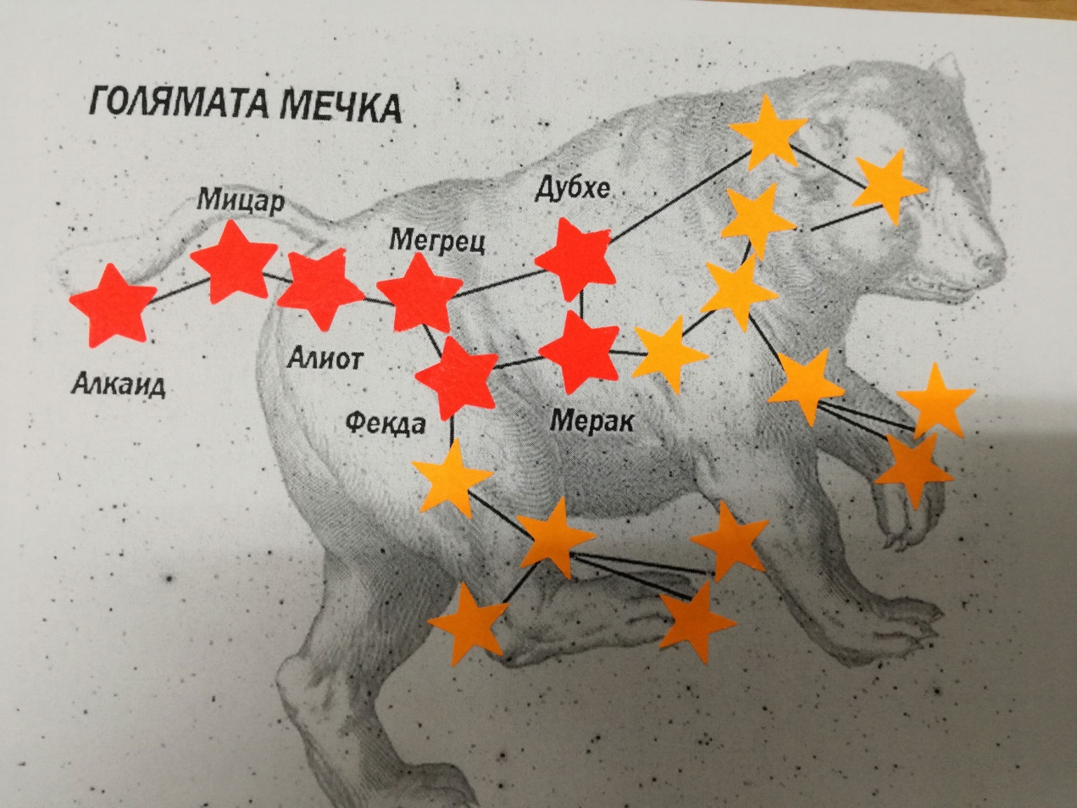
Answer:
The current publication reflects only the author´s view and neither the Slovak National Agency, nor the European Commission are responsible for any use that may be made of the information it contains.

Slide 34
Conclusions, results check 1
Feed Forward: Base your olans for the next lessons on the results of the students:
Difficulty of the lessons: depending on student comprehension of the material and level of completion of the activities.
Preparation: Clear and well appointed goals of the lesson and activities. When the goal is well understood, the attention towards a task/material is easier and more effective.
Approach toward the material: What would be the correct approach that would help the student comprehension and activity completion.
The current publication reflects only the author´s view and neither the Slovak National Agency, nor the European Commission are responsible for any use that may be made of the information it contains.
Notes:
DOI: 10.3102/003465430298487, The Power of Feedback, John Hattie and Helen Timperley, University of Auckland

Slide 35
Conclusions, results check 2
Selfevaluation: selfdiscipline, steering and control of the activities.
Individual approach: Individual approach and guidance.
Check: How did I do? Individual evaluation of the student’s work, pertaining to the specific activity and goal. Must contain information about the advance (or lack of) the student has made and to guide them to achieve the goals and standards.
The current publication reflects only the author´s view and neither the Slovak National Agency, nor the European Commission are responsible for any use that may be made of the information it contains.
Notes:
DOI: 10.3102/003465430298487, The Power of Feedback, John Hattie and Helen Timperley, University of Auckland

