Slide 1
Project: STARS (Successfully Teaching AstRonomy in Schools)
This project has been funded with the support of the Erasmus+ Programme, K2 Action, Strategic Partnerships in School Education.
Project Agreement Number: 2017-1-SK01-KA201-035344
Training programme for teachers (O2)
Module #10 Observatories. Astronomical Observatories. Electromagnetic (EM) spectrum.
The current publication reflects only the author´s view and neither the Slovak National Agency, nor the European Commission are responsible for any use that may be made of the information it contains.

Slide 2
STARS project intro
1. STARS Methodological Handbook for Teachers
ready-to-use resource for teachers
2. STARS Training Program for Teachers
innovative and comprehensive approach
3. STARS Online Platform with examples of good practice and opportunities for discussions and exchange
4. STARS Concept for Astronomy Education Program
International Online Conference in 2020
project-stars.com
The current publication reflects only the author´s view and neither the Slovak National Agency, nor the European Commission are responsible for any use that may be made of the information it contains.

Slide 3
STARS modules
#1 Constellations. #6 Galactic Neighbourhood.
#2 Motion of Celestial Bodies. #7 Sun and the Stars.
#3 Newton‘s Law of Gravitation. #8 Milky Way Galaxy and other galaxies.
#4 Space Exploration. #9 The Universe.
#5 Solar System. #10 Observatories.
The current publication reflects only the author´s view and neither the Slovak National Agency, nor the European Commission are responsible for any use that may be made of the information it contains.

Slide 4
Structure of the modules
There are several topics in each module.
Each topic contains:
A brief introduction and key words;
Theoretical part for the teacher - provides the basic information, necessary for the planning a lesson on that topic (and links to additional information in some cases).
! THESE ARE NOT READY-TO-USE LESSONS!
Practical exercises and activities for the students -ready for use in the classroom (in most cases) and with answers provided where applicable.
The current publication reflects only the author´s view and neither the Slovak National Agency, nor the European Commission are responsible for any use that may be made of the information it contains.

Slide 5
How to work with the materials 1
Carefully read the theoretical part for the teacher.
Should questions arise, look for answers in the supplementary materials , on the project’s website (http://project-stars.com), or other internet sites.
Attention! Make sure the information is reliable!
Prepare the theoretical part of your lesson.
The current publication reflects only the author´s view and neither the Slovak National Agency, nor the European Commission are responsible for any use that may be made of the information it contains.

Slide 6
How to work with the materials 2
When preparing the theoretical part of your lesson:
EM spectrum: you need to make sure the studentd understand well:
the connection between wavelength and frequency;
how different wavelenghts are measured;
how the atmosphere affects the propagation of EM waves with different lengths.
The current publication reflects only the author´s view and neither the Slovak National Agency, nor the European Commission are responsible for any use that may be made of the information it contains.

Slide 7
How to work with the materials 3
When preparing the theoretical part of your lesson:
Observatories:
the students should understand the terms observatory and instrument and the difference between them;
the students should differenciate the types of observatories and telescopes;
make sure teh students understand that some types of telescopes (e.g. optical ones) can be either ground-based or space-based, while others (e.g. X-ray) can only be space-based.
The current publication reflects only the author´s view and neither the Slovak National Agency, nor the European Commission are responsible for any use that may be made of the information it contains.

Slide 8
How to work with the materials 4
Read carefully the practical exercises and their answers.
Should questions arise, look for answers in the supplementary materials , on the project’s website (http://project-stars.com), or other internet sites.
Attention! Make sure the information is reliable!
The current publication reflects only the author´s view and neither the Slovak National Agency, nor the European Commission are responsible for any use that may be made of the information it contains.

Slide 9
How to work with the materials 5
6. Depending on the theoretical content of your lesson, choose appropriate pracical activities to use. You can look for additional exercises in the supplementary materials or at the webpage of the project (http://project-stars.com/?lang=bg), or other internet sites.
Attention! Make sure the information is reliable!
7. Keep in mind that some of the activities require materials that should be available during the lesson.
The current publication reflects only the author´s view and neither the Slovak National Agency, nor the European Commission are responsible for any use that may be made of the information it contains.

Slide 10
How to work with the materials 6
We reccomend you try out the activities yourself before presenting them in the classroom. Based on yours students ages and abilities, you might need to modify the activities (either to make them easier or more difficult). However make sure to keep them correct in terms of physics.
You can give parts of, or whole exercises as homework.
The current publication reflects only the author´s view and neither the Slovak National Agency, nor the European Commission are responsible for any use that may be made of the information it contains.

Slide 11
MODULE #10. CONTENTS
10.1. Astronomical Obsevatories.
10.3. Electromagnetic (EM) spectrum.
The current publication reflects only the author´s view and neither the Slovak National Agency, nor the European Commission are responsible for any use that may be made of the information it contains.

Slide 12
Theoretical part for the teacher
Astronomical observatories: desription of the different types of observatories - ground-based, space-based, stratospheric, underground and underwater. In Attachments 1 to 3 are given examples of the different kinds of observatories.
EM spectrum - description; wavelenghts of the EM spectrum; atmospheric windows.
The current publication reflects only the author´s view and neither the Slovak National Agency, nor the European Commission are responsible for any use that may be made of the information it contains.

Slide 13
List of Practical activities,
Observatories:
1. Model of the SOHO space observatory.
2. Make your own model of a space observatory.
3. Ground-based observatories.
The current publication reflects only the author´s view and neither the Slovak National Agency, nor the European Commission are responsible for any use that may be made of the information it contains.

Slide 14
Exercise 1: Model of the SOHO space observatory
Methodical part: module 10, topic Observatories. Suitable for grades 6 to 8.
Marterials: described in detail in the topic, the model is in file model_SOHO.pdf. .
Procedure: the students should read the provided information, then assemble the model.
The current publication reflects only the author´s view and neither the Slovak National Agency, nor the European Commission are responsible for any use that may be made of the information it contains.

Slide 15
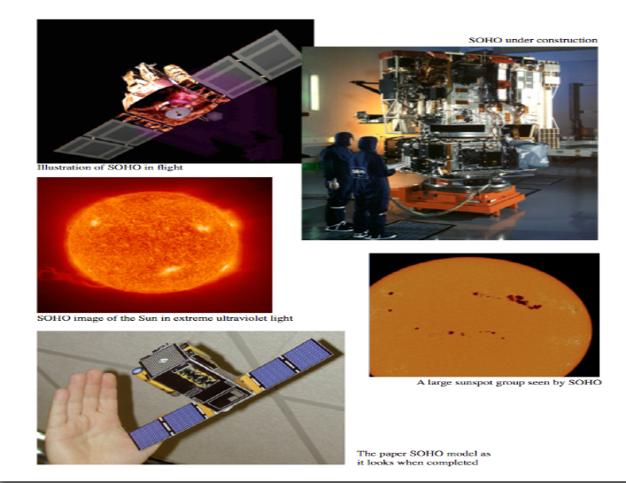
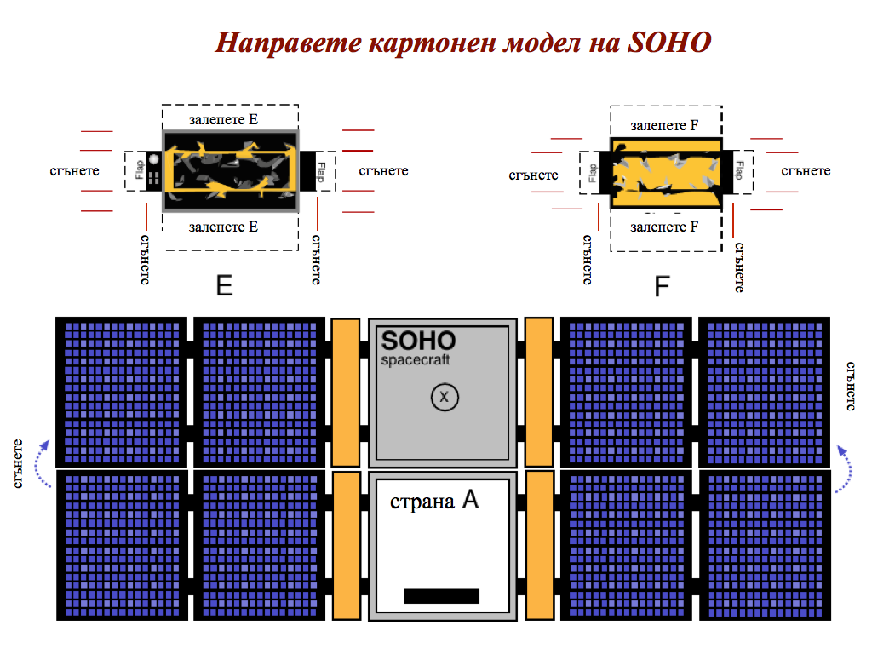
Exercise 1: Model of the SOHO space observatory
The current publication reflects only the author´s view and neither the Slovak National Agency, nor the European Commission are responsible for any use that may be made of the information it contains.

Slide 16
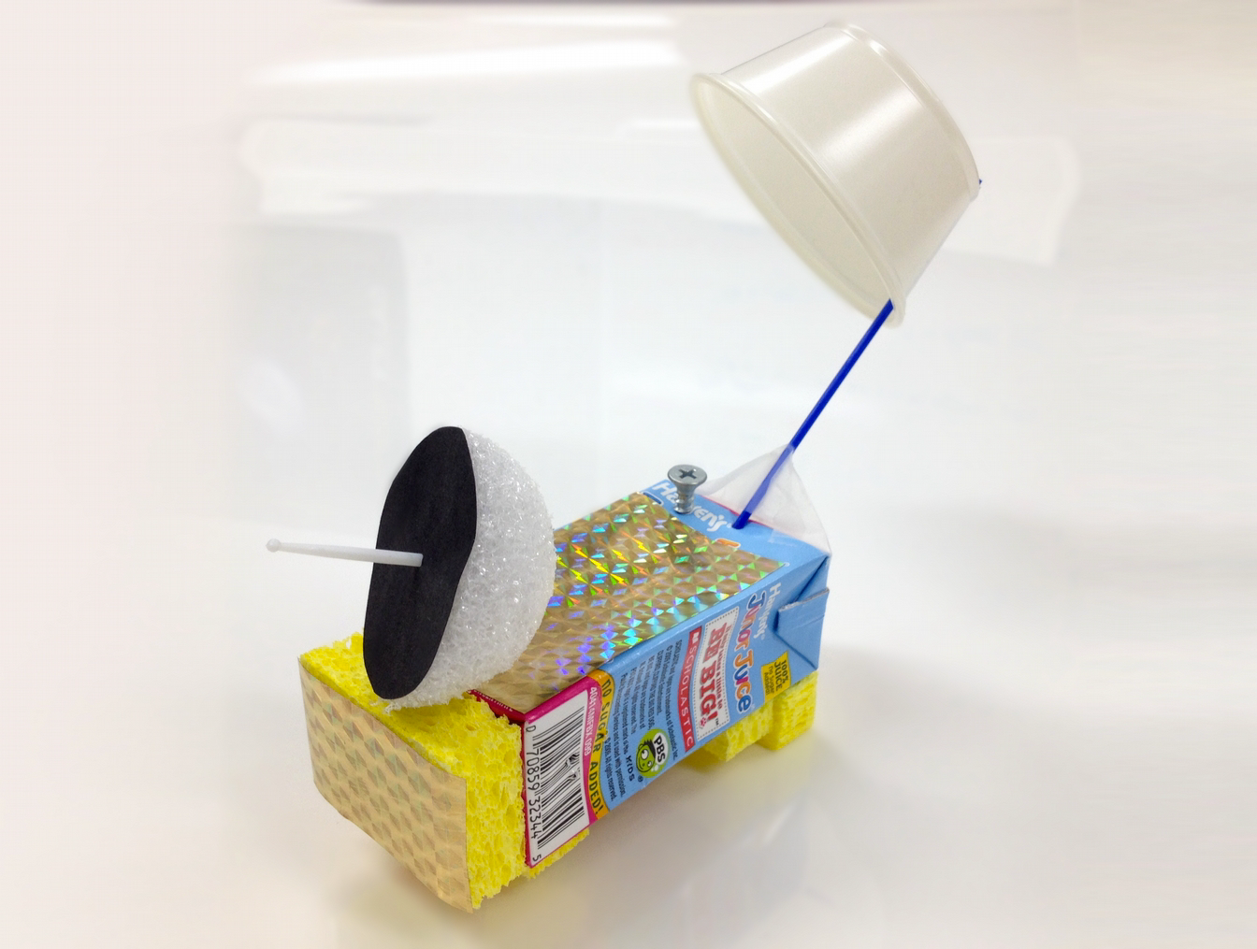
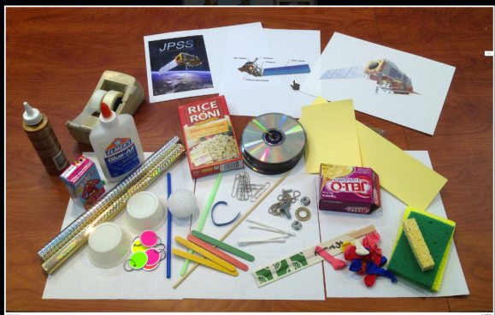
Exercise 2: Build a model of a space observatory.
Example result:
Example materials:
The current publication reflects only the author´s view and neither the Slovak National Agency, nor the European Commission are responsible for any use that may be made of the information it contains.

Slide 17
Exercise 2: Build a model of a space observatory.
Methodical part: module 10, topic Observatories. Suitable for grades up to 6
Aim: The students will learn about and build their own model of a space observatory/telescope using the listed below materials. It is up to each student to decide how the model will look. However, there are some elements that have to be present. These are given in the instructions.
Marterials: described in detail in the topic.
Procedure: the students should read the provided instructions, then assemble the model and present it to the others. Can be done as a competition.
The current publication reflects only the author´s view and neither the Slovak National Agency, nor the European Commission are responsible for any use that may be made of the information it contains.

Slide 18
Exercise 3: Ground-based observatories.
Methodical part: module 10, topic Observatories. Suitable for grades 6 to 8.
Aim: The students will learn to search and systematize information for a chosen by them (or a given by the teacher) ground-based observatory, its instruments and research objectives.
Necessary materials: tablet/smartphone/computer; internet access and Google Maps (https://www.google.com/maps/ ) or a similar site.
Procedure: described in detail in the topic.
The current publication reflects only the author´s view and neither the Slovak National Agency, nor the European Commission are responsible for any use that may be made of the information it contains.

Slide 19
List of Practical activities,
Electromagnetic spectrum:
1. The magic of light.
1.1 How to assemble aspectroscope.
1.2 Study of different sources of light.
2. Wavelentgh-frequency connection.
The current publication reflects only the author´s view and neither the Slovak National Agency, nor the European Commission are responsible for any use that may be made of the information it contains.

Slide 20
Ecercise 1: The magic of light
Methodical part: module 10, topic EM spectrum.
Aim:The students will explore the visible light and its composite colours with a help of a spectroscope they have built themselves.
Materials and prodedure: described in detail in attachment The materials are attached in the PR06_The_magic_of_light_all.zip
The current publication reflects only the author´s view and neither the Slovak National Agency, nor the European Commission are responsible for any use that may be made of the information it contains.

Slide 21
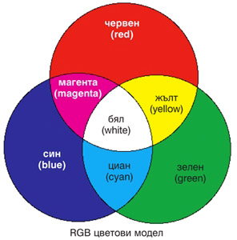
Example: task 1: Magic of light
How to separate composite colours on their basic components:
On the screen of a smartphone or a tablet, in sequence are placed the colours yellow, cyan, magenta (provided in the materials). The spectroscope is pointed at each colour and the observed basic colours are written in the provided table.
Answer:
The current publication reflects only the author´s view and neither the Slovak National Agency, nor the European Commission are responsible for any use that may be made of the information it contains.

Slide 22
Exercise 2: Wavelength-frequency connection.
Methodical part: module 10, topic EM spectrum.
AIM: Students will discover and verify the relationship between Wavelength and Frequency of the Electromagnetic Spectrum.
The current publication reflects only the author´s view and neither the Slovak National Agency, nor the European Commission are responsible for any use that may be made of the information it contains.

Slide 23
Exercise 2: Wavelength-frequency connection.
Materials and prodedure: described in detail in attachment Connection_wavel_and_freq_of_light.zip
The current publication reflects only the author´s view and neither the Slovak National Agency, nor the European Commission are responsible for any use that may be made of the information it contains.

Slide 24
Conclusions, results check 1
Feed Forward: Base your olans for the next lessons on the results of the students:
Difficulty of the lessons: depending on student comprehension of the material and level of completion of the activities.
Preparation: Clear and well appointed goals of the lesson and activities. When the goal is well understood, the attention towards a task/material is easier and more effective.
Approach toward the material: What would be the correct approach that would help the student comprehension and activity completion.
The current publication reflects only the author´s view and neither the Slovak National Agency, nor the European Commission are responsible for any use that may be made of the information it contains.
Notes:
DOI: 10.3102/003465430298487, The Power of Feedback, John Hattie and Helen Timperley, University of Auckland

Slide 25
Conclusions, results check 2
Selfevaluation: selfdiscipline, steering and control of the activities.
Individual approach: Individual approach and guidance.
Check: How did I do? Individual evaluation of the student’s work, pertaining to the specific activity and goal. Must contain information about the advance (or lack of) the student has made and to guide them to achieve the goals and standards.
The current publication reflects only the author´s view and neither the Slovak National Agency, nor the European Commission are responsible for any use that may be made of the information it contains.
Notes:
DOI: 10.3102/003465430298487, The Power of Feedback, John Hattie and Helen Timperley, University of Auckland

