Slide 1
Project: STARS (Successfully Teaching AstRonomy in Schools)
This project has been funded with the support of the Erasmus+ Programme, K2 Action, Strategic Partnerships in School Education.
Project Agreement Number: 2017-1-SK01-KA201-035344
Training programme for teachers (O2)
Module #10
Observatories Telescopes
The current publication reflects only the author´s view and neither the Slovak National Agency, nor the European Commission are responsible for any use that may be made of the information it contains.

Slide 2
Project STARS introduction
1. STARS Methodological Handbook for Teachers
ready-to-use resource for teachers
2. STARS Training Program for Teachers
innovative and comprehensive approach
3. STARS Online Platform with examples of good practice and opportunities for discussions and exchange
4. STARS Concept for Astronomy Education Program
International Online Conference 2020
project-stars.com
The current publication reflects only the author´s view and neither the Slovak National Agency, nor the European Commission are responsible for any use that may be made of the information it contains.

Slide 3
Project STARS modules
#1 Constellations. #6 Galactic Neighbourhood.
#2 Motion of Celestial Bodies. #7 Sun and Stars.
#3 Newton's law of Gravitation. #8 Our Galaxy and other galaxies.
#4 Discovery of the Universe. #9 The Universe.
#5 Solar System. #10 Observatories.
The current publication reflects only the author´s view and neither the Slovak National Agency, nor the European Commission are responsible for any use that may be made of the information it contains.

Slide 4
Structure of the modules
There are several topics in each module.
Each topic contains:
A brief introduction and key words;
Theoretical part for the teacher - provides the basic information, necessary for the planning a lesson on that topic (and links to additional information in some cases).
Practical exercises and activities for the students - ready for use in the classroom (in most cases) and with answers provided where applicable.
The current publication reflects only the author´s view and neither the Slovak National Agency, nor the European Commission are responsible for any use that may be made of the information it contains.

Slide 5
How to work with the materials 1
Carefully read the theoretical part for the teacher.
Should questions arise, look for answers in the supplementary materials , on the project’s website (project-stars.com), or other internet sites. Attention! Make sure the information is reliable!
Prepare the theoretical part of your lesson.
The current publication reflects only the author´s view and neither the Slovak National Agency, nor the European Commission are responsible for any use that may be made of the information it contains.

Slide 6
How to work with the materials 2
Read carefully the practical exercises and their answers.
Should questions arise, look for answers in the supplementary materials , on the project’s website (project-stars.com), or other internet sites. Attention! Make sure the information is reliable!
Depending on the theoretical content of your lesson, choose appropriate practical activities to use. You can look for additional exercises in the supplementary materials or at the webpage of the project (project-stars.com), or other internet sites. Attention! Make sure the information is reliable!
The current publication reflects only the author´s view and neither the Slovak National Agency, nor the European Commission are responsible for any use that may be made of the information it contains.

Slide 7
How to work with the materials 3
Keep in mind that some of the activities require materials that should be available during the lesson.
We recommend you try out the activities yourself before presenting them in the classroom. Based on yours students ages and abilities, you might need to modify the activities (either to make them easier or more difficult). However make sure to keep them correct in terms of physics.
You can give parts of, or whole exercises as homework.
The current publication reflects only the author´s view and neither the Slovak National Agency, nor the European Commission are responsible for any use that may be made of the information it contains.

Slide 8
Моdule 10 – contents
10.1 Telescopes
Type of telescopes and their properties. Optics. Defects. Segments.
The current publication reflects only the author´s view and neither the Slovak National Agency, nor the European Commission are responsible for any use that may be made of the information it contains.

Slide 9
Theoretical contents
10.1 Telescopes
History of usage of telescopes;
type of telescopes (refractor, reflector) and their basic properties;
defects of telescopes;
the influence of the Earth's atmosphere on observation;
adaptive optics.
The current publication reflects only the author´s view and neither the Slovak National Agency, nor the European Commission are responsible for any use that may be made of the information it contains.

Slide 10
List of practical activities
10.1.1 Construction of rays course
10.1.2 A simple Kepler-type telescope
10.1.3 Enhanced Kepler-type telescope
10.1.4 Segmented mirror
10.1.5 Camera obscura
The current publication reflects only the author´s view and neither the Slovak National Agency, nor the European Commission are responsible for any use that may be made of the information it contains.

Slide 11
Practical activity: 10.1.1 Construction of ray course
Methodical part: Build an image created with binoculars and describe its properties.
Material and tool: Drawing tools
Procedure: The pupil constructs the passages of the rays through the optical system.
The current publication reflects only the author´s view and neither the Slovak National Agency, nor the European Commission are responsible for any use that may be made of the information it contains.

Slide 12
Practical activity: 10.1.1 Construction of ray course
1
3
F‘
F
2
The current publication reflects only the author´s view and neither the Slovak National Agency, nor the European Commission are responsible for any use that may be made of the information it contains.

Slide 13
Practical activity: 10.1.1 Construction of ray course
parallel rays
F’_{ob} = F_{ok}
F_{ob}
F’_{ok}
parallel rays
coming from afar
object
Objective
Eyepiece
reseneulohy.cz/1741/obraz-slunce-vytvoreny-pomoci-keplerova-dalekohledu
The current publication reflects only the author´s view and neither the Slovak National Agency, nor the European Commission are responsible for any use that may be made of the information it contains.

Slide 14
Practical activity: 10.1.2 Simple Kepler-type telescope
Methodical part: Assemble a simple Kepler-type astronomical telescope.
Material and tool: Small and large magnifier, ruler, tube for drawings, saw, scissors, glue gun, calculator
Procedure: According to the instructions, the pupil will create a simple astronomical telescope.
The current publication reflects only the author´s view and neither the Slovak National Agency, nor the European Commission are responsible for any use that may be made of the information it contains.

Slide 15
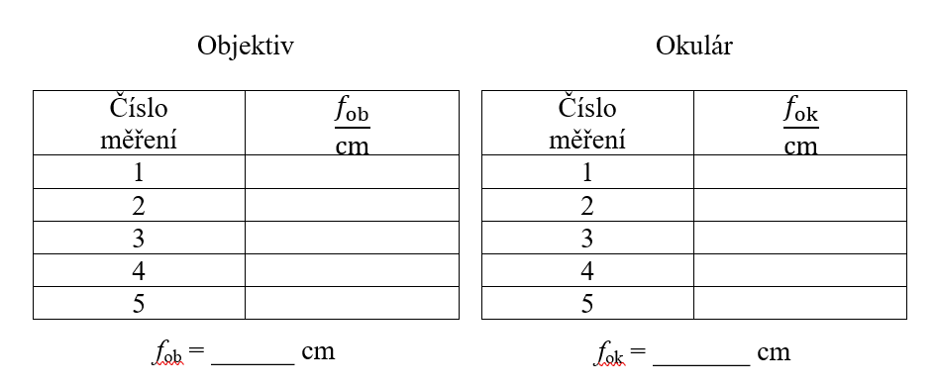
Practical activity: 10.1.2 Simple Kepler-type telescope
The current publication reflects only the author´s view and neither the Slovak National Agency, nor the European Commission are responsible for any use that may be made of the information it contains.

Slide 16
Practical activity: 10.1.2 Simple Kepler-type telescope
The current publication reflects only the author´s view and neither the Slovak National Agency, nor the European Commission are responsible for any use that may be made of the information it contains.

Slide 17
Practical activity: 10.1.2 Simple Kepler-type telescope
! | Never look into the sun with your binoculars! This could cause irreversible damage to eyes!
www.youtube.com/watch?v=R9cMXCemoJI
The current publication reflects only the author´s view and neither the Slovak National Agency, nor the European Commission are responsible for any use that may be made of the information it contains.

Slide 18
Practical activity: 10.1.2 Simple Kepler-type telescope
In practice, for astronomical telescopes, the parameters are often given in the format focal length of objective / objective diameter.
Magnification of the telescope is not the most important property!
The current publication reflects only the author´s view and neither the Slovak National Agency, nor the European Commission are responsible for any use that may be made of the information it contains.

Slide 19
Practical activity: 10.1.3 Enhanced Kepler-type telescope
Methodical part: Compensate for a colour defect in the previous telescope.
Material and tool: Small and large magnifier, ruler, tube for drawings, paper quarter, saw, scissors, glue gun, calculator
Procedure: According to the instructions, the pupil will create an improved astronomical telescope.
The current publication reflects only the author´s view and neither the Slovak National Agency, nor the European Commission are responsible for any use that may be made of the information it contains.

Slide 20
Practical activity: 10.1.3 Enhanced Kepler-type telescope
The current publication reflects only the author´s view and neither the Slovak National Agency, nor the European Commission are responsible for any use that may be made of the information it contains.

Slide 21
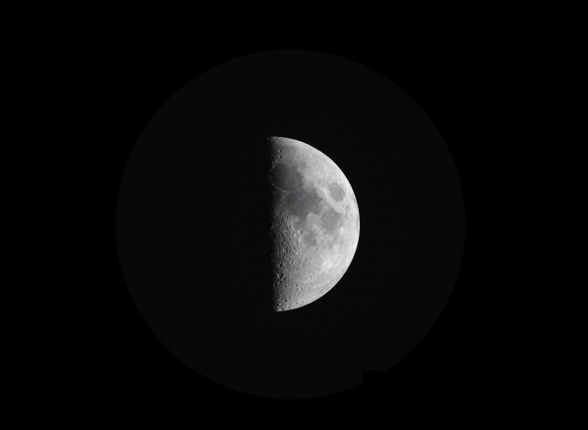
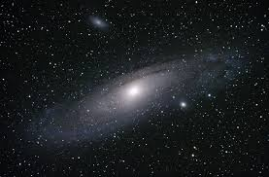
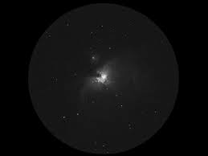
Practical activity: 10.1.3 Enhanced Kepler-type telescope
craters on the Moon
galaxy in Andromeda
nebula in Orion
planets with no details (real telescope is needed)
The current publication reflects only the author´s view and neither the Slovak National Agency, nor the European Commission are responsible for any use that may be made of the information it contains.

Slide 22
Practical activity: 10.1.4 Segmented mirror
Methodical part: Large astronomical telescopes and their building.
Material and tool: Scissor, ruler, calculator
Procedure: The pupil will get an idea of the construction of large telescopes.
The current publication reflects only the author´s view and neither the Slovak National Agency, nor the European Commission are responsible for any use that may be made of the information it contains.

Slide 23
Practical activity: 10.1.4 Segmented mirror
price [USD]
diameter [m]
The current publication reflects only the author´s view and neither the Slovak National Agency, nor the European Commission are responsible for any use that may be made of the information it contains.

Slide 24
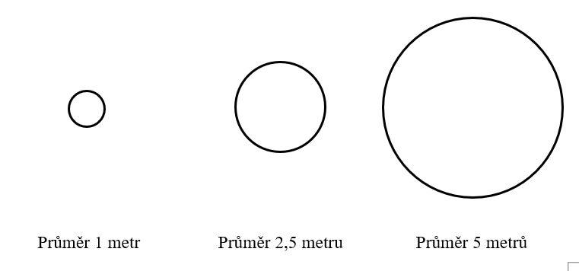
Practical activity: 10.1.4 Segmented mirror
10 metres
1 metre diameter
2.5 metres diameter
5 metres diameter
The current publication reflects only the author´s view and neither the Slovak National Agency, nor the European Commission are responsible for any use that may be made of the information it contains.

Slide 25
Practical activity: 10.1.5 Camera obscure
Methodical part: Assembly of a simple optical device.
Material and tool: Two pieces of paper, aluminium foil, pin, drawing supplies, scissors, adhesive tape
Procedure: The pupil makes a simple optical device.
The current publication reflects only the author´s view and neither the Slovak National Agency, nor the European Commission are responsible for any use that may be made of the information it contains.

Slide 26
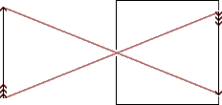
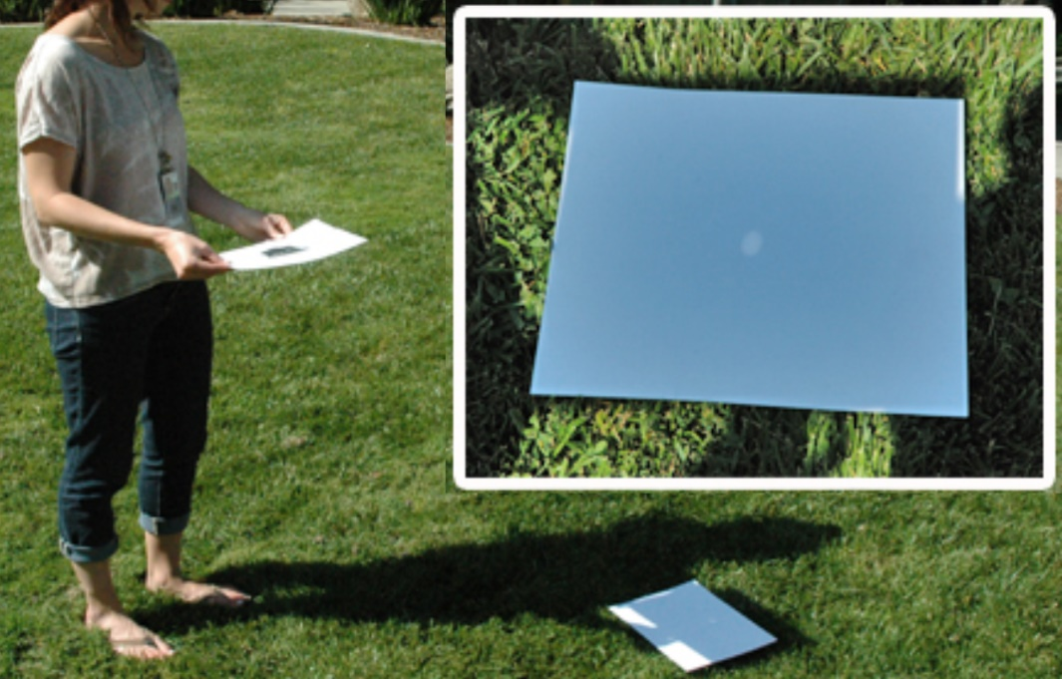
Practical activity: 10.1.5 Camera obscure
Sun
Cut a 3 × 3 centimetre square hole in the centre of a hard paper sheet with A4 format.
Glue a square of 5 × 5 centimetre aluminium foil to the hole with adhesive tape so that no light passes around the foil.
Carefully pierce a small hole into the centre of the square of aluminium foil.
Try to use the created hole to display the Sun on a white paper sheet (see Figure).
The current publication reflects only the author´s view and neither the Slovak National Agency, nor the European Commission are responsible for any use that may be made of the information it contains.

Slide 27
Conclusions, results check 1
Feed Forward: Base your plans for the next lessons on the results of the pupils:
Difficulty of the lessons: depending on pupils comprehension of the material and level of completion of the activities.
Preparation: Clear and well appointed goals of the lesson and activities. When the goal is well understood, the attention towards a task/material is easier and more effective.
Approach toward the material: What would be the correct approach that would help the student comprehension and activity completion.
The current publication reflects only the author´s view and neither the Slovak National Agency, nor the European Commission are responsible for any use that may be made of the information it contains.
Notes:
DOI: 10.3102/003465430298487, The Power of Feedback, John Hattie and Helen Timperley, University of Auckland

Slide 28
Conclusions, results check 2
Self-evaluation: self-discipline, steering and control of the activities.
Individual approach: Individual approach and guidance.
Check: How did I do? Individual evaluation of the pupil’s work, pertaining to the specific activity and goal. Must contain information about the advance (or lack of) the pupil has made and to guide them to achieve the goals and standards.
The current publication reflects only the author´s view and neither the Slovak National Agency, nor the European Commission are responsible for any use that may be made of the information it contains.
Notes:
DOI: 10.3102/003465430298487, The Power of Feedback, John Hattie and Helen Timperley, University of Auckland

