Slide 1


Project: STARS (Successfully Teaching AstRonomy in Schools)
This project has been funded with the support of the Erasmus+ Programme, K2 Action, Strategic Partnerships in School Education.
Project Agreement Number: 2017-1-SK01-KA201-035344
Training programme for teachers (O2)
Module #5a
Solar system
Planets, dwarf planets, small bodies
The current publication reflects only the author´s view and neither the Slovak National Agency, nor the European Commission are responsible for any use that may be made of the information it contains.

Slide 2
Project STARS introduction
1. STARS Methodological Handbook for Teachers
ready-to-use resource for teachers
2. STARS Training Program
for Teachers
innovative and comprehensive approach
3. STARS Online Platform
with examples of good practice and opportunities for discussions and exchange
4. STARS Concept for Astronomy Education Program
International Online Conference 2020
project-stars.com
The current publication reflects only the author´s view and neither the Slovak National Agency, nor the European Commission are responsible for any use that may be made of the information it contains.

Slide 3
Project STARS modules
#1 Constellations. #6 Galactic Neighbourhood.
#2 Motion of Celestial Bodies. #7 Sun and Stars.
#3 Newton's law of Gravitation. #8 Our Galaxy and other galaxies.
#4 Discovery of the Universe. #9 The Universe.
#5 Solar System. #10 Observatories.
The current publication reflects only the author´s view and neither the Slovak National Agency, nor the European Commission are responsible for any use that may be made of the information it contains.

Slide 4
Structure of the modules
There are several topics in each module.
Each topic contains:
A brief introduction and key words;
Theoretical part for the teacher - provides the basic information, necessary for the planning
a lesson on that topic (and links to additional information in some cases).
Practical exercises and activities for the students - ready for use in the classroom (in most cases) and with answers provided where applicable.
The current publication reflects only the author´s view and neither the Slovak National Agency, nor the European Commission are responsible for any use that may be made of the information it contains.

Slide 5
How to work with the materials 1
Carefully read the theoretical part for the teacher.
Should questions arise, look for answers in the supplementary materials , on the project’s website (project-stars.com), or other internet sites.
Attention! Make sure the information is reliable!
Prepare the theoretical part of your lesson.
The current publication reflects only the author´s view and neither the Slovak National Agency, nor the European Commission are responsible for any use that may be made of the information it contains.

Slide 6
How to work with the materials 2
Read carefully the practical exercises and their answers.
Should questions arise, look for answers in the supplementary materials , on the project’s website (project-stars.com), or other internet sites.
Attention! Make sure the information is reliable!
Depending on the theoretical content of your lesson, choose appropriate practical activities to use. You can look for additional exercises in the supplementary materials or at the webpage of the project (project-stars.com), or other internet sites.
Attention! Make sure the information is reliable!
The current publication reflects only the author´s view and neither the Slovak National Agency, nor the European Commission are responsible for any use that may be made of the information it contains.

Slide 7
How to work with the materials 3
Keep in mind that some of the activities require materials that should be available during the lesson.
We recommend you try out the activities yourself before presenting them in the classroom. Based on yours students ages and abilities, you might need to modify the activities (either to make them easier or more difficult). However make sure to keep them correct in terms of physics.
You can give parts of, or whole exercises as homework.
The current publication reflects only the author´s view and neither the Slovak National Agency, nor the European Commission are responsible for any use that may be made of the information it contains.

Slide 8
Моdule 5a – contents
5a.1 Planets
  Models of planets, Earth's orbit around the Sun,
  distances and dimensions of planets.
5a.2 Dwarf planets
  Dwarf planets, Ceres, Pluto.
5a.3 Small bodies of Solar system
  Comets, minor planets, meteorite, meteoroid, meteor.
The current publication reflects only the author´s view and neither the Slovak National Agency, nor the European Commission are responsible for any use that may be made of the information it contains.

Slide 9
Theoretical contents
5a.1 Planets
  History of planets discovery;
  terrestrials planets (Mercury, Venus, Earth, Mars);
  giant planets (Jupiter, Saturn, Uranus, Neptune).
The current publication reflects only the author´s view and neither the Slovak National Agency, nor the European Commission are responsible for any use that may be made of the information it contains.

Slide 10
Theoretical contents
5a.2 Dwarf planets
  Term origin;
  definition of dwarf planet type;
  list of dwarf planets.
The current publication reflects only the author´s view and neither the Slovak National Agency, nor the European Commission are responsible for any use that may be made of the information it contains.

Slide 11
Theoretical contents
5a.3 Small Solar system bodies
  Comets;
  minor planets;
  history of discovery;
  searching for minor planets;
  potentially dangerous minor planets.
The current publication reflects only the author´s view and neither the Slovak National Agency, nor the European Commission are responsible for any use that may be made of the information it contains.

Slide 12
List of Practical activities
5a.1.1 Making models of objects of the Solar system
5a.1.2 Model of the motion of Earth around the Sun
5a.1.3 What are the distances of planets from the Sun?
5a.1.4 Task V: Earth from Mars
5a.1.5 Task VI: How large is the Moon?
5a.1.6 What are the dimensions of the planets?
5a.2.1 Trajectory of dwarf planet
5a.2.2 Dwarf planet‘s set
5a.2.3 Model of trajectory
5a.2.4 What is your weight
5a.3.1 Comet
5a.3.2 Minor planets speed
5a.3.3 Energy
5a.3.4 Impact craters
5a.3.5 Gravitational force
The current publication reflects only the author´s view and neither the Slovak National Agency, nor the European Commission are responsible for any use that may be made of the information it contains.

Slide 13
Practical activity: 5a.1.1 Making models of object of Solar system
Methodical part: The production of models of Solar system objects will not correspond to the correct scale for sizes, but the inclination of the rotation axis will be observed. The Sun model should be correctly white (depending on the spectrum that the star emits), however, the instructions suggest yellow or orange.
The current publication reflects only the author´s view and neither the Slovak National Agency, nor the European Commission are responsible for any use that may be made of the information it contains.

Slide 14
Practical activity: 5a.1.1 Making models of object of Solar system
Material and tool: 10 table tennis balls, plastic foil (medium strong), markers, drill with borer to wood with a diameter (2,5–3) mm, 10 skewers (ideally with a spike), melting gun, knife, flower arranging material, protractor, flexible formable wire approx. 20 cm long, chart with planet parameters
Procedure: Preparation of models of important bodies of the Solar system for other tasks; understanding the significance of the basic characteristics of the planets of the Solar system; developing manual skills.
The current publication reflects only the author´s view and neither the Slovak National Agency, nor the European Commission are responsible for any use that may be made of the information it contains.

Slide 15
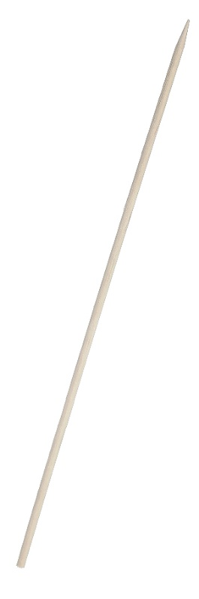
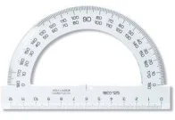
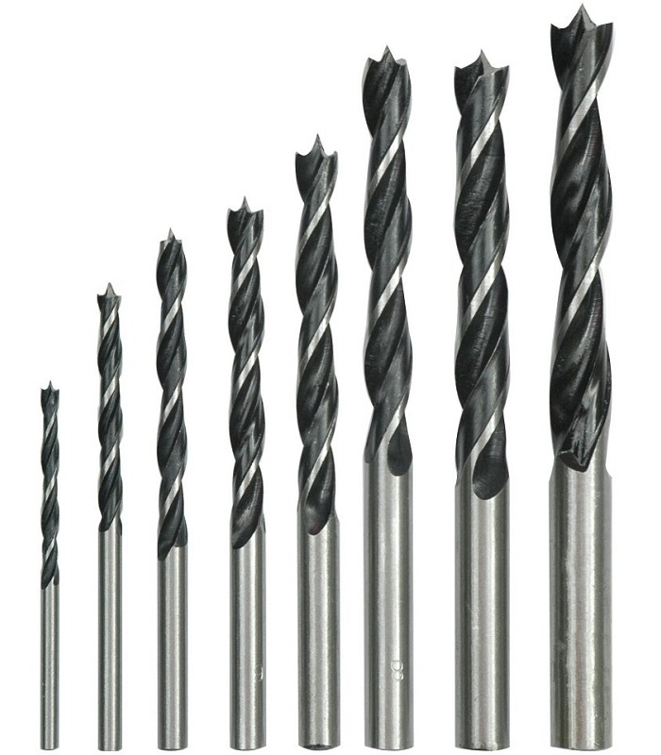
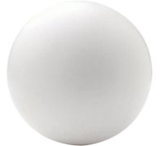


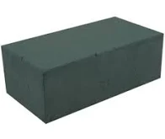
Practical activity: 5a.1.1 Making models of object of Solar system
2 cm
model
of Sun
borer to wood
same for models of Moon (inclination 2°), Mercury (0°), Venus (3°)
and Mars (25°)
23.5°
fix skewer in the ball
by melting gun
ball
for table tennis
skewer
model
of Earth
flower arranging material
(5 × 5) cm
The current publication reflects only the author´s view and neither the Slovak National Agency, nor the European Commission are responsible for any use that may be made of the information it contains.

Slide 16


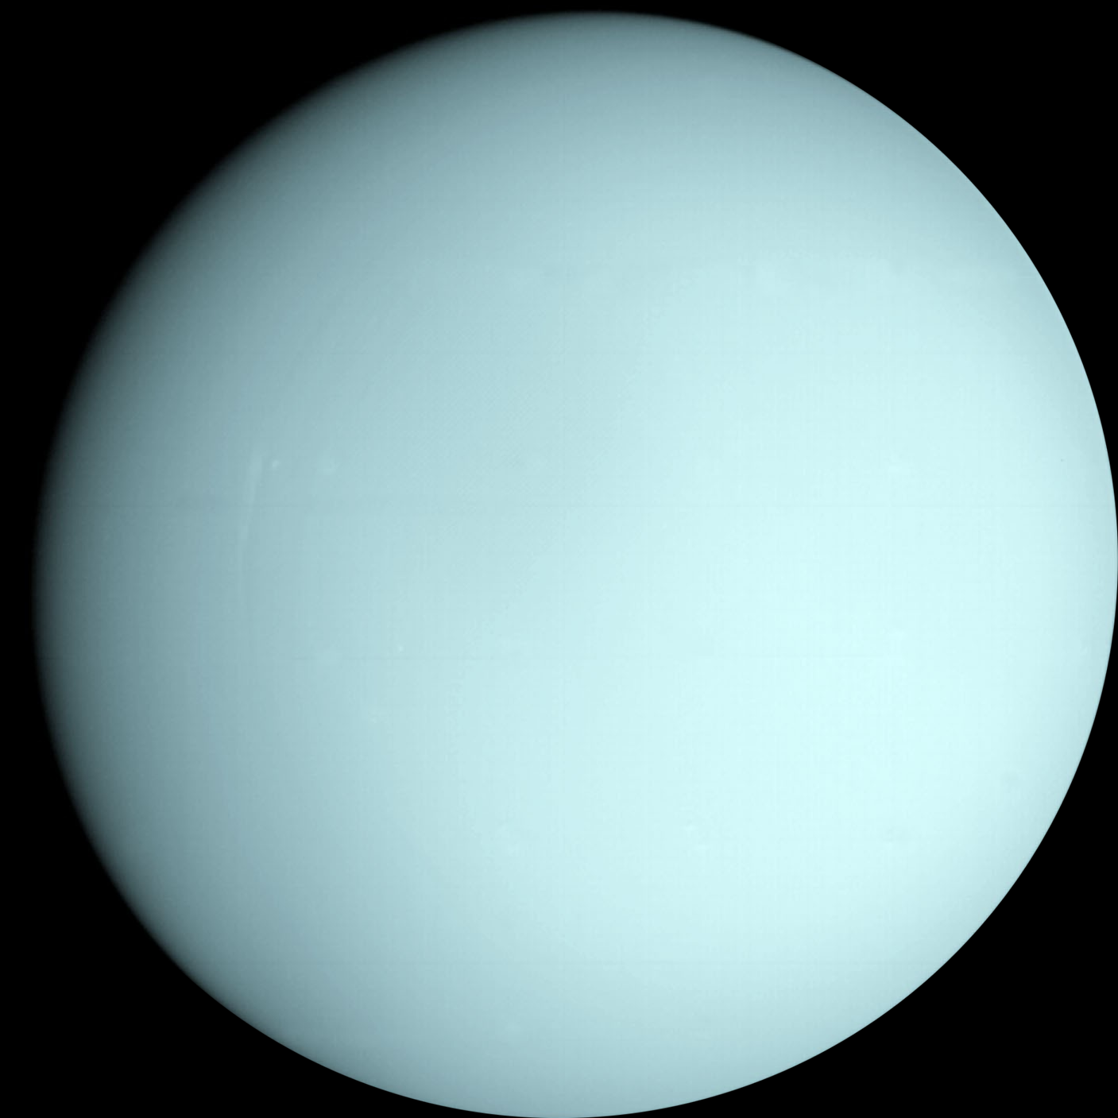






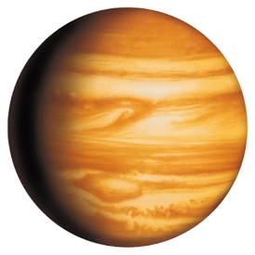
Practical activity: 5a.1.1 Making models of object of Solar system
model
of Saturn
Ø 4.7 cm
fix ring to planet model by melting gun
foil
ring
same for models of Jupiter (inclination 3°), Uranus (fixation on the right)
and Neptune (28°)
wire
27°
wire
Ø 2 cm
skewer
skewer
draw the shape of the rings on the cut out circle,
the rings begin at some distance from the surface of Saturn
model
of Uranus
flower arranging material
The current publication reflects only the author´s view and neither the Slovak National Agency, nor the European Commission are responsible for any use that may be made of the information it contains.

Slide 17
Practical activity: 5a.1.2 Model the motion of Earth around Sun
Methodical part: During the implementation it is necessary to pay attention to the correct direction of the Earth's rotation (from west to east), the correct position of the Earth's rotational axis (the axis does not change with respect to distant stars), the correct distance of the Earth from the Sun (closest in winter, farthest in summer, valid for northern hemisphere).
Material and tool: Models of the Sun and the Earth, or even the model of the Moon, a pin with a coloured round head, a strong light source, a calculator, charts
Procedure: Understanding the nature of alternating seasons; understanding the nature of the motion of bodies in the solar system; understanding the alternation of day and night.
The current publication reflects only the author´s view and neither the Slovak National Agency, nor the European Commission are responsible for any use that may be made of the information it contains.

Slide 18


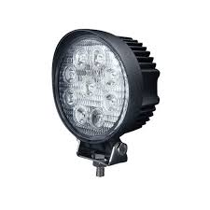
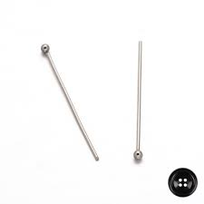
Practical activity: 5a.1.2 Model the motion of Earth around Sun
By rotating Earth demonstrate the alternation of day and night
                Find a place on Earth where day and night do not change.
                Compare the length of the night at the observer's location and at the equator.
Earth's motion along a circular trajectory
                The situation for the northern hemisphere to be summer, winter, spring.
Earth's motion along an elliptical trajectory
Movement even with the Moon
                Situation to make the full moon, new moon, first quarter, last quarter.
At which latitudes is the sun observed at least once a year to the south (i.e. as in our country)
models of Sun and Earth
pin to spot
Czech Republic
strong
light source
The current publication reflects only the author´s view and neither the Slovak National Agency, nor the European Commission are responsible for any use that may be made of the information it contains.

Slide 19
Practical activity: 5a.1.3 What are distances of planet from Sun?
Methodical part: During the implementation, it is necessary to pay attention to the correct scale when choosing the distances of the models of individual planets.
Material and tool: Model of Sun and planets, calculator, chart, chalk
Procedure: The pupil will learn to estimate the distances between planets.
The current publication reflects only the author´s view and neither the Slovak National Agency, nor the European Commission are responsible for any use that may be made of the information it contains.

Slide 20

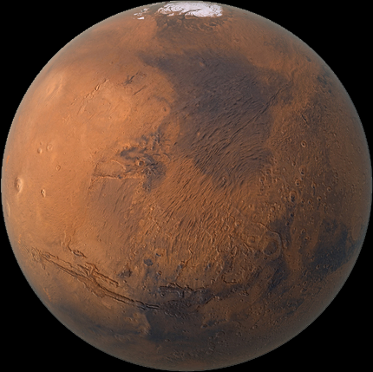
Practical activity: 5a.1.3 What are distances of planet from Sun?
place models of Mars, Jupiter, Saturn to the correct scale
place models of Mercury, Venus and Earth to correct scale
models of Sun and Earth
are touching
table
models of Sun and Mars on the edge of a table
The current publication reflects only the author´s view and neither the Slovak National Agency, nor the European Commission are responsible for any use that may be made of the information it contains.

Slide 21
Practical activity: 5a.1.4 Task V: Earth from Mars
Methodical part: The problem is focused on the mutual position of objects in the solar system, maximum elongation. The change from task II is that we are observing from Mars.
Material and tool: Calculator
Procedure: Pupil will use trigonometric functions and 3rd Kepler's law to calculate the angular distance of the Earth from the Sun when observing from Mars.
The current publication reflects only the author´s view and neither the Slovak National Agency, nor the European Commission are responsible for any use that may be made of the information it contains.

Slide 22
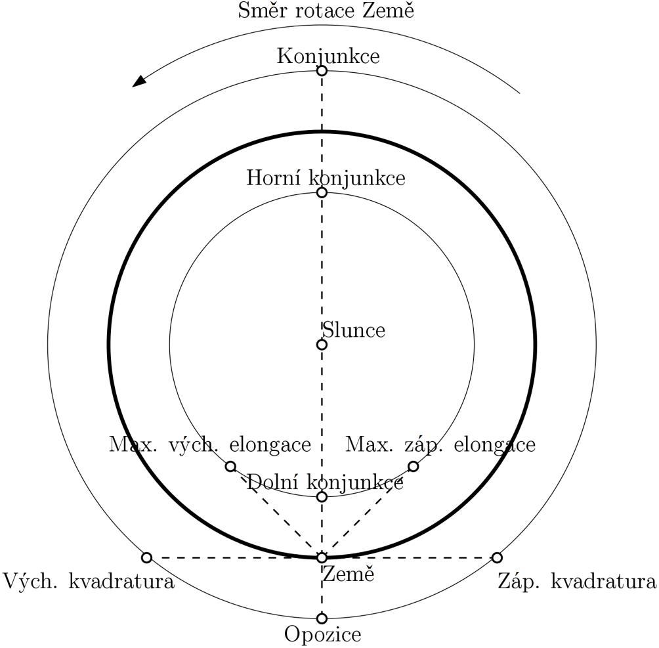
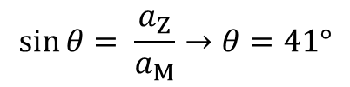
Practical activity: 5a.1.4 Task V: Earth from Mars
Direction of Earth‘s orbit
T_{M} = 687 days ~ 1.88 year
Sun
1.0 au
θ
maximum
elongation
1.52 au
$$\sin{θ}= \frac{a_{Z}}{a_{M}}→θ=41°$$
Earth
Mars
The current publication reflects only the author´s view and neither the Slovak National Agency, nor the European Commission are responsible for any use that may be made of the information it contains.

Slide 23
Practical activity: 5a.1.5 Task VI: How large is the Moon?
Methodical part: The task is focused on the calculation of various parameters of objects in the Solar system using trigonometric functions (usually they are not discussed in primary school, so it is an extension curriculum) and the 3rd Kepler's law.
Material and tool: Calculator
Procedure: Pupil will use trigonometric functions and 3rd Kepler's law to calculate the mass, angular size, actual size of objects in the Solar system.
The current publication reflects only the author´s view and neither the Slovak National Agency, nor the European Commission are responsible for any use that may be made of the information it contains.

Slide 24
Practical activity: 5a.1.5 Task VI: How large is the Moon?
angular size of the Sun for observers on Earth with knowledge of the Earth-Sun distance and the Sun's radius
→ use of an approximate relation for small angles, without trigonometric function, result is 32 arc minutes
the distance of Moon from Sun with knowledge of the mass of Earth and the orbital period the Moon around Earth
→ use of the 3rd Kepler's law in neglecting the mass of the Moon, result is 383 thousand km
estimate actual size of Moon with respect to a total solar eclipse (= the Moon has the same angular size as the Sun)
→ use of approximate relation for small angles, without trigonometric function, result is 1780 km
the angular size of the Earth for observers from the Moon; the area of the Earth visible from the Moon
→ use of approximate relation for small angles, without trigonometric function, result 1°55‘; spherical canopy area and comparison with sphere area, result 49%
The current publication reflects only the author´s view and neither the Slovak National Agency, nor the European Commission are responsible for any use that may be made of the information it contains.

Slide 25
Practical activity: 5a.1.6 What are the planets‘ size?
Methodical part: The task is to calculate the size of planet models to match the correct dimensions of the planets in the Solar system.
Material and tool: Model of Sun and planets, calculator, charts, chalk
Procedure: Understanding the dimensional diversity of the planets of the Solar system; gaining the competence to perceive size and distance conditions in the Solar system.
The current publication reflects only the author´s view and neither the Slovak National Agency, nor the European Commission are responsible for any use that may be made of the information it contains.

Slide 26
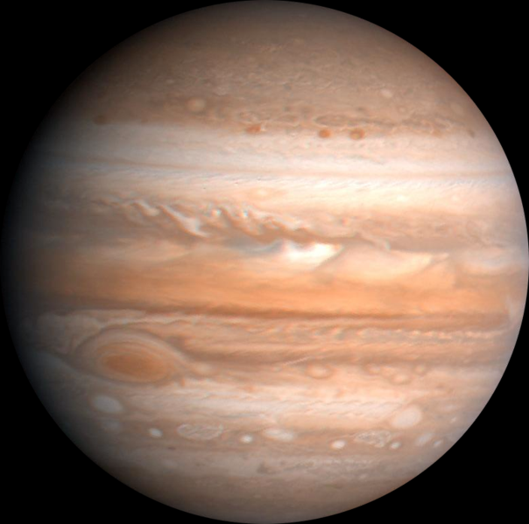
Practical activity: 5a.1.6 What are the planets‘ size?
How large would be the models of other planets and the Sun, how far from the Sun.
model of Jupiter
as a base
Object name | Size (Earth = 1) | Distance from Sun
Sun | 109× → 20 cm | -
Mercury | 0.38× → 0.7 mm | 0.4 au → 8 m
Venus | 0.95× → 1.7 mm | 0.7 au → 15 m
Earth | 1.0× → 1.8 mm | 1.0 au → 21 m
Mars | 0.53× → 1 mm | 1.5 au → 31 m
Jupiter | 11× → 20 mm | 5.2 au → 109 m
Saturn | 9.3× → 17 mm | 9.5 au → 199 m
Uranus | 4.0× → 7.3 mm | 20 au → 420 m
Neptune | 3.9× → 7.1 mm | 30 au → 629 m
size of model of Jupiter (20 mm)
real size of Jupiter (143 thousand km)
scale for distance 1 cm = 71 500 km
e.g. for Earth:
1 au = 150 mil. km
150 000 000 / 71 500 ~ 2 100 cm
The current publication reflects only the author´s view and neither the Slovak National Agency, nor the European Commission are responsible for any use that may be made of the information it contains.

Slide 27
Practical activity: 5a.2.1 Dwarf planet trajectory
Methodical part: The task is focused on the calculation of orbit of dwarf planets, the distance in aphelion and perihelion and the subsequent ordering of objects according to the distance from the Sun. The second part of the problem uses trigonometric functions.
Material and tool: Calculator, spreadsheet, encyclopaedia (internet)
Procedure: Pupils will be able to the calculate the distances in aphelion and perihelion and should conclude that the sum of the distances in aphelion and perihelion is equal to twice the size of the semi-major axis. The next part also includes the effect of inclination of the orbit.
The current publication reflects only the author´s view and neither the Slovak National Agency, nor the European Commission are responsible for any use that may be made of the information it contains.

Slide 28
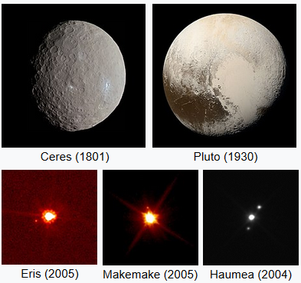
Practical activity: 5a.2.1 Dwarf planet trajectory
Distance in perihelion (for Ceres) r_{P} = a (1 – e) = 2.77 (1 – 0.0758) au = 2.56 au
Distance in aphelion (for Ceres) r_{A} = a (1 + e) = 2.77 (1 + 0.0758) au = 2.98 au
Order in perihelion: Ceres, Pluto, Haumea, Eris, Makemake
Order in aphelion: Ceres, Pluto, Haumea, Makemake, Eris
From this order, it is obvious that dwarf planet Eris gets closer to the Sun than dwarf planet Makemake, the difference 0.7 au roughly matches the distance of Venus from the Sun.
The current publication reflects only the author´s view and neither the Slovak National Agency, nor the European Commission are responsible for any use that may be made of the information it contains.

Slide 29
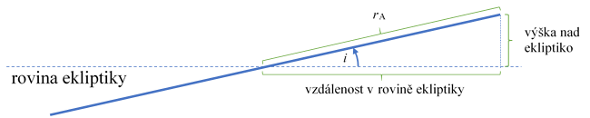
Practical activity: 5a.2.1 Dwarf planet trajectory
Distance in perihelion in ecliptic plane (for Ceres): a (1 – e) cos i = 2.77 (1 – 0.0758) cos 11° au = 2.51 au
Distance in aphelion in ecliptic plane (for Ceres): a (1 + e) cos i = 2.77 (1 + 0.0758) cos 11° au = 2.93 au
Distance from ecliptic in perihelion (for Ceres): a (1 – e) sin i = 2.77 (1 – 0.0758) sin 11° au = 0.49 au
Distance from ecliptic in aphelion (for Ceres): a (1 + e) sin i = 2.77 (1 + 0.0758) sin 11° au = 0.57 au
The current publication reflects only the author´s view and neither the Slovak National Agency, nor the European Commission are responsible for any use that may be made of the information it contains.

Slide 30
Practical activity: 5a.2.2 Dwarf planet‘s set
Methodical part: The problem is focused on working with a graph, deriving the equation of a graph and finding the intersection with the x-axis.
Material and tool: Calculator, graph paper or spreadsheet
Procedure: Pupils will get acquainted with the calculation of the dwarf planet‘s set. The height of the object above the horizon for several days in a row serves as a source of data.
The current publication reflects only the author´s view and neither the Slovak National Agency, nor the European Commission are responsible for any use that may be made of the information it contains.

Slide 31
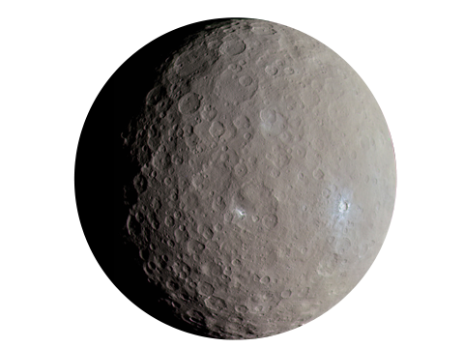
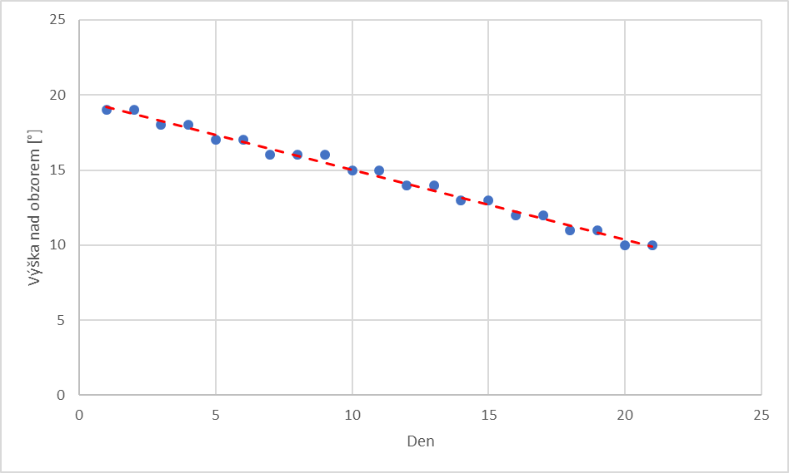
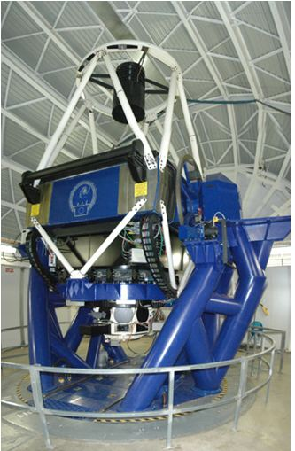
Practical activity: 5a.2.2 Dwarf planet‘s set
Ceres
Day | Height above horizon (°) | Day | Height above horizon (°)
1 | 19 | 12 | 14
2 | 19 | 13 | 14
3 | 18 | 14 | 13
4 | 18 | 15 | 13
5 | 17 | 16 | 12
6 | 17 | 17 | 12
7 | 16 | 18 | 11
8 | 16 | 19 | 11
9 | 16 | 20 | 10
10 | 15 | 21 | 10
11 | 15
y = −0.45 x + 19
1st and 21st day (20 days) = –9° → 9° / 20 = −0.45°
intersection with y-axis = 19
Ceres set → h = 0° → y = 0
0,45 x = 19
x = 42
Faulkes Telescope North
The current publication reflects only the author´s view and neither the Slovak National Agency, nor the European Commission are responsible for any use that may be made of the information it contains.

Slide 32
Practical activity: 5a.2.3 Model of trajectory
Methodical part: The dwarf planet Pluto is closer to the Sun in a small section of its trajectory than Neptune if we project its orbital trajectory into the plane of the ecliptic.
Material and tool: Scissors, sheet of paper, compass, protractor, pencil
Procedure: Pupils will be convinced on the model of the trajectories of Neptune and Pluto that Neptune and Pluto cannot collide.
The current publication reflects only the author´s view and neither the Slovak National Agency, nor the European Commission are responsible for any use that may be made of the information it contains.

Slide 33
Practical activity: 5a.2.3 Model of trajectory
19.2 cm
Ø 15 cm
insert both trajectories
into each other with green
gaps at an angle of 17 °
cut
ellipse
19.8 cm
ellipse
cut
cut
Sun
Pluto closer than Neptune
February 7, 1979 to February 11, 1999
orbital period of Pluto = 248 years
20 / 248 = 8 %
7 309 days
= 20 ∙ 365 + 5 (leap years –
1980, 1984, 1988, 1992 a 1996)
+ 4 (from 7th to 11th day of month)
19.8 cm
ellipse axis
orbit
of Pluto
orbit of Neptune
The current publication reflects only the author´s view and neither the Slovak National Agency, nor the European Commission are responsible for any use that may be made of the information it contains.

Slide 34
Practical activity: 5a.2.4 What is your weight
Methodical part: How much you weigh depends on the gravitational force where you are. It is necessary to realize that the mass does not change in different places, it always remains the same. Only the weight associated with the gravitational force changes. They cannot actually land on gaseous planets and the Sun because they do not have a solid surface.
Material and tool: Meter ruler, calculator, spreadsheet, graph paper
Procedure: Pupil will experience how the mass of the planet affects the high jump.
The current publication reflects only the author´s view and neither the Slovak National Agency, nor the European Commission are responsible for any use that may be made of the information it contains.

Slide 35

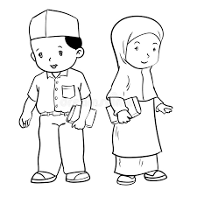

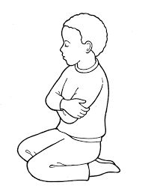
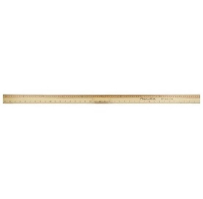
Practical activity: 5a.2.4 What is your weight
3× jump
How the height of the jump is affected by the mass of the Solar System object
group of three
Object | Mass of Solar system object (×10²³ kg) | Average jump height on Earth (cm) | Conversion factor for jump height | Jump height on object (cm)
Sun | 19 900 000 | 50 | ×0.036 | 1.8
Mercury | 3.3 | 50 | ×2.63 | 132
Venus | 48.7 | 50 | ×1.11 | 55.5
Earth | 59.7 | 50 | ×1 | 50
Moon | 0.73 | 50 | ×5.88 | 294
Mars | 6.42 | 50 | ×2.63 | 132
Ceres | 0.0094 | 50 | ×34.5 | 1730
Jupiter | 19 000 | 50 | ×0.40 | 20
Saturn | 5 680 | 50 | ×0.91 | 46
Uranus | 868 | 50 | ×1.11 | 55.5
Neptune | 1 020 | 50 | ×0.88 | 44
Pluto | 0.13 | 50 | ×16.7 | 835
rule
Calculation of the average height of the jump on Earth
Jump | Try #1 | Try #2 | Try #3 | Average jump
Height (cm) | 53 | 50 | 47 | 50
The current publication reflects only the author´s view and neither the Slovak National Agency, nor the European Commission are responsible for any use that may be made of the information it contains.

Slide 36
Practical activity: 5a.2.4 What is your weight
Order of Solar system objects according to mass
blue – mass of object ×10²³ kg
orange – jump height in cm
Solar system object | Jump height on object
Ceres | 1730
Pluto | 835
Moon | 294
Mercury | 132
Mars | 132
Venus | 55.5
Earth | 50
Uran | 55.5
Neptune | 44
Saturn | 46
Jupiter | 20
Sun | 1.8
log scale on vertical axis
The current publication reflects only the author´s view and neither the Slovak National Agency, nor the European Commission are responsible for any use that may be made of the information it contains.

Slide 37
Practical activity: 5a.3.1 Comet
Methodical part: Comets are usually objects with a elongated elliptical orbit, formed of ice and dust, and have a tail when approached the Sun.
Material and tool: Encyclopaedia, atlas or internet, calculator, spreadsheet
Procedure: Pupils draw individual parts of the comet.
The current publication reflects only the author´s view and neither the Slovak National Agency, nor the European Commission are responsible for any use that may be made of the information it contains.

Slide 38
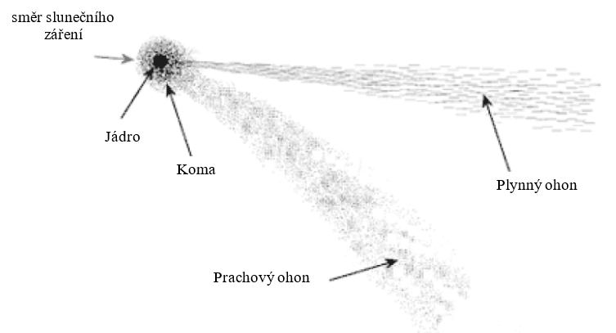
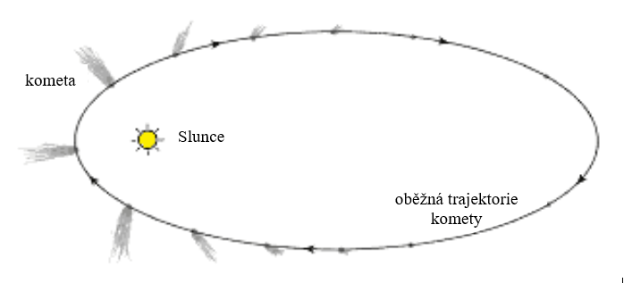
Practical activity: 5a.3.1 Comet
The comet's tail can never point towards the Sun because it is caused by the solar wind and the pressure of the sun's rays. If the comet moves away from the Sun, the tail will point in front of the comet, not fly behind the comet.
The comet's tail does not form until the comet approaches the Sun and gases and dust evaporate from its surface.
The current publication reflects only the author´s view and neither the Slovak National Agency, nor the European Commission are responsible for any use that may be made of the information it contains.

Slide 39
Practical activity: 5a.3.1 Comet
Comet | Minor planet
Found behind Pluto's orbit | Found between Mars and Jupiter
Made of ice and dust - "dirty" snowballs | Formed by rocks
Have a tail | Do not have a tail
Usually have an elliptical orbit (long-period – orbital period over 200 years - have an eccentricity higher than 0.85; short-period have an average eccentricity of 0.5) | Have a less eccentricity (98% of the numbered minor planets have an eccentricity of less than 0.3; 80% less than 0.2 and 30% less than 0.1)
The current publication reflects only the author´s view and neither the Slovak National Agency, nor the European Commission are responsible for any use that may be made of the information it contains.

Slide 40
Practical activity: 5a.3.2 Speed of minor planet
Methodical part: Minor planets are found in various areas of the Solar system, the most famous minor planets is between the orbits of Mars and Jupiter. Minor planets can have different designations, even after Czech personalities. The problem is more demanding on calculations, large numbers, power, square root, circle circumference, average speed.
Material and tool: Encyclopaedia, atlas or internet, calculator, spreadsheet
Procedure: Pupils practice unit transfers and 3rd Kepler's law.
The current publication reflects only the author´s view and neither the Slovak National Agency, nor the European Commission are responsible for any use that may be made of the information it contains.

Slide 41
Practical activity: 5a.3.2 Speed of minor planet
Minor planet with designation (5000) IAU is at distance 2.54 au from Sun.
Assume a circular orbit. What is its orbital period in seconds?
Using 3rd Kepler‘s law $a_{au}^{3}=T_{rok}^{2}$ we found T = 4.05 years = 1.28 ∙ 10⁸ s.
Estimate the speed of minor planet on circular orbit around the Sun.
Average speed v = s / T, trajectory is circumference of circle o = 2πr. Average speed is v = 18.7 km∙s^{–1}.
How would the orbital speed of minor planet change if it were at a distance of Jupiter?
Using 3rd Kepler‘s law orbital period is calculated, average speed would be 13.1 km∙s^{–1}.
The current publication reflects only the author´s view and neither the Slovak National Agency, nor the European Commission are responsible for any use that may be made of the information it contains.

Slide 42
Practical activity: 5a.3.3 Energy
Methodical part: The law of conservation of energy is valid, so when we do not consider losses, all potential energy is converted into kinetic energy. The impact of a 1 kilogram object on the Earth at a speed of 20 km∙s^{–1} will release energy that would be equal to heat 500 l of water from 0 °C to 95 °C.
Material and tool: Paper, computer, calculator
Procedure: Pupils will practice the law of conservation of energy, kinetic and potential energy.
The current publication reflects only the author´s view and neither the Slovak National Agency, nor the European Commission are responsible for any use that may be made of the information it contains.

Slide 43


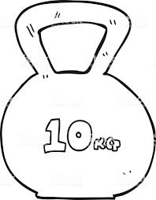

Practical activity: 5a.3.3 Energy
95 °C
E_{p} = mhg
v = 20 km⋅s⁻¹
10 kg
E_{k} = ½ mv²
500 l
m = 1 kg
0 °C
E_{p} = E_{k}
v = ?
E_{k} = ?
2 ∙ 10⁸ J
v = 1 140 km⋅h⁻¹
sped 3,5×
energy 12.5×
10 km
5 km
for v = 70 km⋅s⁻¹
→ E_{k} = 2.5∙ 10⁹ J
mass 2×
energy 2×
for m = 2 kg
→ E_{k} = 4 ∙ 10⁸ J
The current publication reflects only the author´s view and neither the Slovak National Agency, nor the European Commission are responsible for any use that may be made of the information it contains.

Slide 44
Practical activity: 5a.3.4 Impact crater
Methodical part: The activity is focused on measuring the dimensions of real impact craters on the Earth's surface using Mapy.cz or Google Maps.
Material and tool: Meter ruler, calculator, spreadsheet, graph paper
Procedure: Pupils work with a map, practice calculations of kinetic energy, volume, weight and density.
The current publication reflects only the author´s view and neither the Slovak National Agency, nor the European Commission are responsible for any use that may be made of the information it contains.

Slide 45
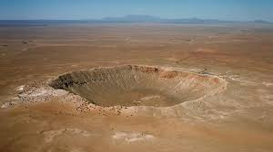
Practical activity: 5a.3.4 Impact crater
Name of Impact Crater | Latitude | Longitude | Size (km) | Area (km²) | State
Barringer‘s crater This crater was formed 50,000 years ago by the impact of an iron meteorite. | 35°02' N | 111°01' W | 1.2 | 1 | Arizona, USA
Manicouagan One of the largest preserved impact craters, it was formed more than 200 million years ago. | 51°23' N | 68°42' W | 69.3 | 3 200 | Canada
Clearwater Lakes These two impact craters were created by the impact of a pair of minor planets on the Earth's surface. | 56°13' N | 74°30' W | 32.4 and 22.1 | 730 and 360 | Canada
Chicxulub crater This impact crater is difficult to find. It was formed 66 million years ago by the impact of a meteorite of 10 km. The impact has released a lot of energy, climate change and the extinction of many species occurred. | 21°24' N | 89°31' W | More than 100 km | - | Mexico
Upheaval Dome This crater has all the features of a typical impact crater – central peak, inner crater and outer concentric impact rings. | 38°26' N | 109°54' W | 3.5 | 8 | Utah, USA
Gosses Bluff This impact crater was formed more than 140 million years ago by the impact of a 1 km minor planet. The central circle is not the edge of the crater, it lies much further. | 23°50' S | 132°19' E | 5.4 | 20 | Australia
Tenoumer There are two more around the crater, which are easy to find, the first is 166 km in azimuth 27°, the second 376 km in azimuth 219°. The crater was formed 20,000 years ago. | 22°55' N | 10°24' W | 1.9 | 3 | Mauretania
Vredefort A crater composed of several rings. Age 2 billion years. Meteorite with a size of 10 km. | 27°00' S | 27°30' E | 60 (inner ring) | 2 000 | Republic of South Africa
Barringer‘s crater at Arizona
The current publication reflects only the author´s view and neither the Slovak National Agency, nor the European Commission are responsible for any use that may be made of the information it contains.

Slide 46
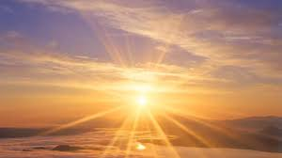
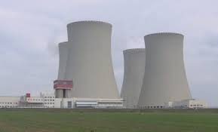
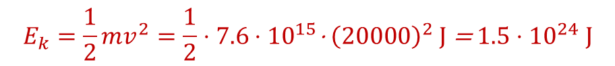
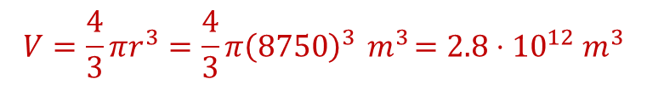
Practical activity: 5a.3.4 Impact crater
Chicxulub crater in Mexico
same energy emits by Sun over its entire surface
(in 0,004 s)
formed by the impact of a rocky body (density = 2 700 kg·m^{–3})
with a diameter 17.5 km
volume of the body (spherical), via formula for the volume of the sphere
$$V=\frac{4}{3}πr^{3}=\frac{4}{3}π{\left(8750\right)}^{3}{ m}^{3}=2.8⋅{10}^{12}{ m}^{3}$$
thermal energy of Temelín nuclear power plant at Czech Republic during continuous annual operation
(2 · 10¹⁷ J)
mass of the body, via formula with knowledge of volume and density
$$m=ρV=2700⋅2.8⋅{10}^{12} \text{kg}=7.6⋅{10}^{15} \text{kg}$$
kinetic energy released during impact with speed 20 km·s^{–1}
$$E_{k}=\frac{1}{2}mv^{2}=\frac{1}{2}⋅7.6⋅{10}^{15}\text{⋅ }{\left(20000\right)}^{2} \text{J} \text{= }1.5⋅{10}^{24} \text{J}$$
The current publication reflects only the author´s view and neither the Slovak National Agency, nor the European Commission are responsible for any use that may be made of the information it contains.

Slide 47
Practical activity: 5a.3.5 Gravitational force
Methodical part: The activity is focused on the calculation (estimation) of the gravitational force acting between two bodies of different masses and different distances.
Material and tool: Calculator, spreadsheet
Procedure: Pupils will practice calculations of gravitational force, sphere volume and unit conversions.
The current publication reflects only the author´s view and neither the Slovak National Agency, nor the European Commission are responsible for any use that may be made of the information it contains.

Slide 48




Practical activity: 5a.3.5 Gravitational force
Ø 0.2 m
Ø 0.2 m
Ø 20 m
Ø 20 m
Ø 0.1 m
Ø 10 km
ρ = 1300 kg∙m^{–3}
ρ = 1300 kg∙m^{–3}
ρ = 1300 kg∙m^{–3}
1 m
1 km
15 km
$$F_{g}=G\frac{m_{1}m_{2}}{r^{2}}$$
$$F_{g}=G\frac{m_{1}m_{2}}{r^{2}}$$
$$F_{g}=G\frac{m_{1}m_{2}}{r^{2}}$$
grains volume over sphere volume,
weight from density knowledge
grains volume over sphere volume,
weight from density knowledge
grains volume over sphere volume,
weight from density knowledge
F_{g} = 2.0 ∙ 10⁻⁹ N
F_{g} = 2.0 ∙ 10⁻³ N
F_{g} = 1.4 ∙ 10⁻⁴ N
The current publication reflects only the author´s view and neither the Slovak National Agency, nor the European Commission are responsible for any use that may be made of the information it contains.

Slide 49
Conclusions, results check 1
Feed Forward: Base your plans for the next lessons on the results of the pupils:
Difficulty of the lessons: depending on pupils comprehension of the material and level of completion of the activities.
Preparation: Clear and well appointed goals of the lesson and activities. When the goal is well understood, the attention towards a task/material is easier and more effective.
Approach toward the material: What would be the correct approach that would help the student comprehension and activity completion.
The current publication reflects only the author´s view and neither the Slovak National Agency, nor the European Commission are responsible for any use that may be made of the information it contains.
Notes:
DOI: 10.3102/003465430298487, The Power of Feedback, John Hattie and Helen Timperley, University of Auckland

Slide 50
Conclusions, results check 2
Self-evaluation: self-discipline, steering and control of the activities.
Individual approach: Individual approach and guidance.
Check: How did I do? Individual evaluation of the pupil’s work, pertaining to the specific activity and goal. Must contain information about the advance (or lack of) the pupil has made and to guide them to achieve the goals and standards.
The current publication reflects only the author´s view and neither the Slovak National Agency, nor the European Commission are responsible for any use that may be made of the information it contains.
Notes:
DOI: 10.3102/003465430298487, The Power of Feedback, John Hattie and Helen Timperley, University of Auckland

