Slide 1
Project: STARS (Successfully Teaching AstRonomy in Schools)
This project has been funded with the support of the Erasmus+ Programme, K2 Action, Strategic Partnerships in School Education.
Project Agreement Number: 2017-1-SK01-KA201-035344
Training programme for teachers (O2)
Module #5b
Solar system Solar and lunar eclipses
The current publication reflects only the author´s view and neither the Slovak National Agency, nor the European Commission are responsible for any use that may be made of the information it contains.

Slide 2
Project STARS introduction
1. STARS Methodological Handbook for Teachers
ready-to-use resource for teachers
2. STARS Training Program for Teachers
innovative and comprehensive approach
3. STARS Online Platform with examples of good practice and opportunities for discussions and exchange
4. STARS Concept for Astronomy Education Program
International Online Conference 2020
project-stars.com
The current publication reflects only the author´s view and neither the Slovak National Agency, nor the European Commission are responsible for any use that may be made of the information it contains.

Slide 3
Project STARS modules
#1 Constellations. #6 Galactic Neighbourhood.
#2 Motion of Celestial Bodies. #7 Sun and Stars.
#3 Newton's law of Gravitation. #8 Our Galaxy and other galaxies.
#4 Discovery of the Universe. #9 The Universe.
#5 Solar System. #10 Observatories.
The current publication reflects only the author´s view and neither the Slovak National Agency, nor the European Commission are responsible for any use that may be made of the information it contains.

Slide 4
Structure of the modules
There are several topics in each module.
Each topic contains:
A brief introduction and key words;
Theoretical part for the teacher - provides the basic information, necessary for the planning a lesson on that topic (and links to additional information in some cases).
Practical exercises and activities for the students - ready for use in the classroom (in most cases) and with answers provided where applicable.
The current publication reflects only the author´s view and neither the Slovak National Agency, nor the European Commission are responsible for any use that may be made of the information it contains.

Slide 5
How to work with the materials 1
Carefully read the theoretical part for the teacher.
Should questions arise, look for answers in the supplementary materials , on the project’s website (project-stars.com), or other internet sites. Attention! Make sure the information is reliable!
Prepare the theoretical part of your lesson.
The current publication reflects only the author´s view and neither the Slovak National Agency, nor the European Commission are responsible for any use that may be made of the information it contains.

Slide 6
How to work with the materials 2
Read carefully the practical exercises and their answers.
Should questions arise, look for answers in the supplementary materials , on the project’s website (project-stars.com), or other internet sites. Attention! Make sure the information is reliable!
Depending on the theoretical content of your lesson, choose appropriate practical activities to use. You can look for additional exercises in the supplementary materials or at the webpage of the project (project-stars.com), or other internet sites. Attention! Make sure the information is reliable!
The current publication reflects only the author´s view and neither the Slovak National Agency, nor the European Commission are responsible for any use that may be made of the information it contains.

Slide 7
How to work with the materials 3
Keep in mind that some of the activities require materials that should be available during the lesson.
We recommend you try out the activities yourself before presenting them in the classroom. Based on yours students ages and abilities, you might need to modify the activities (either to make them easier or more difficult). However make sure to keep them correct in terms of physics.
You can give parts of, or whole exercises as homework.
The current publication reflects only the author´s view and neither the Slovak National Agency, nor the European Commission are responsible for any use that may be made of the information it contains.

Slide 8
Моdule 5b – contents
5b.1 Eclipse
Lunar eclipse, solar eclipse.
The current publication reflects only the author´s view and neither the Slovak National Agency, nor the European Commission are responsible for any use that may be made of the information it contains.

Slide 9
Theoretical contents
5b.1 Eclipse
Lunar eclipse (basic information, types of eclipses, eclipse prediction, list of nearest eclipses);
solar eclipse (basic information, types of eclipses, phenomena observable during a total eclipse, eclipse prediction, list of nearest eclipses, eclipse observation and security).
The current publication reflects only the author´s view and neither the Slovak National Agency, nor the European Commission are responsible for any use that may be made of the information it contains.

Slide 10
List of Practical activities
5b.1.1 Demonstration of Lunar eclipse
5b.1.2 Lunar eclipse model in the field
5b.1.3 Types of Lunar eclipses – differences from Solar eclipses
5b.1.4 Demonstration of Solar eclipse
5b.1.5 Solar eclipse model in the field
5b.1.6 Apparent size of Sun and Moon in the sky – types of Solar eclipses
5b.1.7 Observation of Total solar eclipse from other planets
The current publication reflects only the author´s view and neither the Slovak National Agency, nor the European Commission are responsible for any use that may be made of the information it contains.

Slide 11
Practical activity: 5b.1.1 Demonstration of Lunar eclipse
Methodical part: The biggest issue is to ensure a suitable light source - flat, circular (min. 20 cm), directional, not very strong (approx. 30 W at a distance of 2.5 m). A room with black walls absorbing scattered and reflected light.
Material and tool: Weaker directional planar light source, 2 balls (volleyball + tennis ball or table tennis ball + gymnastic ball 15 cm)
Procedure: Pupils will understand the principle of a total and partial lunar eclipse. They remember the relative position of the bodies during a lunar eclipse.
The current publication reflects only the author´s view and neither the Slovak National Agency, nor the European Commission are responsible for any use that may be made of the information it contains.

Slide 12
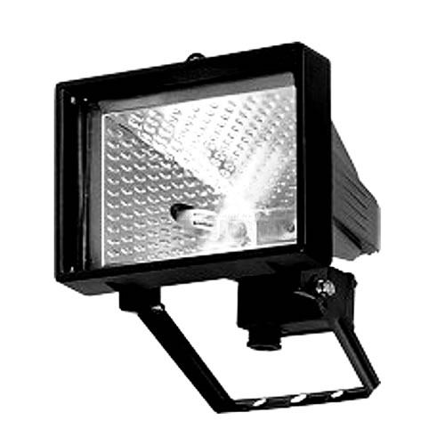
Practical activity: 5b.1.1 Demonstration of Lunar eclipse
the movement of the Moon
formation of full and partial
lunar eclipse
darkened room with black walls
~ 30 W
(4times smaller than Earth model)
model of Sun
reflector
model of Earth
volleyball ball
model of Moon
tennis ball
The current publication reflects only the author´s view and neither the Slovak National Agency, nor the European Commission are responsible for any use that may be made of the information it contains.

Slide 13
Practical activity: 5b.1.2 Lunar eclipse model in field
Methodical part: Make the preparation in advance in class or as a homework. Beware of converting units to the correct scale. Perform the demonstration on a flat and free surface. Small bodies (Moon and Earth) are held by pupils in their hands. The distance between the Earth and the Sun is just a step away. Pay attention to the correct order of bodies: Sun – Earth – Moon.
Material and tool: Gymnastic ball 70 cm, balls 6.5 mm and 1.8 mm
Procedure: Pupils realize the enormous vastness of interplanetary space and can imagine the mutual distance of bodies in relation to their dimensions.
The current publication reflects only the author´s view and neither the Slovak National Agency, nor the European Commission are responsible for any use that may be made of the information it contains.

Slide 14
Practical activity: 5b.1.2 Lunar eclipse model in field
Convert real values of diameters and distances to the correct scale to make a gymnastic ball with a diameter of 70 cm
corresponded to the Sun with a diameter of 1.4 million km
real values
model
Sun diameter 1,400,000 km
Earth diameter 13,000 km
Moon diameter 3,500 km
distance Earth from Sun 150,000,000 km
distance Moon from Earth 400,000 km
0.7 m
6.5 mm
1.75 mm
75 m
0.2 m
The current publication reflects only the author´s view and neither the Slovak National Agency, nor the European Commission are responsible for any use that may be made of the information it contains.

Slide 15
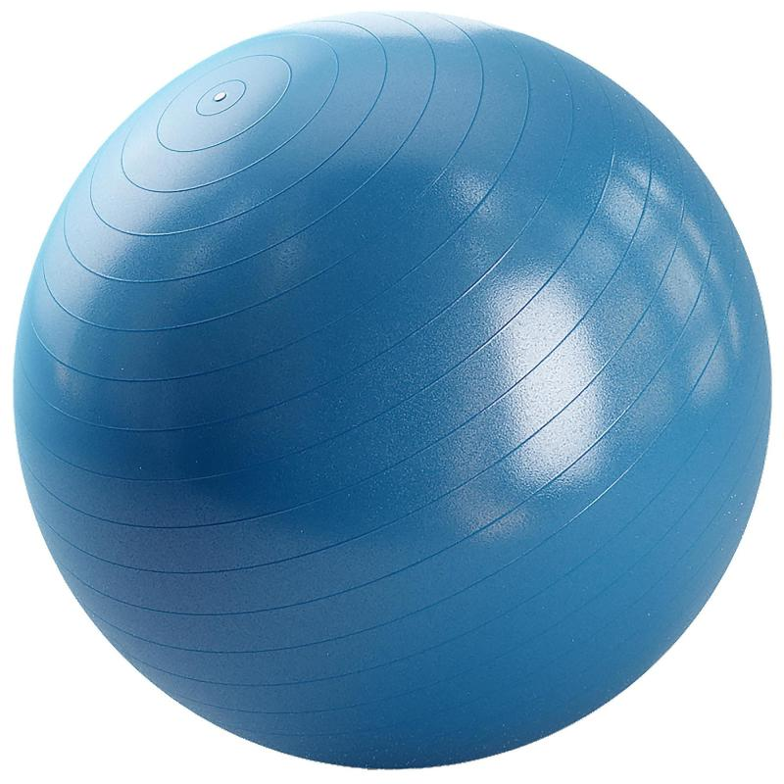
Practical activity: 5b.1.2 Lunar eclipse model in field
not to scale here
but pupils realize
in the field on a scale!
75 m
20 cm
determine approximately by steps
by ruler
model of Earth
bead, ball bearing,
airsoft ball, etc.
Ø 6.5 mm
model of Sun
gymnastic ball
Ø 70 cm
model of Moon
ball, pepper
Ø 1.8 mm
The current publication reflects only the author´s view and neither the Slovak National Agency, nor the European Commission are responsible for any use that may be made of the information it contains.

Slide 16
Practical activity: 5b.1.3 Types of Lunar eclipses – difference from Solar eclipses
Methodical part: When viewed from Earth, the disk of the Sun is approximately the same size as the disk of the Moon. Therefore, a total, annular and hybrid solar eclipse may occur. When the Moon is eclipsed, the situation is completely different. The shadow cast by the Earth into space is so great that the Moon will always fit in whole. A lunar eclipse is always observable from the entire Earth's hemisphere, where there is night.
The Moon also does not orbit the Earth in the same plane as the Earth around the Sun (= in the ecliptic plane). Therefore, a lunar eclipse will occur only if all three bodies exceptionally reach the same plane. If they orbited in the same plane constantly, the Moon would be eclipsed with each full moon.
The current publication reflects only the author´s view and neither the Slovak National Agency, nor the European Commission are responsible for any use that may be made of the information it contains.

Slide 17
Practical activity: 5b.1.3 Types of Lunar eclipses – difference from Solar eclipses
Material and tool: No
Procedure: Pupils will understand the fundamental difference between solar and lunar eclipses. They will also clarify the effect of the inclination of the plane of the Moon's orbit around the Earth relative to the plane of the ecliptic on the type of lunar eclipse.
The current publication reflects only the author´s view and neither the Slovak National Agency, nor the European Commission are responsible for any use that may be made of the information it contains.

Slide 18
Practical activity: 5b.1.3 Types of Lunar eclipses – difference from Solar eclipses
$$α=\frac{D_{S}}{r_{Z}+x}$$
$$\frac{D_{S}}{r_{Z}+x}=\frac{D_{Z}}{x}$$
conical shadow of the Earth
Under what conditions could an annular lunar eclipse occur?
x = 1.4 mil. km
cut-off diameter of Moon D_{M}
$$\frac{D_{Z}}{x}=\frac{D_{M}}{x−r_{M}}$$
D_{M} = 9 500 km
3times bigger
cut-off distance of Moon r_{M}
$$\frac{D_{Z}}{x}=\frac{D_{M}}{x−r_{M}}$$
r_{M} = 10⁶ km
2.6times farther
The current publication reflects only the author´s view and neither the Slovak National Agency, nor the European Commission are responsible for any use that may be made of the information it contains.

Slide 19
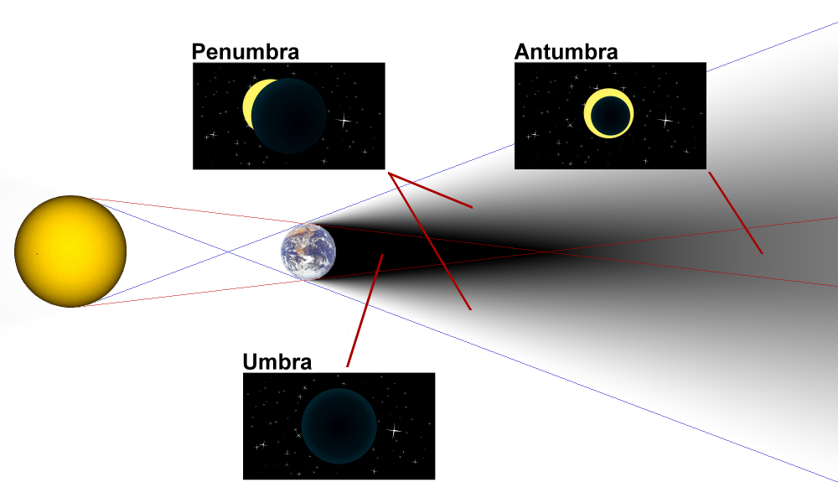
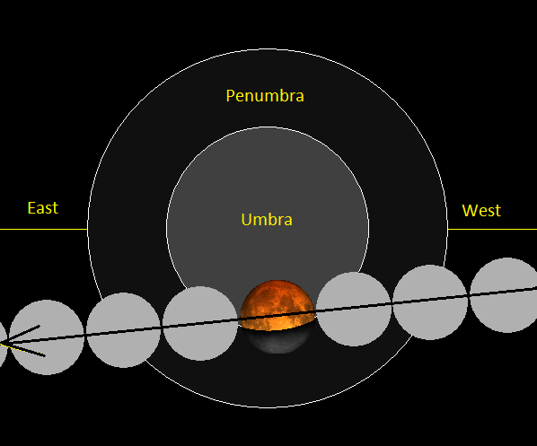
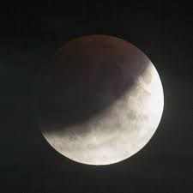
Practical activity: 5b.1.3 Types of Lunar eclipses – difference from Solar eclipses
partial lunar eclipse
The current publication reflects only the author´s view and neither the Slovak National Agency, nor the European Commission are responsible for any use that may be made of the information it contains.

Slide 20
Practical activity: 5b.1.4 Demonstration of Solar Eclipse
Methodical part: The biggest issue is to ensure a suitable light source - flat, circular (min. 20 cm), directional, not very strong (approx. 30 W at a distance of 2.5 m). A room with black walls absorbing scattered and reflected light.
Material and tool: Weaker directional planar light source, 2 balls (volleyball + tennis ball or table tennis ball + gymnastic ball 15 cm)
Procedure: Pupils will understand the principle of solar eclipses and areas of full shadow and partial shadow. They remember the relative position of the bodies during a solar eclipse.
The current publication reflects only the author´s view and neither the Slovak National Agency, nor the European Commission are responsible for any use that may be made of the information it contains.

Slide 21
Practical activity: 5b.1.4 Demonstration of Solar Eclipse
darkened room with black walls
the movement of the Moon
formation of full and partial
solar eclipse
~ 30 W
(4times smaller than Earth model)
model of Sun
reflector
model of Moon
tennis ball
model of Earth
volleyball ball
The current publication reflects only the author´s view and neither the Slovak National Agency, nor the European Commission are responsible for any use that may be made of the information it contains.

Slide 22
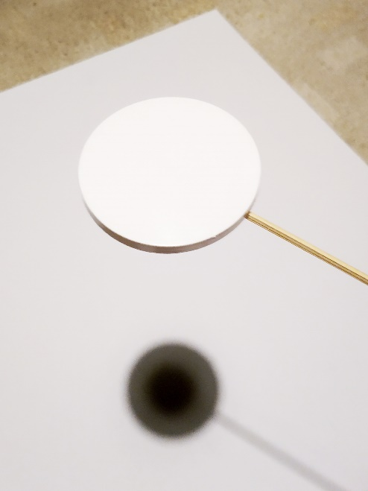
Practical activity: 5b.1.4 Demonstration of Solar Eclipse
If suitable spherical body models are not available, the shadow and half-shadow can be projected on a flat surface using a circular shade, see the figure beside the text. The shadow and half-shadow areas are still clearly visible, but the model already partially loses the impression of reality.
The current publication reflects only the author´s view and neither the Slovak National Agency, nor the European Commission are responsible for any use that may be made of the information it contains.

Slide 23
Practical activity: 5b.1.5 Solar eclipse model in the field
Methodical part: Make the preparation in advance in class or as a homework. Beware of converting units to the correct scale. Perform the demonstration on a flat and free surface. Small bodies (Moon and Earth) are held by pupils in their hands. The distance between the Earth and the Sun is just a step away. Pay attention to the correct order of bodies: Sun – Moon – Earth.
Material and tool: Gymnastic ball 70 cm, balls 6.5 mm a 1.8 mm
Procedure: Pupils realize the enormous vastness of interplanetary space and can imagine the mutual distance of bodies in relation to their dimensions.
The current publication reflects only the author´s view and neither the Slovak National Agency, nor the European Commission are responsible for any use that may be made of the information it contains.

Slide 24
Practical activity: 5b.1.5 Solar eclipse model in the field
Convert real values of diameters and distances to the correct scale to make a gymnastic ball with a diameter of 70 cm
corresponded to the Sun with a diameter of 1.4 million km
real values
model
Sun diameter 1,400,000 km
Earth diameter 13,000 km
Moon diameter 3,500 km
distance Earth from Sun 150,000,000 km
distance Moon from Earth 400,000 km
0.7 m
6.5 mm
1.75 mm
75 m
0.2 m
The current publication reflects only the author´s view and neither the Slovak National Agency, nor the European Commission are responsible for any use that may be made of the information it contains.

Slide 25
Practical activity: 5b.1.5 Solar eclipse model in the field
not to scale here
but pupils realize
in the field on a scale!
75 m
20 cm
determine approximately by steps
by ruler
model of Earth
bead, ball bearing,
airsoft ball, etc.
Ø 6.5 mm
model of Sun
gymnastic ball
Ø 70 cm
model of Moon
ball, pepper
Ø 1.8 mm
The current publication reflects only the author´s view and neither the Slovak National Agency, nor the European Commission are responsible for any use that may be made of the information it contains.

Slide 26
Practical activity: 5b.1.6 Apparent size of the Sun and Moon in the sky – types of Solar eclipse
Methodical part: The distance of the Moon from the Earth fluctuates as it orbits on an elliptical trajectory by 11%, the distance of Earth from Sun by less than 3.5%. Larger changes in size or distance will affect types of solar eclipses.
Material and tool: No
Procedure: Pupils will understand the differences between different types of solar eclipses. They will further consolidate the idea of the mutual position of bodies during eclipses and clarify the effect of the inclination of the plane of the Moon's orbit around the Earth relative to the plane of the ecliptic.
The current publication reflects only the author´s view and neither the Slovak National Agency, nor the European Commission are responsible for any use that may be made of the information it contains.

Slide 27
Practical activity: 5b.1.6 Apparent size of the Sun and Moon in the sky – types of Solar eclipse
Both the Sun and the Moon are as big as they really are, but the Moon orbits closer to the Earth. What types of eclipses could occur (total, annular, hybrid, partial)? Would solar eclipses be more frequent or rarer than they actually are?
The Moon orbits closer, its shadow has a larger angular size than the Sun. A total eclipse MAY occur, but an annular or hybrid eclipse CANNOT occur. Because the shadow is larger, eclipses will occur more often. (The inclination of the plane of the Moon's orbit around the Earth relative to the ecliptic plane remains the same, the angular size of the Sun remains the same, the angular size of the Moon is larger.)
The current publication reflects only the author´s view and neither the Slovak National Agency, nor the European Commission are responsible for any use that may be made of the information it contains.

Slide 28
Practical activity: 5b.1.6 Apparent size of the Sun and Moon in the sky – types of Solar eclipse
Both the Sun and the Moon are as big as they really are, but the Moon orbits further from the Earth. What types of eclipses could occur (total, annular, hybrid, partial)? Would solar eclipses be more frequent or rarer than they actually are?
The Moon orbits further away, its shadow has a smaller angular size than the Sun. There CANNOT be total or hybrid eclipse, ONLY annular one. Because the shadow is smaller, eclipses will occur less often. (The inclination of the plane of the Moon's orbit around the Earth relative to the ecliptic plane remains the same, the angular size of the Sun remains the same, the angular size of the Moon is smaller.)
The current publication reflects only the author´s view and neither the Slovak National Agency, nor the European Commission are responsible for any use that may be made of the information it contains.

Slide 29
Practical activity: 5b.1.6 Apparent size of the Sun and Moon in the sky – types of Solar eclipse
Both the Sun and the Moon are as big as they really are, but the Earth orbits closer to the Sun. What types of eclipses could occur (total, annular, hybrid, partial)? Would solar eclipses be more frequent or rarer than they actually are?
The Sun is closer to the Earth, its angular size in the sky is larger than that of the Moon. There CANNOT be total or hybrid eclipse, ONLY annular one. Because the Sun has a larger angular size and the Moon is still moving in the same belt defined by the inclination of its plane of orbit to the ecliptic plane, the Moon is more likely to get in front of the Sun and eclipses would be more frequent. In that regard, the reasoning is fundamentally different from point b), although the first impression leads to the conclusion that situations b) and c) are, in the end, identical.
The current publication reflects only the author´s view and neither the Slovak National Agency, nor the European Commission are responsible for any use that may be made of the information it contains.

Slide 30
Practical activity: 5b.1.6 Apparent size of the Sun and Moon in the sky – types of Solar eclipse
Both the Sun and the Moon are as big as they really are, but the Earth orbits further from the Sun. What types of eclipses could occur (total, annular, hybrid, partial)? Would solar eclipses be more frequent or rarer than they actually are?
The Sun is further from the Earth, its angular size in the sky is smaller than that of the Moon. A total eclipse MAY occur, but an annular or hybrid eclipse CANNOT occur. Eclipses will be less frequent. Because the Sun has a smaller angular size and the Moon is still moving in the same belt defined by the inclination of its plane of orbit to the ecliptic plane, the Moon is less likely to get in front of the Sun and eclipses would be less frequent. In that regard, the reasoning is fundamentally different from point a), although the first impression leads to the conclusion that situations a) and d) are, in the end, identical.
The current publication reflects only the author´s view and neither the Slovak National Agency, nor the European Commission are responsible for any use that may be made of the information it contains.

Slide 31
Practical activity: 5b.1.6 Apparent size of the Sun and Moon in the sky – types of Solar eclipse
In fact, the Moon is slowly moving away from the Earth. Which of the situations a) to d) describes this? What will be the gradual development of the occurrence of individual types of eclipses?
In the future, the situation described in point b) will gradually occur. Gradually, in particular, total eclipses will decrease until they cease to exist completely. Hybrid eclipses will be rarer, in the limited case they can only occur if the bodies are exactly in one line. Annular eclipses will occur continuously, but the shape of the ring may gradually become more asymmetric.
The current publication reflects only the author´s view and neither the Slovak National Agency, nor the European Commission are responsible for any use that may be made of the information it contains.

Slide 32
Practical activity: 5b.1.7 Observation of a total solar eclipse from other planets
Methodical part: Pupils must have acquired basic knowledge of planets. Some situations can be estimated, for others it is necessary to calculate, compare the angular size of Sun and the body that could cover the solar disk.
Material and tool: Pages with characteristics of planets and their moons
Procedure: Pupils will deepen their idea of the mechanism of the solar eclipse and emphasize the necessary condition for a total eclipse. They will also remember information about planets and their moons.
The current publication reflects only the author´s view and neither the Slovak National Agency, nor the European Commission are responsible for any use that may be made of the information it contains.

Slide 33
Practical activity: 5b.1.7 Observation of a total solar eclipse from other planets
Mercury: The planet has no moon and is closest to the Sun. There is no body that could cause a total solar eclipse observable from the surface of Mercury. NO (trivial)
Venus: The planet has no moon. The only body that can be located between Venus and the Sun is Mercury. When observed from Venus, the angular size of Mercury is certainly smaller than the angular size of the Sun. (Verification by calculation – diameter of the Sun: 1.4·10⁶ km, distance of the Sun: 108·10⁶ km, angular size 0.013 rad; diameter of Mercury: 5·10³ km, minimum distance of Mercury: 50·10⁶ km (half-axis difference), angular size 0.000 1 rad → the Sun is not covered.) There is no body that could cause a total solar eclipse observable from the surface of Venus. NO (standard)
The current publication reflects only the author´s view and neither the Slovak National Agency, nor the European Commission are responsible for any use that may be made of the information it contains.

Slide 34
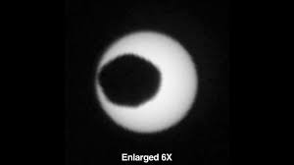
Practical activity: 5b.1.7 Observation of a total solar eclipse from other planets
Mars: The planet has two miniature moons – Phobos and Deimos, and it is necessary to consider the eclipse of the Sun by the Earth. The assumption is that neither body is large enough to cause a total solar eclipse on the surface of Mars. If the Sun does not cover the Earth, it is no longer necessary to consider the inner planets of Venus and Mercury, because they are smaller and further away. (Verification by calculation – diameter of the Sun: 1.4·10⁶ km, distance of the Sun 228·10⁶ km, angular size 0.0061 rad; Phobos diameter 10 km, distance from the surface of Mars 6,000 km (the radius of the orbit minus the radius of Mars), angular size 0.0017 rad → the Sun is not covered; Deimos is smaller and further away → does not cover as well; Earth diameter 13 000 km, minimum distance from Mars 54.5·10⁶ km, angular size 0.00024 rad → the Sun is not covered.) There is no body that could cause a total solar eclipse observable from the surface of Mars. NO (difficult)
The current publication reflects only the author´s view and neither the Slovak National Agency, nor the European Commission are responsible for any use that may be made of the information it contains.

Slide 35
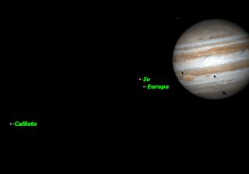
Practical activity: 5b.1.7 Observation of a total solar eclipse from other planets
Jupiter: The planet has many large moons and is far from the Sun, which already appears very small. Complete eclipses of the Sun may occur caused by the moons of Jupiter. (Verification by calculation for the inner moon Io – diameter of the Sun: 1.4·10⁶ km, distance of the Sun 779·10⁶ km, angular size 0.001 8 rad; Io diameter 3 600 km, distance from the surface of Jupiter 352 000 km (the radius of the orbit minus the radius of Jupiter), angular size 0.01 rad -> the Sun is covered.) A total solar eclipse can occur on the surface of Jupiter. YES (standard)
The current publication reflects only the author´s view and neither the Slovak National Agency, nor the European Commission are responsible for any use that may be made of the information it contains.

Slide 36
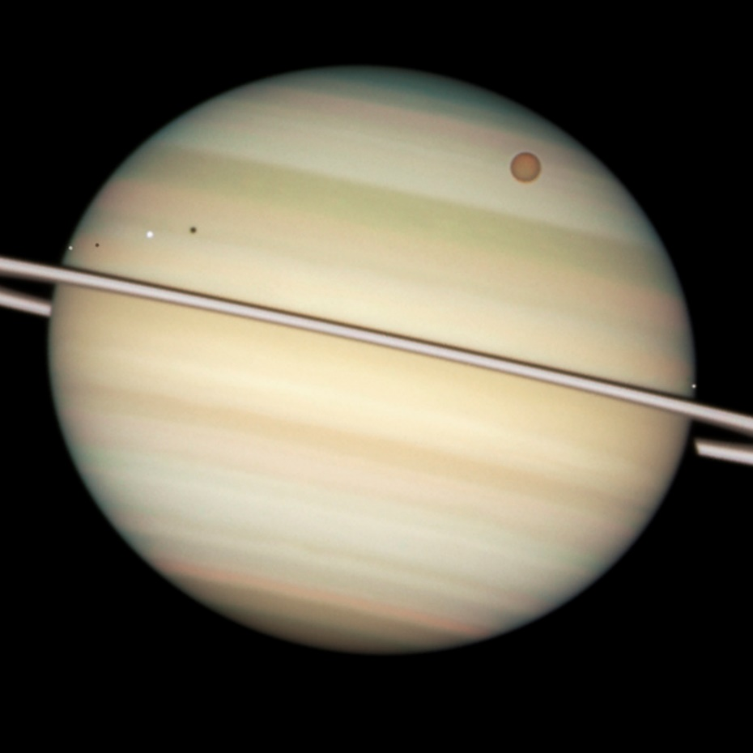
Practical activity: 5b.1.7 Observation of a total solar eclipse from other planets
Saturn: The planet has many large moons and is far from the Sun, which already appears very small. Complete eclipses of the Sun may occur caused by the moons of Saturn. (Verification by calculation for the biggest moon Titan – diameter of the Sun: 1.4·10⁶ km, distance of the Sun 1.43·10⁹ km, angular size 0.000 98 rad; Titan diameter 5 100 km, distance from the surface of Saturn 1.16·10⁶ km (the radius of the orbit minus the radius of Saturn), angular size 0.004 4 rad → the Sun is covered.) A total solar eclipse can occur on the surface of Saturn. YES (standard)
The current publication reflects only the author´s view and neither the Slovak National Agency, nor the European Commission are responsible for any use that may be made of the information it contains.

Slide 37
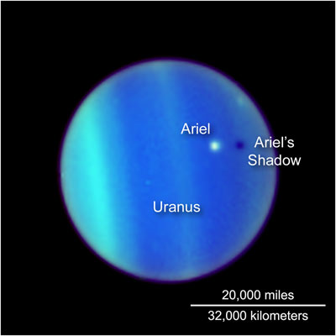
Practical activity: 5b.1.7 Observation of a total solar eclipse from other planets
Uranus: It is many times farther from the Sun than Saturn and has large moons at a short distance. The angular size of the moons is larger than the angular size of the Sun. (Can be supplemented by calculation, see above.) A total solar eclipse can occur on the surface of Uranus. YES (trivial based on previous ones)
Neptune: It is even further from the Sun than Uranus and has the great moon Triton at a short distance. The angular size of Triton is larger than the angular size of the Sun. (Can be supplemented by calculation, see above.) A total solar eclipse can occur on the surface of Neptune. YES (trivial based on previous ones)
The current publication reflects only the author´s view and neither the Slovak National Agency, nor the European Commission are responsible for any use that may be made of the information it contains.

Slide 38
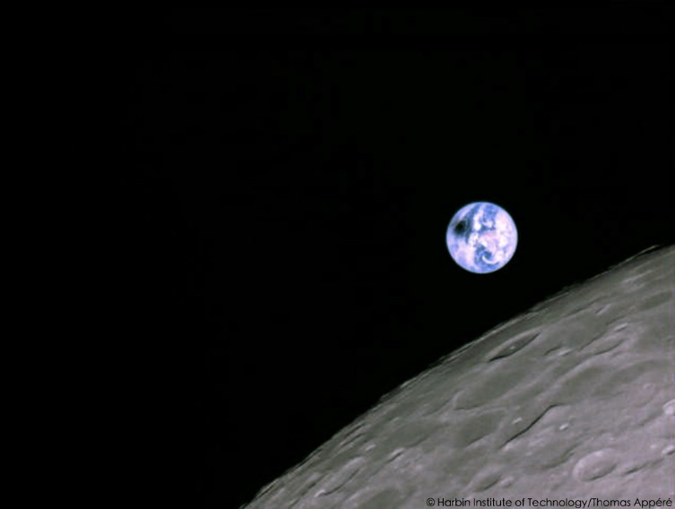
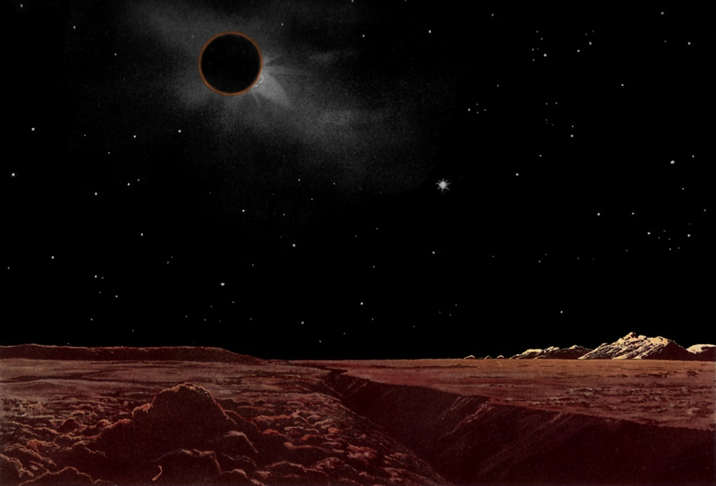
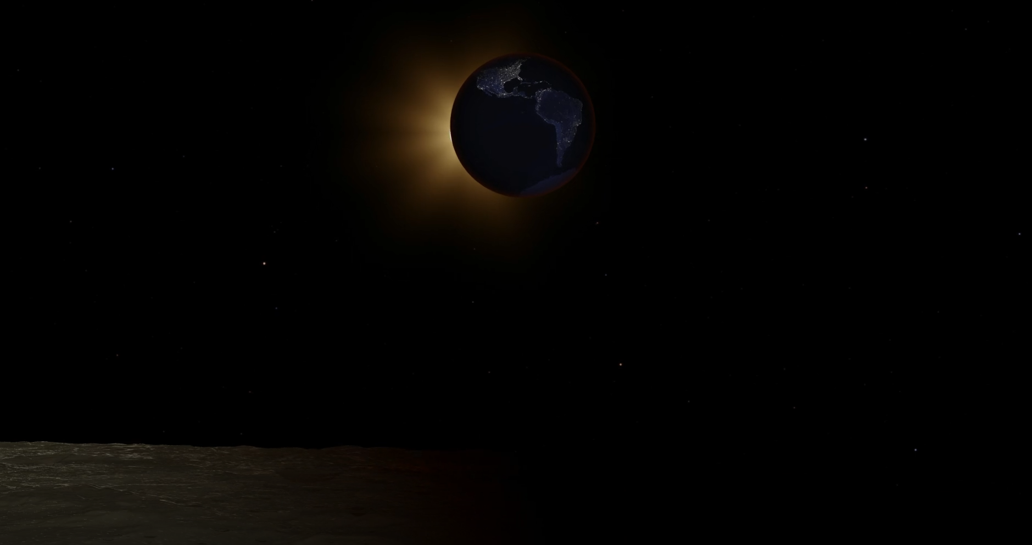
Practical activity: 5b.1.7 Observation of a total solar eclipse from other planets
Is a total solar eclipse observed from the moon's surface?
The current publication reflects only the author´s view and neither the Slovak National Agency, nor the European Commission are responsible for any use that may be made of the information it contains.

Slide 39
Conclusions, results check 1
Feed Forward: Base your plans for the next lessons on the results of the pupils:
Difficulty of the lessons: depending on pupils comprehension of the material and level of completion of the activities.
Preparation: Clear and well appointed goals of the lesson and activities. When the goal is well understood, the attention towards a task/material is easier and more effective.
Approach toward the material: What would be the correct approach that would help the student comprehension and activity completion.
The current publication reflects only the author´s view and neither the Slovak National Agency, nor the European Commission are responsible for any use that may be made of the information it contains.
Notes:
DOI: 10.3102/003465430298487, The Power of Feedback, John Hattie and Helen Timperley, University of Auckland

Slide 40
Conclusions, results check 2
Self-evaluation: self-discipline, steering and control of the activities.
Individual approach: Individual approach and guidance.
Check: How did I do? Individual evaluation of the pupil’s work, pertaining to the specific activity and goal. Must contain information about the advance (or lack of) the pupil has made and to guide them to achieve the goals and standards.
The current publication reflects only the author´s view and neither the Slovak National Agency, nor the European Commission are responsible for any use that may be made of the information it contains.
Notes:
DOI: 10.3102/003465430298487, The Power of Feedback, John Hattie and Helen Timperley, University of Auckland

