Slide 1


Project: STARS (Successfully Teaching AstRonomy in Schools)
This project has been funded with the support of the Erasmus+ Programme, K2 Action, Strategic Partnerships in School Education.
Project Agreement Number: 2017-1-SK01-KA201-035344
Training programme for teachers (O2)
Module #6
Exoplanets
Habitable zone, transit photometry
The current publication reflects only the author´s view and neither the Slovak National Agency, nor the European Commission are responsible for any use that may be made of the information it contains.

Slide 2
Project STARS introduction
1. STARS Methodological Handbook for Teachers
ready-to-use resource for teachers
2. STARS Training Program
for Teachers
innovative and comprehensive approach
3. STARS Online Platform
with examples of good practice and opportunities for discussions and exchange
4. STARS Concept for Astronomy Education Program
International Online Conference 2020
project-stars.com
The current publication reflects only the author´s view and neither the Slovak National Agency, nor the European Commission are responsible for any use that may be made of the information it contains.

Slide 3
Project STARS modules
#1 Constellations. #6 Galactic Neighbourhood.
#2 Motion of Celestial Bodies. #7 Sun and Stars.
#3 Newton's law of Gravitation. #8 Our Galaxy and other galaxies.
#4 Discovery of the Universe. #9 The Universe.
#5 Solar System. #10 Observatories.
The current publication reflects only the author´s view and neither the Slovak National Agency, nor the European Commission are responsible for any use that may be made of the information it contains.

Slide 4
Structure of the modules
There are several topics in each module.
Each topic contains:
A brief introduction and key words;
Theoretical part for the teacher - provides the basic information, necessary for the planning
a lesson on that topic (and links to additional information in some cases).
Practical exercises and activities for the students - ready for use in the classroom (in most cases) and with answers provided where applicable.
The current publication reflects only the author´s view and neither the Slovak National Agency, nor the European Commission are responsible for any use that may be made of the information it contains.

Slide 5
How to work with the materials 1
Carefully read the theoretical part for the teacher.
Should questions arise, look for answers in the supplementary materials , on the project’s website (project-stars.com), or other internet sites.
Attention! Make sure the information is reliable!
Prepare the theoretical part of your lesson.
The current publication reflects only the author´s view and neither the Slovak National Agency, nor the European Commission are responsible for any use that may be made of the information it contains.

Slide 6
How to work with the materials 2
Read carefully the practical exercises and their answers.
Should questions arise, look for answers in the supplementary materials , on the project’s website (project-stars.com), or other internet sites.
Attention! Make sure the information is reliable!
Depending on the theoretical content of your lesson, choose appropriate practical activities to use. You can look for additional exercises in the supplementary materials or at the webpage of the project (project-stars.com), or other internet sites.
Attention! Make sure the information is reliable!
The current publication reflects only the author´s view and neither the Slovak National Agency, nor the European Commission are responsible for any use that may be made of the information it contains.

Slide 7
How to work with the materials 3
Keep in mind that some of the activities require materials that should be available during the lesson.
We recommend you try out the activities yourself before presenting them in the classroom. Based on yours students ages and abilities, you might need to modify the activities (either to make them easier or more difficult). However make sure to keep them correct in terms of physics.
You can give parts of, or whole exercises as homework.
The current publication reflects only the author´s view and neither the Slovak National Agency, nor the European Commission are responsible for any use that may be made of the information it contains.

Slide 8
Моdule 6 – contents
6.1 Exoplanets
  Habitable zone, transit photometry.
The current publication reflects only the author´s view and neither the Slovak National Agency, nor the European Commission are responsible for any use that may be made of the information it contains.

Slide 9
Theoretical contents
6.1 Exoplanets
  Exoplanet designation;
  history of discovery;
  detection methods (radial velocity, transit photometry).
The current publication reflects only the author´s view and neither the Slovak National Agency, nor the European Commission are responsible for any use that may be made of the information it contains.

Slide 10
List of practical activities
6.1.1 Habitable zone
6.2.1 Transit photometry
The current publication reflects only the author´s view and neither the Slovak National Agency, nor the European Commission are responsible for any use that may be made of the information it contains.

Slide 11
Practical activity: 6.1.1 Habitable zone
Methodical part: Pupils will understand that there are places with high and low temperatures around the parent star, including areas (habitable zone), where the surface of exoplanet is suitable for keeping water in a liquid state.
Material and tool: Radiant heat source, two thermometers (one with a blackened bulb, one with a shiny bulb), laboratory stand with clamps, meter rule, graph paper
Procedure: Pupils study the change in the surface temperature of the exoplanet with the change in distance from the parent star.
The current publication reflects only the author´s view and neither the Slovak National Agency, nor the European Commission are responsible for any use that may be made of the information it contains.

Slide 12
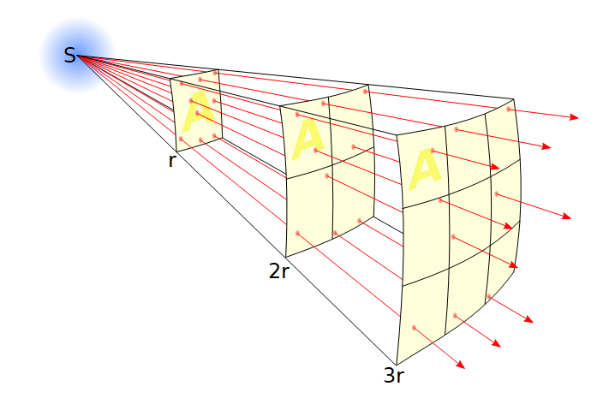

Practical activity: 6.1.1 Habitable zone
Change of surface temperature with change of distance from parent star
Surface temperature decreases with increasing distance.
Change of surface temperature with change of albedo (reflectivity of exoplanet surface)
Surface temperature decreases with increasing albedo.
Influence of the atmosphere
The presence of the atmosphere increases the temperature of the exoplanet.
Habitable zone
The interval of distances from the parent star, where exoplanets can have liquid water on their surface at sufficient atmospheric pressure. Temperatures between 0 ° C and 100 ° C (depending on atmospheric pressure).
Solar system and habitable zone
Just Earth.
astronomia.zcu.cz/hvezdy/exoplanety/102-katalogy-exoplanet
The current publication reflects only the author´s view and neither the Slovak National Agency, nor the European Commission are responsible for any use that may be made of the information it contains.

Slide 13

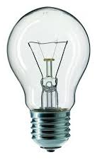


Practical activity: 6.1.1 Habitable zone
do not look unnecessarily
into a light bulb
stabilization of values on thermometers
watch out for
exceeding temperatures
on thermometers
recording values
interpolation
data curves
5 cm distance reduction
The curve for the blackened thermometer lies above the curve for the glossy thermometer, higher reflectivity leads to a lower temperature.
1 m
temperature
charts for both
thermometers
distance from source
radiant light source
black bulb
aluminium foil bulb
The current publication reflects only the author´s view and neither the Slovak National Agency, nor the European Commission are responsible for any use that may be made of the information it contains.

Slide 14
Practical activities: 6.2.1 Transit photometry
Methodical part: Pupils will understand how the method of transit photometry works and on what parameters the light curve of a star with a transiting exoplanet depends.
Material and tool: Light bulb (preferably spherical with diffusing globe), light detector (ideally equipped with a data logger or connectable to a PC with suitable software for analysing measured data; alternatively can use a stopwatch), laboratory stand with a clamp, cork/polystyrene balls of diverse sizes, piece of string
Procedure: Pupils study the method of transit photometry.
The current publication reflects only the author´s view and neither the Slovak National Agency, nor the European Commission are responsible for any use that may be made of the information it contains.

Slide 15
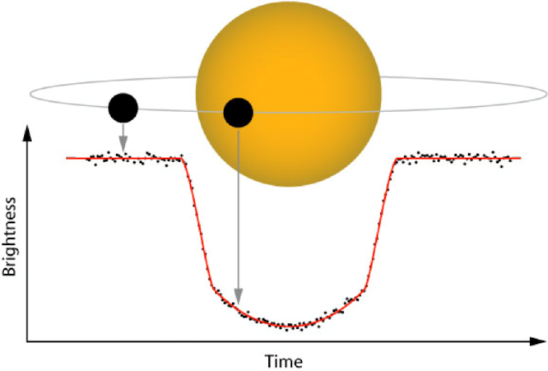
Practical activities: 6.2.1 Transit photometry
Direct imaging of exoplanet
Complicated with regard to their very small angular distance from its star and low brightness compared with the parent star.
Light curve
Dependence of the observed brightness of an object (typically a star) on time.
The effect of an exoplanet on light from the parent star
Exoplanets can regularly cover the disk of the parent star → regular dips on the light curve.
Shape of light curve
The separation of dips depends on the orbital period, the depth of dips on the ratio of the size of the star to the exoplanet
The current publication reflects only the author´s view and neither the Slovak National Agency, nor the European Commission are responsible for any use that may be made of the information it contains.

Slide 16
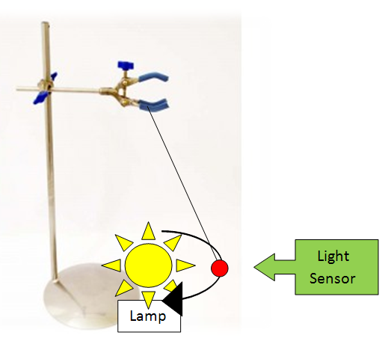
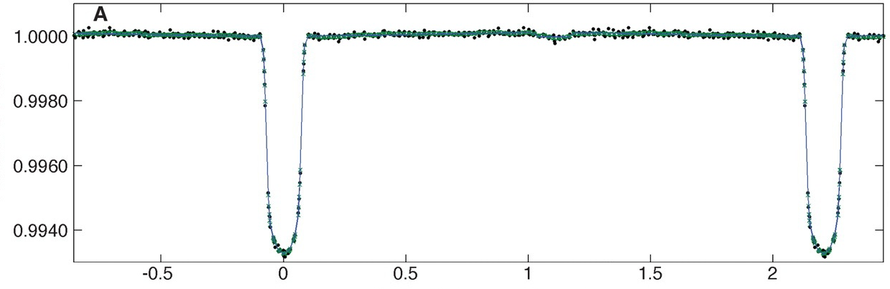
Practical activities: 6.2.1 Transit photometry
laboratory
stand
string
relative luminous flux
bulb
clamps
string
time
ball
detector
of light
ball
bulb
The current publication reflects only the author´s view and neither the Slovak National Agency, nor the European Commission are responsible for any use that may be made of the information it contains.

Slide 17
Conclusions, results check 1
Feed Forward: Base your plans for the next lessons on the results of the pupils:
Difficulty of the lessons: depending on pupils comprehension of the material and level of completion of the activities.
Preparation: Clear and well appointed goals of the lesson and activities. When the goal is well understood, the attention towards a task/material is easier and more effective.
Approach toward the material: What would be the correct approach that would help the student comprehension and activity completion.
The current publication reflects only the author´s view and neither the Slovak National Agency, nor the European Commission are responsible for any use that may be made of the information it contains.
Notes:
DOI: 10.3102/003465430298487, The Power of Feedback, John Hattie and Helen Timperley, University of Auckland

Slide 18
Conclusions, results check 2
Self-evaluation: self-discipline, steering and control of the activities.
Individual approach: Individual approach and guidance.
Check: How did I do? Individual evaluation of the pupil’s work, pertaining to the specific activity and goal. Must contain information about the advance (or lack of) the pupil has made and to guide them to achieve the goals and standards.
The current publication reflects only the author´s view and neither the Slovak National Agency, nor the European Commission are responsible for any use that may be made of the information it contains.
Notes:
DOI: 10.3102/003465430298487, The Power of Feedback, John Hattie and Helen Timperley, University of Auckland

