Slide 1
Project: STARS (Successfully Teaching AstRonomy in Schools)
This project has been funded with the support of the Erasmus+ Programme, K2 Action, Strategic Partnerships in School Education.
Project Agreement Number: 2017-1-SK01-KA201-035344
Training programme for teachers (O2)
Module #8
Our Galaxy and other galaxies Units, distances in Universe
The current publication reflects only the author´s view and neither the Slovak National Agency, nor the European Commission are responsible for any use that may be made of the information it contains.

Slide 2
Project STARS introduction
1. STARS Methodological Handbook for Teachers
ready-to-use resource for teachers
2. STARS Training Program for Teachers
innovative and comprehensive approach
3. STARS Online Platform with examples of good practice and opportunities for discussions and exchange
4. STARS Concept for Astronomy Education Program
International Online Conference 2020
project-stars.com
The current publication reflects only the author´s view and neither the Slovak National Agency, nor the European Commission are responsible for any use that may be made of the information it contains.

Slide 3
Project STARS modules
#1 Constellations. #6 Galactic Neighbourhood.
#2 Motion of Celestial Bodies. #7 Sun and Stars.
#3 Newton's law of Gravitation. #8 Our Galaxy and other galaxies.
#4 Discovery of the Universe. #9 The Universe.
#5 Solar System. #10 Observatories.
The current publication reflects only the author´s view and neither the Slovak National Agency, nor the European Commission are responsible for any use that may be made of the information it contains.

Slide 4
Structure of the modules
There are several topics in each module.
Each topic contains:
A brief introduction and key words;
Theoretical part for the teacher - provides the basic information, necessary for the planning a lesson on that topic (and links to additional information in some cases).
Practical exercises and activities for the students - ready for use in the classroom (in most cases) and with answers provided where applicable.
The current publication reflects only the author´s view and neither the Slovak National Agency, nor the European Commission are responsible for any use that may be made of the information it contains.

Slide 5
How to work with the materials 1
Carefully read the theoretical part for the teacher.
Should questions arise, look for answers in the supplementary materials , on the project’s website (project-stars.com), or other internet sites. Attention! Make sure the information is reliable!
Prepare the theoretical part of your lesson.
The current publication reflects only the author´s view and neither the Slovak National Agency, nor the European Commission are responsible for any use that may be made of the information it contains.

Slide 6
How to work with the materials 2
Read carefully the practical exercises and their answers.
Should questions arise, look for answers in the supplementary materials , on the project’s website (project-stars.com), or other internet sites. Attention! Make sure the information is reliable!
Depending on the theoretical content of your lesson, choose appropriate practical activities to use. You can look for additional exercises in the supplementary materials or at the webpage of the project (project-stars.com), or other internet sites. Attention! Make sure the information is reliable!
The current publication reflects only the author´s view and neither the Slovak National Agency, nor the European Commission are responsible for any use that may be made of the information it contains.

Slide 7
How to work with the materials 3
Keep in mind that some of the activities require materials that should be available during the lesson.
We recommend you try out the activities yourself before presenting them in the classroom. Based on yours students ages and abilities, you might need to modify the activities (either to make them easier or more difficult). However make sure to keep them correct in terms of physics.
You can give parts of, or whole exercises as homework.
The current publication reflects only the author´s view and neither the Slovak National Agency, nor the European Commission are responsible for any use that may be made of the information it contains.

Slide 8
Моdule 8 – contents
8.1 Distance units
Astronomical unit, light year, parsec, annual parallax.
8.2 Distance in Universe
Methods for distance measurement, model of Universe, constellation model.
The current publication reflects only the author´s view and neither the Slovak National Agency, nor the European Commission are responsible for any use that may be made of the information it contains.

Slide 9
Theoretical contents
8.1 Distance units
Astronomical unit;
light year;
annual parallax (note: it is not a unit of distance, but it is necessary to clarify the parsec);
parsec.
The current publication reflects only the author´s view and neither the Slovak National Agency, nor the European Commission are responsible for any use that may be made of the information it contains.

Slide 10
Theoretical contents
8.2 Distances in Universe
Our Galaxy, Local Group, galaxy cluster;
Cosmic distance ladder;
Standard candles;
Universe.
The current publication reflects only the author´s view and neither the Slovak National Agency, nor the European Commission are responsible for any use that may be made of the information it contains.

Slide 11
List of practical activities
8.1.1 Parallax
8.1.2 Measurement of distance
8.1.3 Scales of planet distances in the Solar system
8.1.4 Scales of planet sizes in the Solar system
8.2.1 Distances and scales in the Universe
8.2.2 Balloon model of expanding Universe
8.2.3 Model of Orion constellation
The current publication reflects only the author´s view and neither the Slovak National Agency, nor the European Commission are responsible for any use that may be made of the information it contains.

Slide 12
Practical activity: 8.1.1 Parallax
Methodical part: Introduction to the concept of parallax and its use to measure distances.
Material and tool: Distance object (tree, lamppost), two hula-hoops, length measuring tool (long wooden metre), table or laboratory stand, tape measure.
Procedure: The pupil learns to measure the distance using parallax.
The current publication reflects only the author´s view and neither the Slovak National Agency, nor the European Commission are responsible for any use that may be made of the information it contains.

Slide 13
Practical activity: 8.1.1 Parallax
Distance of the close object (coffee table with metre) | The number on the metre that overlaps with the distant object ON THE LEFT | The number on the metre that overlaps with the distant object ON THE RIGHT
2 metres
4 metres
The current publication reflects only the author´s view and neither the Slovak National Agency, nor the European Commission are responsible for any use that may be made of the information it contains.

Slide 14
Practical activity: 8.1.1 Parallax
What is the relationship between the distance of the object and the apparent change of position when viewed from a different perspective?
Where and how is this method used in astronomy?
The current publication reflects only the author´s view and neither the Slovak National Agency, nor the European Commission are responsible for any use that may be made of the information it contains.

Slide 15
Practical activity: 8.1.2 Measurement of distances
Methodical part: Measurement of terrestrial distances by astronomical method.
Material and tool: Clearly visible object (e.g. hall tower, tall chimney), band, compass or compass.
Procedure: The pupil will learn to measure earth distances by astronomical method.
The current publication reflects only the author´s view and neither the Slovak National Agency, nor the European Commission are responsible for any use that may be made of the information it contains.

Slide 16
Practical activity: 8.1.2 Measurement of distances
(measured object)
C
North
asa theorem
β
α
Base
draw e.g. at a scale of 1:500
A
B
The current publication reflects only the author´s view and neither the Slovak National Agency, nor the European Commission are responsible for any use that may be made of the information it contains.

Slide 17
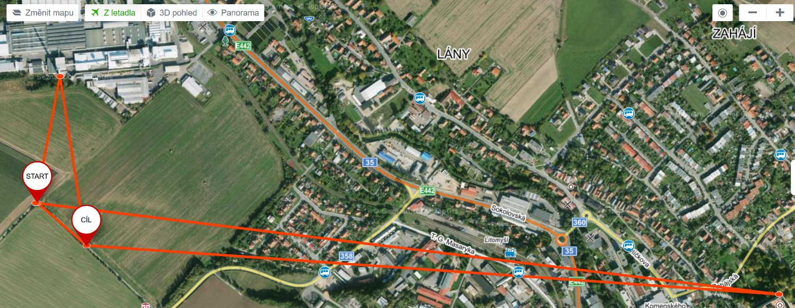
Practical activity: 8.1.2 Measurement of distances
measurement
error
The current publication reflects only the author´s view and neither the Slovak National Agency, nor the European Commission are responsible for any use that may be made of the information it contains.

Slide 18
Practical activity: 8.1.3 Scales of planet distances in the Solar system
Methodical part: Consolidation of knowledge of the astronomical unit.
Material and tool: Nothing.
Procedure: The pupil repeats the distances of the planets in the Solar system and creates a suitable model.
The current publication reflects only the author´s view and neither the Slovak National Agency, nor the European Commission are responsible for any use that may be made of the information it contains.

Slide 19
Practical activity: 8.1.3 Scales of planet distances in the Solar system
Planet | Distance from the Sun at au | Distance (1 au = 1 metre) | Distance (1 au = 10 cm)
Mercury | 0.4 | 0.4 m | 4 cm
Venus | 0.7 | 0.7 m | 7 cm
Earth | 1.0 | 1.0 m | 10 cm
Mars | 1.5 | 1.5 m | 15 cm
Jupiter | 5.2 | 5.2 m | 52 cm
Saturn | 9.5 | 9.5 m | 95 cm
Uranus | 19.2 | 19.2 m | 192 cm
Neptune | 30.1 | 30.1 m | 301 cm
The current publication reflects only the author´s view and neither the Slovak National Agency, nor the European Commission are responsible for any use that may be made of the information it contains.

Slide 20
Practical activity: 8.1.4 Scales of planet sizes in the Solar system
Methodical part: Sizes of individual planets in the solar system and their comparison with the Earth.
Material and tool: Nothing.
Procedure: The pupil repeats the sizes of the planets in the Solar system and creates a suitable model.
The current publication reflects only the author´s view and neither the Slovak National Agency, nor the European Commission are responsible for any use that may be made of the information it contains.

Slide 21
Practical activity: 8.1.4 Scales of planet sizes in the Solar system
Planet | Diameter (km) | Scale
Mercury | 4,880 | 0.40
Venus | 12,103 | 0.95
Earth | 12,756 | 1.00
Mars | 6,794 | 0.53
Jupiter | 142,984 | 11.23
Saturn | 120,536 | 9.46
Uranus | 51,118 | 4.06
Neptune | 49,532 | 3.88
The current publication reflects only the author´s view and neither the Slovak National Agency, nor the European Commission are responsible for any use that may be made of the information it contains.

Slide 22
Practical activity: 8.1.x Distance units
After completing activities 8.1.1 to 8.1.4, pupils should be able to say that
kilometres are used e.g. to measure distances between planets and theirs moons,
astronomical units are used to measure distance between planets or between central star and planets in planetary system,
light years are used to measure distance between stars,
parsecs are used to measure distance between galaxies.
The current publication reflects only the author´s view and neither the Slovak National Agency, nor the European Commission are responsible for any use that may be made of the information it contains.

Slide 23
Practical activity: 8.2.1 Distances and scales in the Universe
Methodical part: Promote ideas about distances in the Universe.
Material and tool: Encyclopaedia, atlas or internet/computer program like Stellarium/Star chart, calculator.
Procedure: The pupil will get an idea of the distances in space.
The current publication reflects only the author´s view and neither the Slovak National Agency, nor the European Commission are responsible for any use that may be made of the information it contains.

Slide 24
Practical activity: 8.2.1 Distances and scales in the Universe
different sources on internet, books → different values, but order of magnitude is the same
number of valid digits, according to the input, typically to 2 valid digits
counting with large numbers (100,000,000,000 = 10¹² = 100 billions)
The current publication reflects only the author´s view and neither the Slovak National Agency, nor the European Commission are responsible for any use that may be made of the information it contains.

Slide 25
Practical activity: 8.2.1 Distances and scales in the Universe
Sort cosmic bodies according to their distance from Earth from largest to smallest. Determine their distance.
ISS, Polaris, Jupiter, M31 galaxy in Andromeda, centre of our Galaxy, NGC 4414 galaxy in the constellation of Coma Berenices, Moon
Huang, C. The Scale of the Universe 2 = youtu.be/uaGEjrADGPA
Obreschkow, D. Cosmic Eye = youtu.be/8Are9dDbW24
Solution: ISS (approx 400 km, i.e. 0.0013 light seconds), Moon (384,000 km, i.e. 1.3 light seconds), Jupiter (5.2 au, i.e. 2,600 light seconds, 43 light minutes), Polaris (approx. 400 ly), centre of our Galaxy (30,000 ly), M31 Galaxy in Andromeda (approx. 2.5 million ly), NGC 4414 Galaxy in the constellation of Coma Berenices (approx. 60 million ly).
The current publication reflects only the author´s view and neither the Slovak National Agency, nor the European Commission are responsible for any use that may be made of the information it contains.

Slide 26
Practical activity: 8.2.1 Distances and scales in the Universe
for comparison convert to one unit
Sort space bodies by size from smallest to largest. Determine their dimensions.
Saturn planet, Sun, nucleus of Halley comet, Jupiter moon Io, Galaxy, meteorite, Local Group, Vesta minor planet
Solution: meteorite (dimensions are various, from several cm to tenths of cm – smaller are hard to search – to 2.7 m of Hoba meteorite found in 1920 in Namibia), nucleus of Halley comet (approx. 10 km), Vesta minor planet (mean diameter approx. 525 km), Jupiter moon Io (diameter approx. 3600 km, approx. 1/4 of the radius of Earth), Saturn planet (mean radius 58,000 km, mean diameter 116,000 km; approx. 9 times bigger than Earth), Sun (mean diameter almost 1,400,000 km, 109 times bigger than Earth), Galaxy (diameter approx. 100,000 ly), Local Group (diameter approx. 10,000,000 ly).
The current publication reflects only the author´s view and neither the Slovak National Agency, nor the European Commission are responsible for any use that may be made of the information it contains.

Slide 27
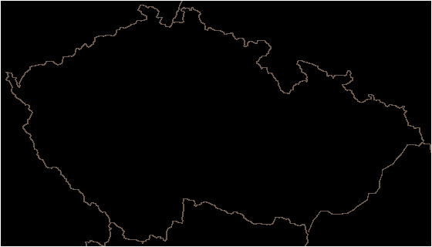
Practical activity: 8.2.1 Distances and scales in the Universe
How long does it take to the light beam to travel from the East of the Czech Republic to the West?
0.0016 s
The current publication reflects only the author´s view and neither the Slovak National Agency, nor the European Commission are responsible for any use that may be made of the information it contains.

Slide 28
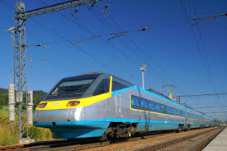
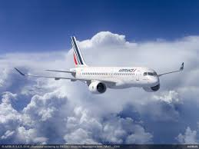
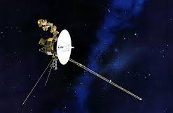
Practical activity: 8.2.1 Distances and scales in the Universe
The closest star situated outside our Solar System is Proxima Centauri and its distance is approx. 4.2 ly. How long would take the journey there:
by train set Pendolino at a speed of 250 km/h;
by airplane Airbus at a speed of 800 km/h;
by Voyager spacecraft at a speed of 17 km/s.
18,000,000 years
5,700,000 years
75,000 years
Huge distances in space and travel by ordinary means of travel.
The current publication reflects only the author´s view and neither the Slovak National Agency, nor the European Commission are responsible for any use that may be made of the information it contains.

Slide 29
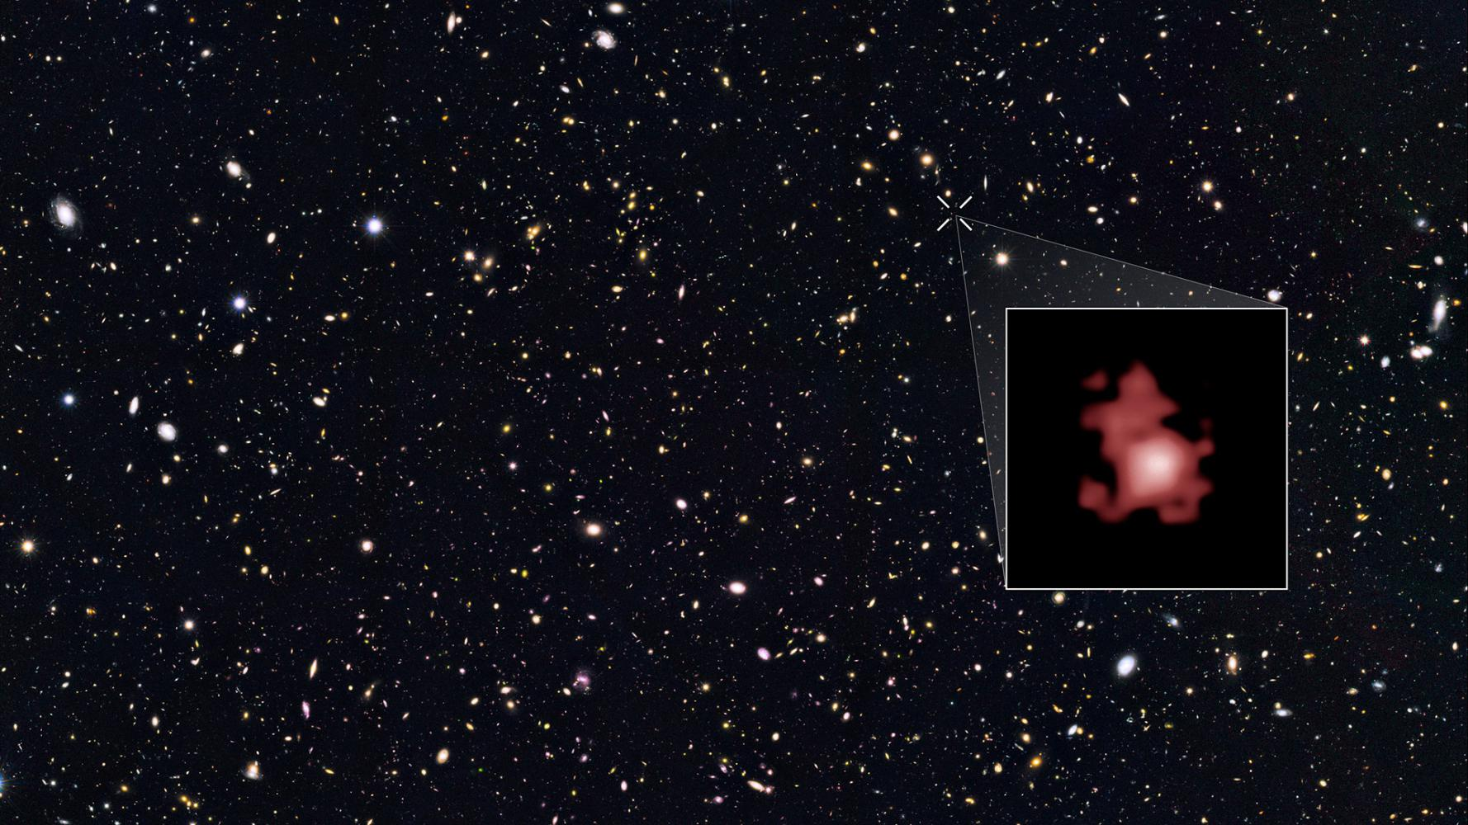
Practical activity: 8.2.1 Distances and scales in the Universe
Galaxy GN-z11 in the constellation of Ursa Major, discovered in 2016 by Hubble Space Telescope, is one of the remotest observed objects in the Universe. Its actual distance is estimated to 9,800 Mpc.
How many light years is that?
How many times is this distance larger that the Galaxy diameter?
Mpc unit and conversion to ly
9,800 Mpc ~ 32 Gly
curious pupils and observe 32 Gly with age of Universe 14 bill. years
expansion of Universe
The current publication reflects only the author´s view and neither the Slovak National Agency, nor the European Commission are responsible for any use that may be made of the information it contains.

Slide 30
Practical activity: 8.2.2 Balloon model of expanding Universe
Methodical part: Promote the idea of expanding the universe.
Material and tool: Rubber balloon, felt-pen (or self-adhesive decoration stars), paper/tape measure, calculator.
Procedure: The pupil will get an idea of the expansion of the universe.
The current publication reflects only the author´s view and neither the Slovak National Agency, nor the European Commission are responsible for any use that may be made of the information it contains.

Slide 31
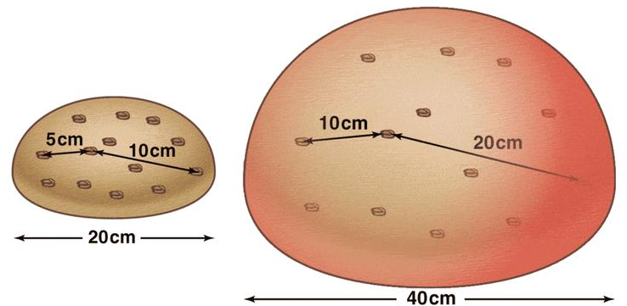
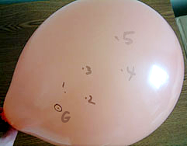
Practical activity: 8.2.2 Balloon model of expanding Universe
The current publication reflects only the author´s view and neither the Slovak National Agency, nor the European Commission are responsible for any use that may be made of the information it contains.

Slide 32
Practical activity: 8.2.2 Balloon model of expanding Universe
Distance from „galaxy“ G /cm | Meas 1 d₁/cm | Meas 2 d₂/cm | Meas 3 d₃/cm | Difference (d₂ — d₁) /cm | Difference (d₃ — d₂) /cm
Mark 1
Mark 2
Mark 3
Mark 4
Mark 5
Circumference of the balloon /cm |  |  |  | X | X
The current publication reflects only the author´s view and neither the Slovak National Agency, nor the European Commission are responsible for any use that may be made of the information it contains.

Slide 33
Practical activity: 8.2.2 Balloon model of expanding Universe
How did the distance from the G „galaxy“ to the remaining marks 1 – 5 change after each blowing up of the balloon?
Which marks did recess more - the ones that in the beginning were closer or further away from the G?
Let say that the blowing up of the balloon takes always the same time t (e.g. 10 s). From differences d₂ - d₁ and d₃ - d₂ it is possible to calculate the „speed“ of recess v₁ = (d₂ - d₁)/t and v₂ = (d₃ - d₂)/t (our speeds are small, but for the galaxies in the Universe we get them in km/s!).
Do the speeds depend on the distance d1? If it is the case, how?
The current publication reflects only the author´s view and neither the Slovak National Agency, nor the European Commission are responsible for any use that may be made of the information it contains.

Slide 34
Practical activity: 8.2.3 Model of Orion constellation
Methodical part: Create three-dimensional model of the constellation of Orion.
Material and tool: bamboo stick, paper, glue or adhesive tape, tape measure, coloured paper, polystyrene board, internet or computer program like Stellarium/Star chart.
Procedure: The pupil will get an idea of the meaning of the constellations and the position of the stars in it.
The current publication reflects only the author´s view and neither the Slovak National Agency, nor the European Commission are responsible for any use that may be made of the information it contains.

Slide 35
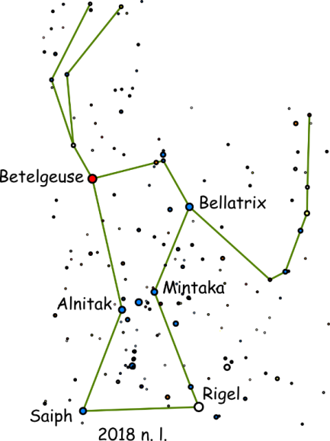
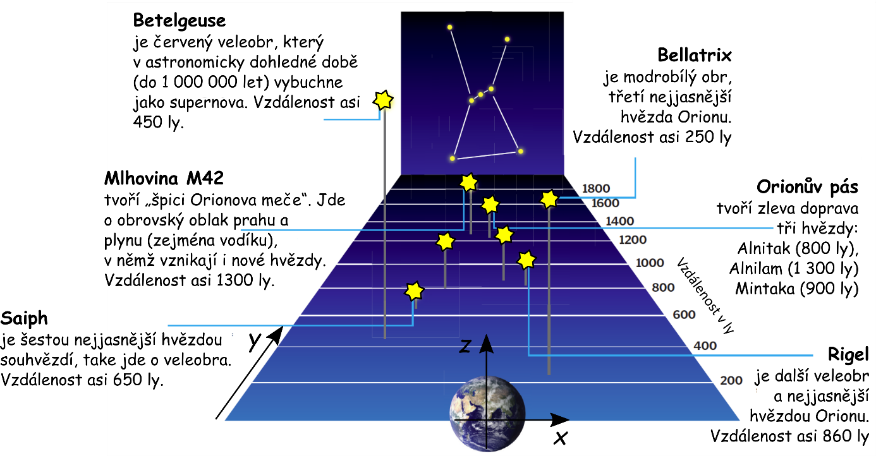
Practical activity: 8.2.3 Model of Orion constellation
The current publication reflects only the author´s view and neither the Slovak National Agency, nor the European Commission are responsible for any use that may be made of the information it contains.

Slide 36
Practical activity: 8.2.3 Model of Orion constellation
Star | Distance r /ly | x /cm | y /cm | z / cm
Betelgeuse | 450 | -4.1 | 45 | 21
Rigel | 860 | 5.7 | 86 | 8.4
Bellatrix | 250 | 0.7 | 25 | 16
Mintaka | 900 | 0.0 | 90 | 21
Alnilam | 1,300 | -2.9 | 130 | 24
Alnitak | 800 | -3.2 | 80 | 17
Saiph | 650 | -5.0 | 65 | 6.6
M42 | 1,300 | -2.3 | 130 | 14
The current publication reflects only the author´s view and neither the Slovak National Agency, nor the European Commission are responsible for any use that may be made of the information it contains.

Slide 37
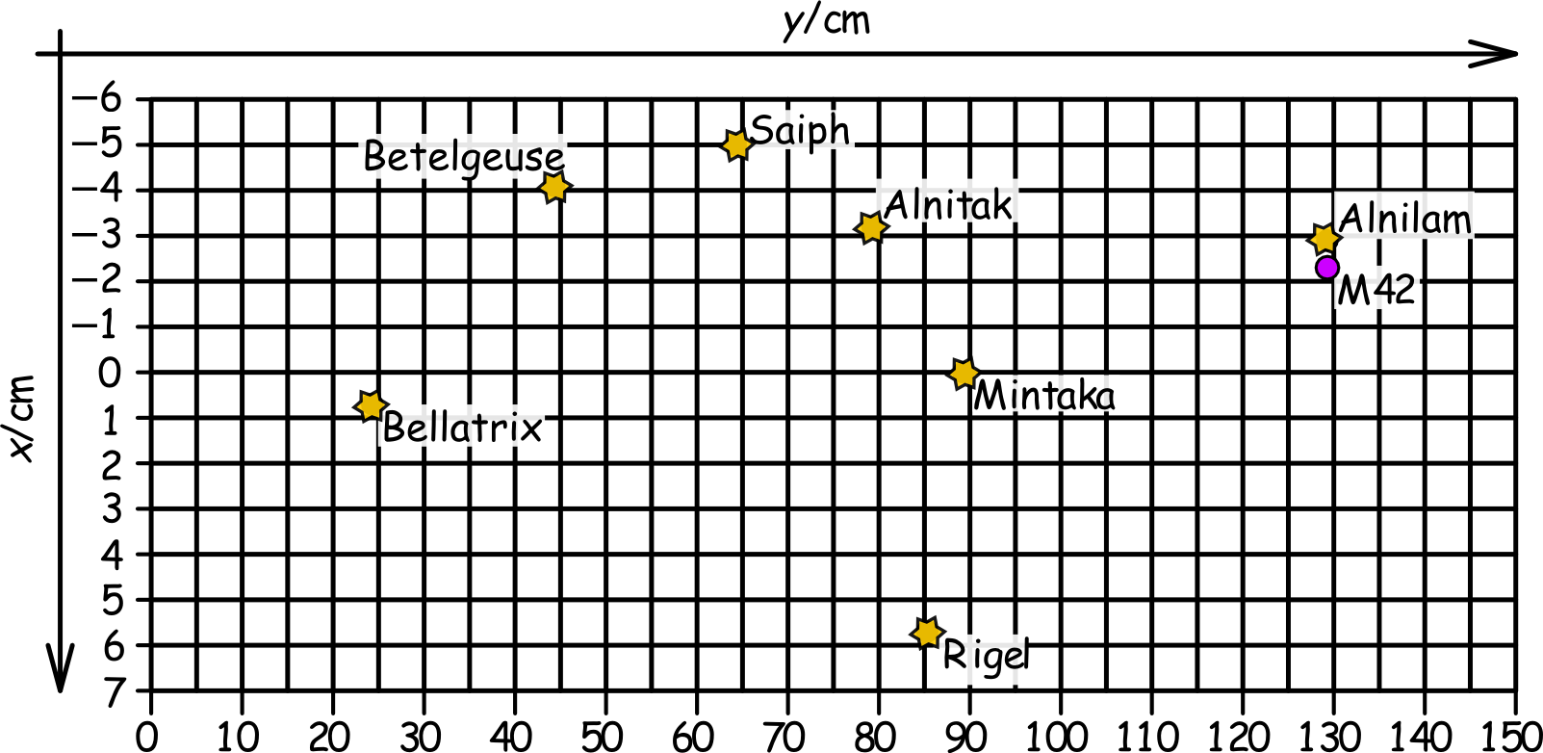
Practical activity: 8.2.3 Model of Orion constellation
The current publication reflects only the author´s view and neither the Slovak National Agency, nor the European Commission are responsible for any use that may be made of the information it contains.

Slide 38
Conclusions, results check 1
Feed Forward: Base your plans for the next lessons on the results of the pupils:
Difficulty of the lessons: depending on pupils comprehension of the material and level of completion of the activities.
Preparation: Clear and well appointed goals of the lesson and activities. When the goal is well understood, the attention towards a task/material is easier and more effective.
Approach toward the material: What would be the correct approach that would help the student comprehension and activity completion.
The current publication reflects only the author´s view and neither the Slovak National Agency, nor the European Commission are responsible for any use that may be made of the information it contains.
Notes:
DOI: 10.3102/003465430298487, The Power of Feedback, John Hattie and Helen Timperley, University of Auckland

Slide 39
Conclusions, results check 2
Self-evaluation: self-discipline, steering and control of the activities.
Individual approach: Individual approach and guidance.
Check: How did I do? Individual evaluation of the pupil’s work, pertaining to the specific activity and goal. Must contain information about the advance (or lack of) the pupil has made and to guide them to achieve the goals and standards.
The current publication reflects only the author´s view and neither the Slovak National Agency, nor the European Commission are responsible for any use that may be made of the information it contains.
Notes:
DOI: 10.3102/003465430298487, The Power of Feedback, John Hattie and Helen Timperley, University of Auckland

