Slide 1
Project: STARS (Successfully Teaching AstRonomy in Schools)
This project has been funded with the support of the Erasmus+ Programme, K2 Action, Strategic Partnerships in School Education.
Project Agreement Number: 2017-1-SK01-KA201-035344
Training programme for teachers (O2)
Module #9
The Universe. The Universe –
Historical Ideas. The Big Bang. Microwave Background Radiation.
The current publication reflects only the author´s view and neither the Slovak National Agency, nor the European Commission are responsible for any use that may be made of the information it contains.

Slide 2
STARS project intro
1. STARS Methodological Handbook for Teachers
ready-to-use resource for teachers
2. STARS Training Program for Teachers
innovative and comprehensive approach
3. STARS Online Platform with examples of good practice and opportunities for discussions and exchange
4. STARS Concept for Astronomy Education Program
International Online Conference 2020
project-stars.com
The current publication reflects only the author´s view and neither the Slovak National Agency, nor the European Commission are responsible for any use that may be made of the information it contains.

Slide 3
STARS modules
#1 Constellations. #6 Galactic Neighbourhood.
#2 Motion of Celestial Bodies. #7 Sun and the Stars.
#3 Newton‘s Law of Gravitation. #8 Milky Way Galaxy and other Galaxies.
#4 Space Exploration. #9 The Universe.
#5 Solar System. #10 Observatories.
The current publication reflects only the author´s view and neither the Slovak National Agency, nor the European Commission are responsible for any use that may be made of the information it contains.

Slide 4
Structure of the modules
There are several topics in each module.
Each topic contains:
A brief introduction and key words;
Theoretical part for the teacher - provides the basic information, necessary for the planning a lesson on that topic (and links to additional information in some cases).
! THESE ARE NOT READY-TO-USE LESSONS!
Practical exercises and activities for the students -ready for use in the classroom (in most cases) and with answers provided where applicable.
The current publication reflects only the author´s view and neither the Slovak National Agency, nor the European Commission are responsible for any use that may be made of the information it contains.

Slide 5
How to work with the materials 1
Carefully read the theoretical part for the teacher.
Should questions arise, look for answers in the supplementary materials , on the project’s website (http://project-stars.com), or other internet sites.
Attention! Make sure the information is reliable!
Prepare the theoretical part of your lesson.
The current publication reflects only the author´s view and neither the Slovak National Agency, nor the European Commission are responsible for any use that may be made of the information it contains.

Slide 6
How to work with the materials 2
Read carefully the practical exercises and their answers.
Should questions arise, look for answers in the supplementary materials , on the project’s website (http://project-stars.com), or other internet sites.
Attention! Make sure the information is reliable!
6. Depending on the theoretical content of your lesson, choose appropriate pracical activities to use. You can look for additional exercises in the supplementary materials or at the webpage of the project (http://project-stars.com/?lang=bg), or other internet sites.
Attention! Make sure the information is reliable!
The current publication reflects only the author´s view and neither the Slovak National Agency, nor the European Commission are responsible for any use that may be made of the information it contains.

Slide 7
How to work with the materials 3
7. Keep in mind that some of the activities require materials that should be available during the lesson.
8. We reccomend you try out the activities yourself before presenting them in the classroom. Based on yours students ages and abilities, you might need to modify the activities (either to make them easier or more difficult). However make sure to keep them correct in terms of physics.
You can give parts of, or whole exercises as homework.
The current publication reflects only the author´s view and neither the Slovak National Agency, nor the European Commission are responsible for any use that may be made of the information it contains.

Slide 8
Theoretical content
1. The Universe:
What is the Universe? Historical and modern ideas.
1.1 Cosmology. Cosmology as a science. Hubble–Lemaître law.
1.2 The Big Bang. СModern ideas about the creation of the Universe. The beginning. Time. Centre and infinity of the Universe.
The current publication reflects only the author´s view and neither the Slovak National Agency, nor the European Commission are responsible for any use that may be made of the information it contains.

Slide 9
Theoretical content
1.3 Cosmic microwave background radiaton. Discovery and characteristics
1.4 Future of the Universe. Dark matter and dark energy.
The current publication reflects only the author´s view and neither the Slovak National Agency, nor the European Commission are responsible for any use that may be made of the information it contains.

Slide 10
List of Practical activities, module #7
Hubble–Lemaître law.
The expanding universe.
The current publication reflects only the author´s view and neither the Slovak National Agency, nor the European Commission are responsible for any use that may be made of the information it contains.

Slide 11
Exercise 1: Hubble–Lemaître law.
Methodical part: module #9, tiopc 1.
AIM: To introduce the Hubble–Lemaître law in its graphical form.
Materials and Procedure: explained in detail in module8, topic 1, practicle exercises section.
The current publication reflects only the author´s view and neither the Slovak National Agency, nor the European Commission are responsible for any use that may be made of the information it contains.

Slide 12
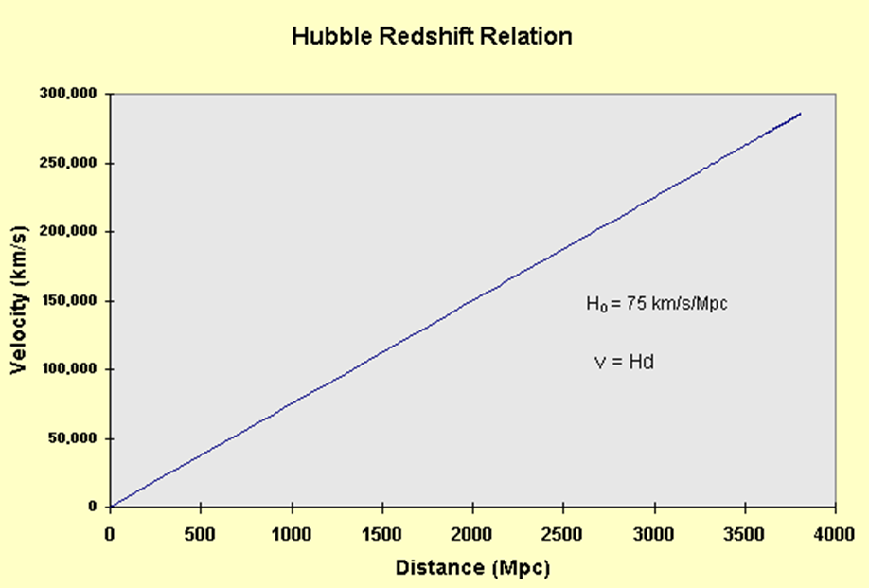
The current publication reflects only the author´s view and neither the Slovak National Agency, nor the European Commission are responsible for any use that may be made of the information it contains.

Slide 13
GUIDING QUESTIONS | ANSWERS
What is shown on the horizontal axis?What are the units used?How (using what methods) can the scientists measure this parameter? | Distance from our galaxy, the Milky Way, to other galaxies. Megaparsecs (million parsecs). From the apparent angular size of the galaxy or by the brightness of objects in it.
What is shown on the vertical axis?How (using what methods) can the scientists measure this parameter? | The recessional velocity of a galaxy. It is measured by examining the Doppler shift of lines in the spectrum of flight from the galaxy.
Which of the two parameters is harder to measure? | The distance.
What are the dimensions of the parameter, represented by the slope of the graph? | Velocity over distance.
What is the parameter, represented by the slope of the graph? | The Hubble Constant.
What would be the dimensions of the parameter that is the inverse of the slope of the graph?Can we use it to study the Universe? If yes - how, if no - why? | Time. Yes, can estimate the age of the Universe.
The current publication reflects only the author´s view and neither the Slovak National Agency, nor the European Commission are responsible for any use that may be made of the information it contains.

Slide 14
EXERCISE 2: The expanding Universe.
Mehodical part: module#9, topic 1.
AIM: This activity aims to illustrate the expansion of the Universe.
Materials and Procedure: explained in detail in module#9, topic 1, practical exercise section.
The current publication reflects only the author´s view and neither the Slovak National Agency, nor the European Commission are responsible for any use that may be made of the information it contains.

Slide 15
Additional resources:
1.Models of space crafts and telescopes: https://www.esa.int/kids/en/things_to_do
2. Build and launch your own rocket: http://www.esa.int/Education/Teachers_Corner/Up_up_up_Build_and_launch_your_own_rockets_Teach_with_space_PR23
The current publication reflects only the author´s view and neither the Slovak National Agency, nor the European Commission are responsible for any use that may be made of the information it contains.

Slide 16
Conclusions, results check 1
Feed Forward: Base your olans for the next lessons on the results of the students:
Difficulty of the lessons: depending on student comprehension of the material and level of completion of the activities.
Preparation: Clear and well appointed goals of the lesson and activities. When the goal is well understood, the attention towards a task/material is easier and more effective.
Approach toward the material: What would be the correct approach that would help the student comprehension and activity completion.
The current publication reflects only the author´s view and neither the Slovak National Agency, nor the European Commission are responsible for any use that may be made of the information it contains.
Notes:
DOI: 10.3102/003465430298487, The Power of Feedback, John Hattie and Helen Timperley, University of Auckland

Slide 17
Conclusions, results check 2
Selfevaluation: selfdiscipline, steering and control of the activities.
Individual approach: Individual approach and guidance.
Check: How did I do? Individual evaluation of the student’s work, pertaining to the specific activity and goal. Must contain information about the advance (or lack of) the student has made and to guide them to achieve the goals and standards.
The current publication reflects only the author´s view and neither the Slovak National Agency, nor the European Commission are responsible for any use that may be made of the information it contains.
Notes:
DOI: 10.3102/003465430298487, The Power of Feedback, John Hattie and Helen Timperley, University of Auckland

